Slide 1
Software untuk mencari Artikel Jurnal dan Kajian Literatur
SITI MONALISA, ST, M.KOM

Slide 2
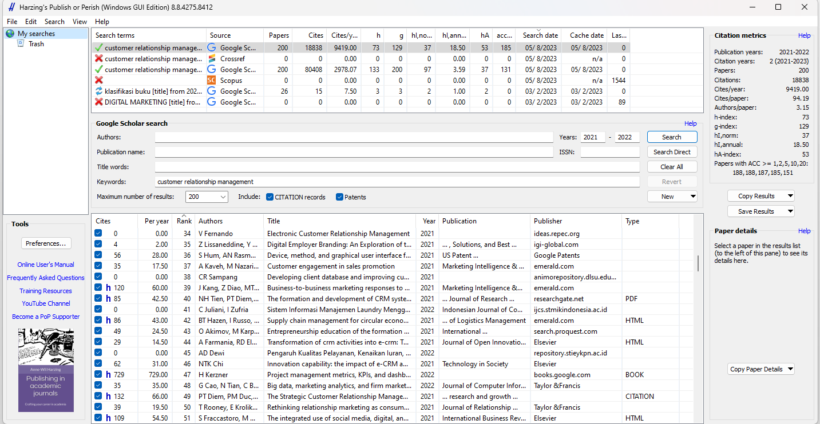
Download dan Install Harving’s Publish or Perish
Masukkan keywords dan save to result as RIS/refManager

Slide 3
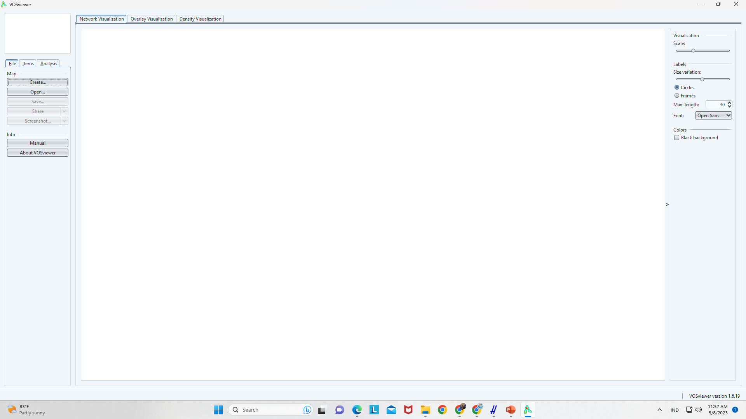
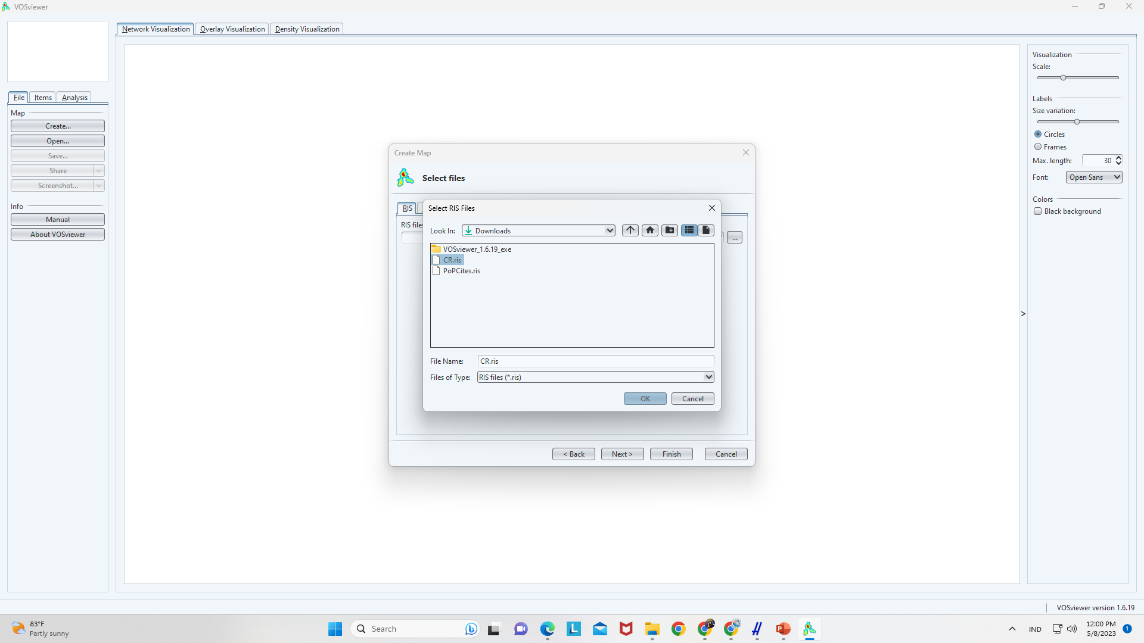
Download dan Install Vos Viewer
Klik create-create a map on bibliographic data
next-read datafrom reference manager files

Slide 4
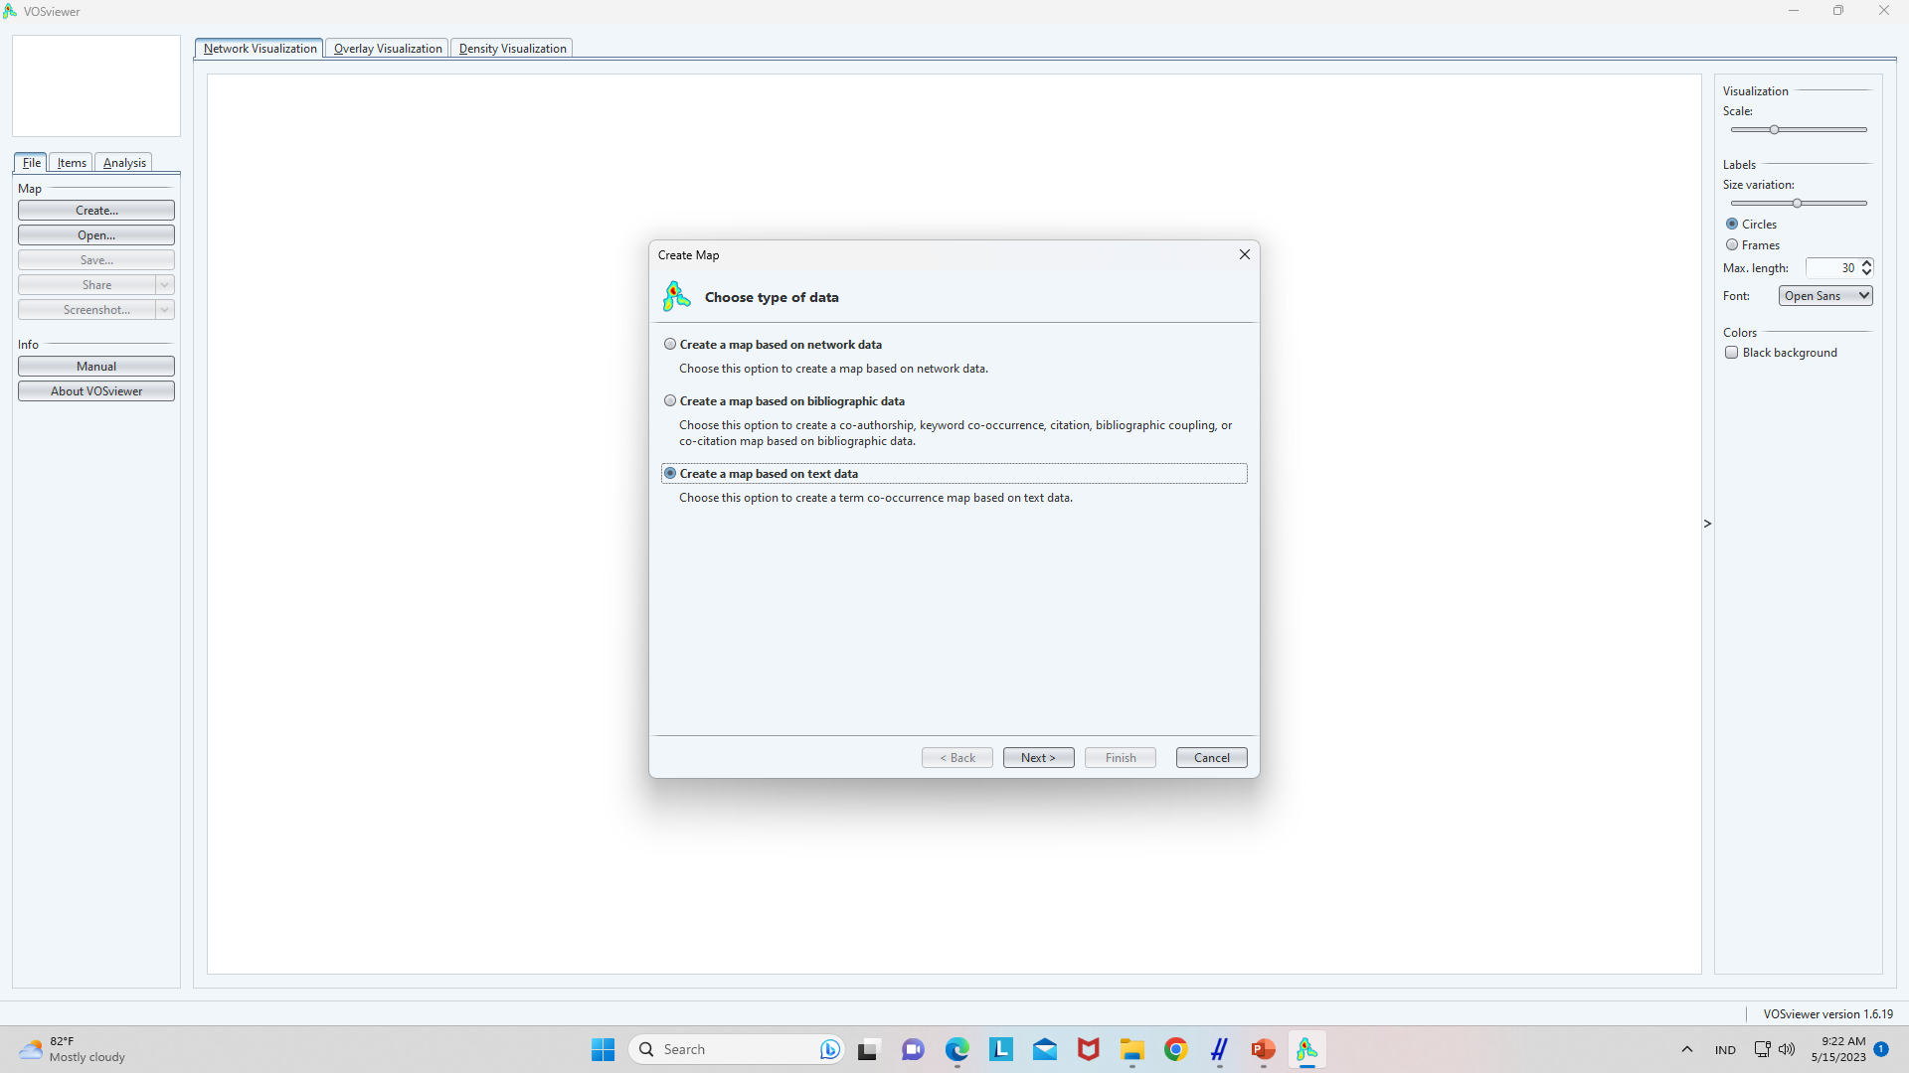
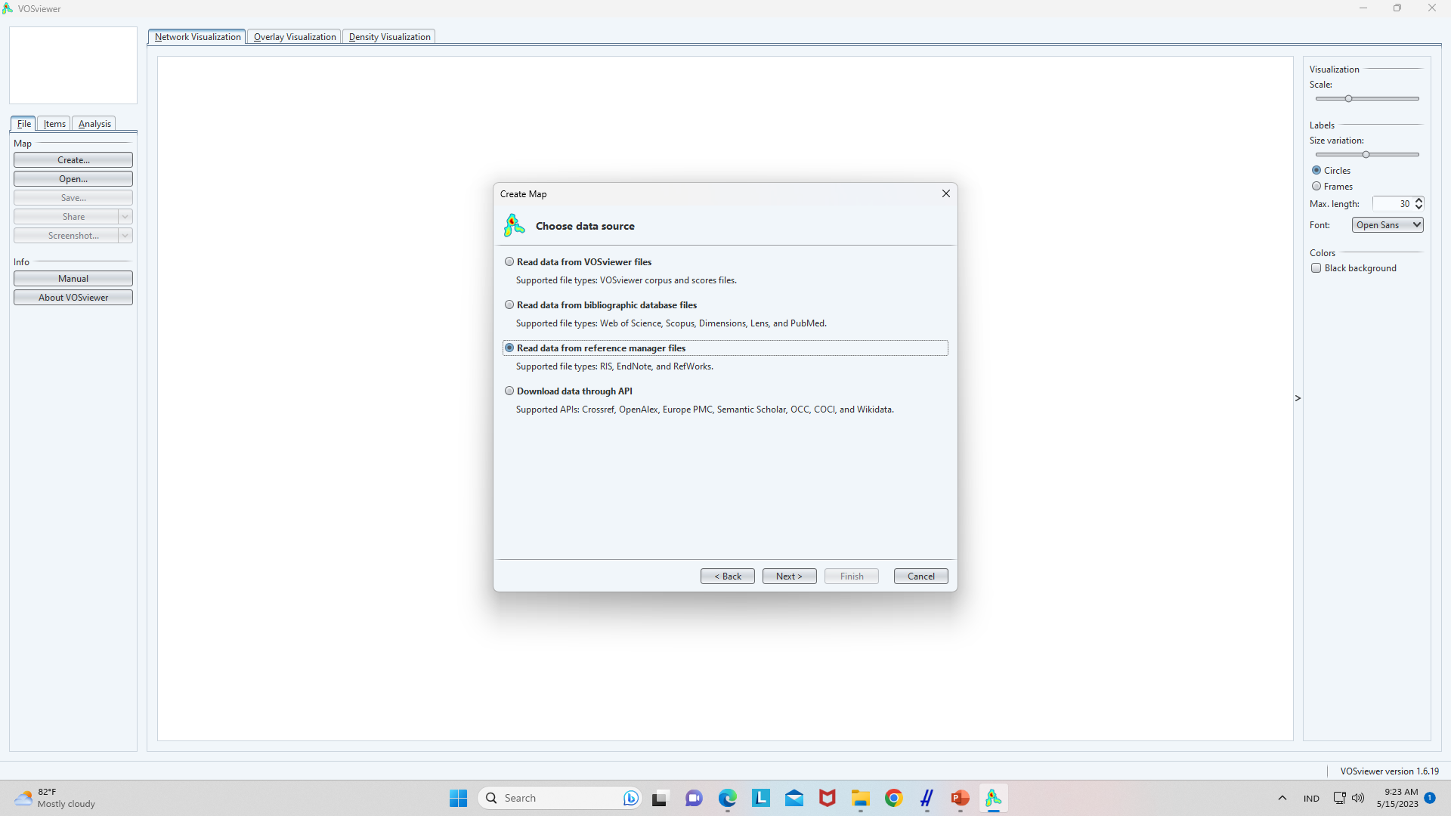

Slide 5
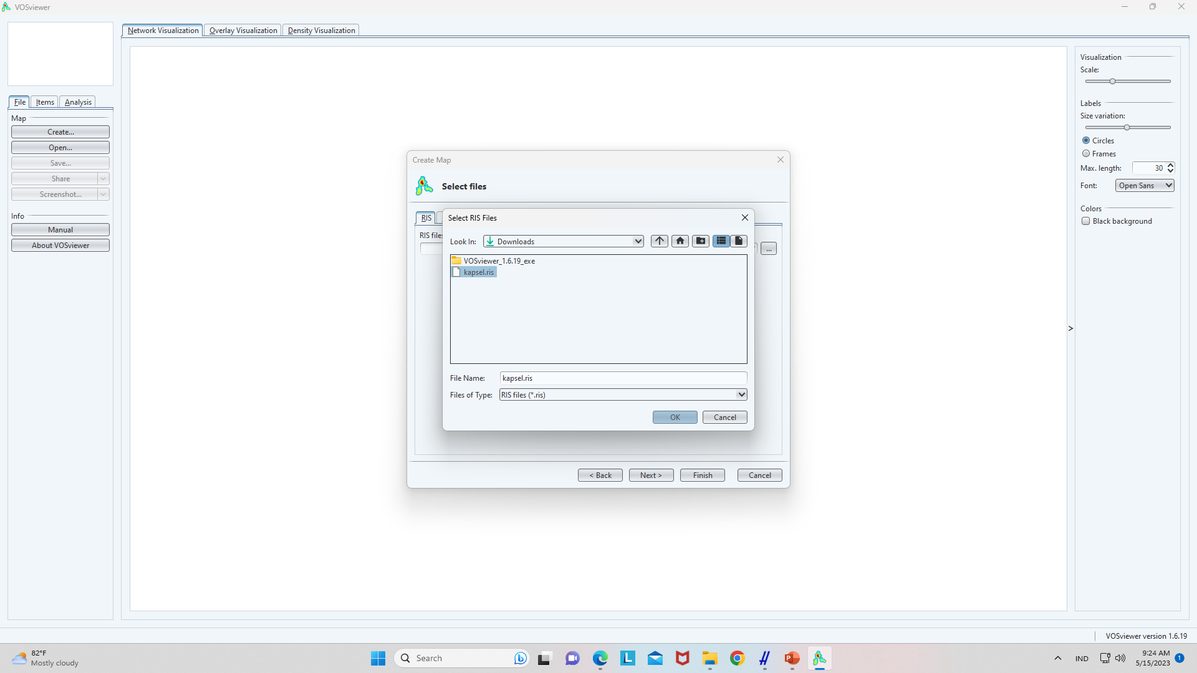
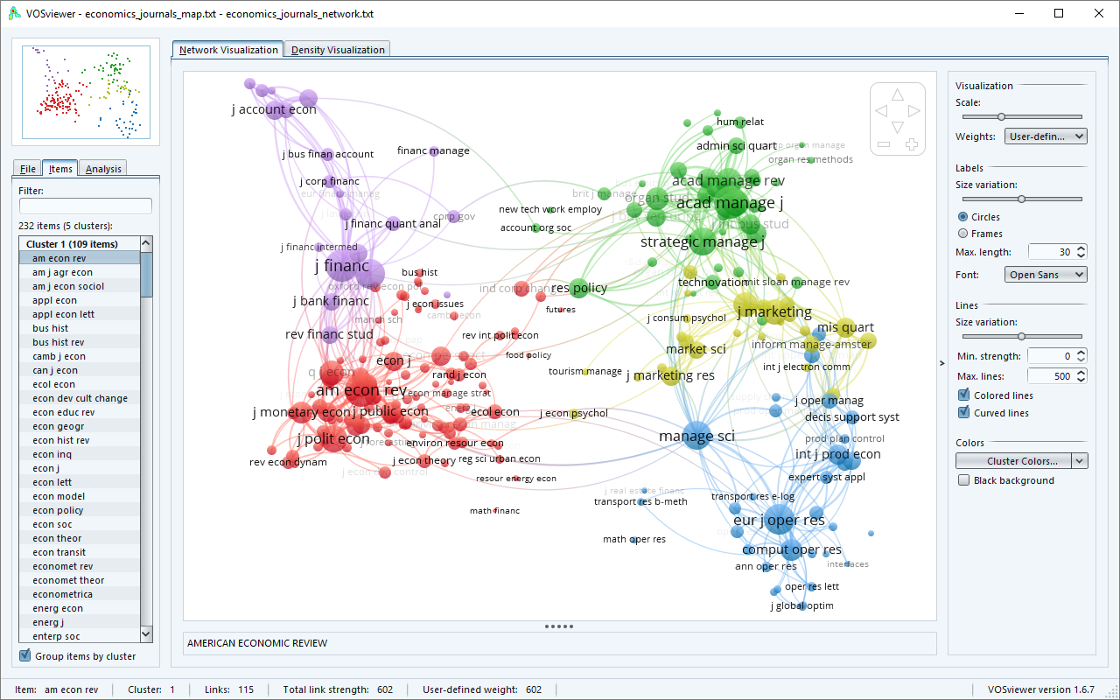

Slide 6
Topik Penelitian
Elektronic customer relationship management
Customer service
Customer lifetime
Customers' experience
Customers satisfaction
Customers loyalty
Customers brand
Customer segmentation
Social customer relationship management
Customer engagement

