Slide 1
INSKILL
SYAIFULLAH.SE.,M.Sc

Slide 2
SMART COMMUNICATION

Slide 3
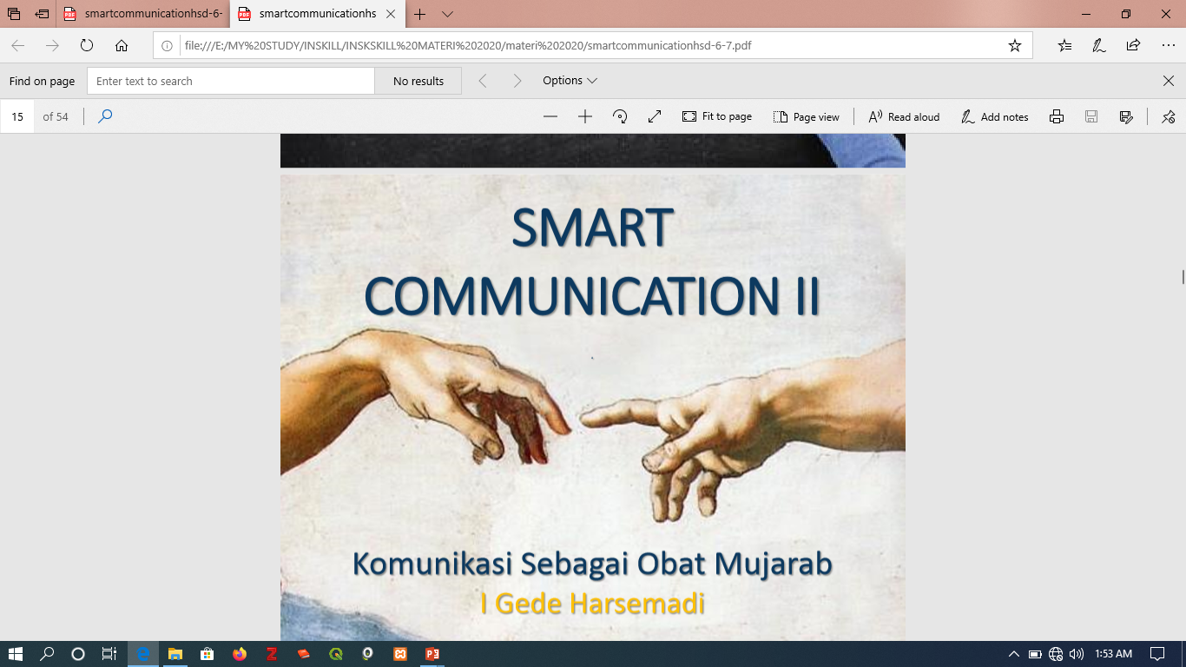

Slide 4
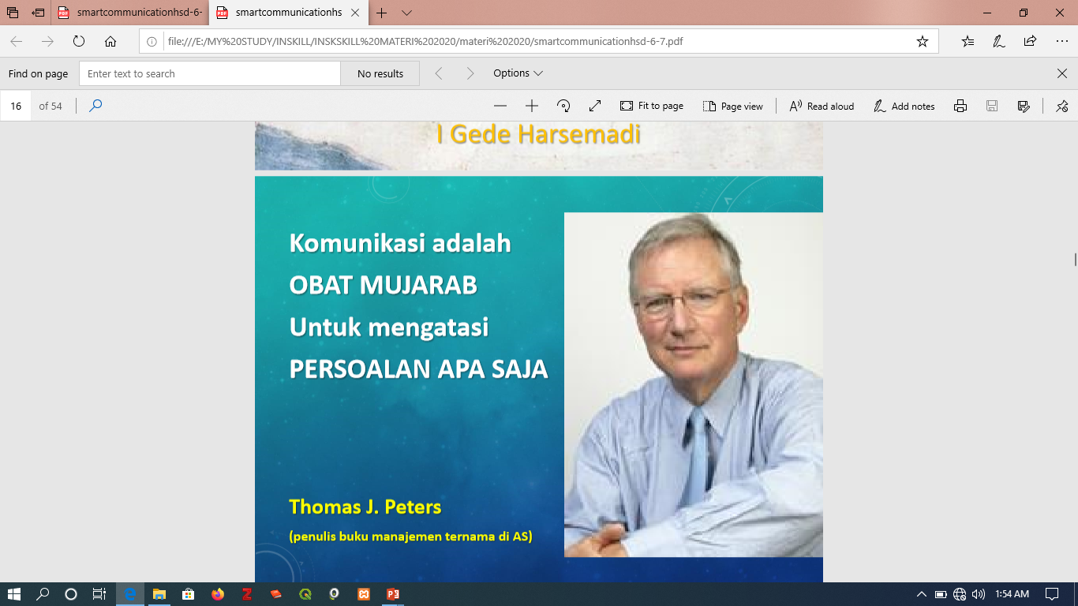

Slide 5


Slide 6
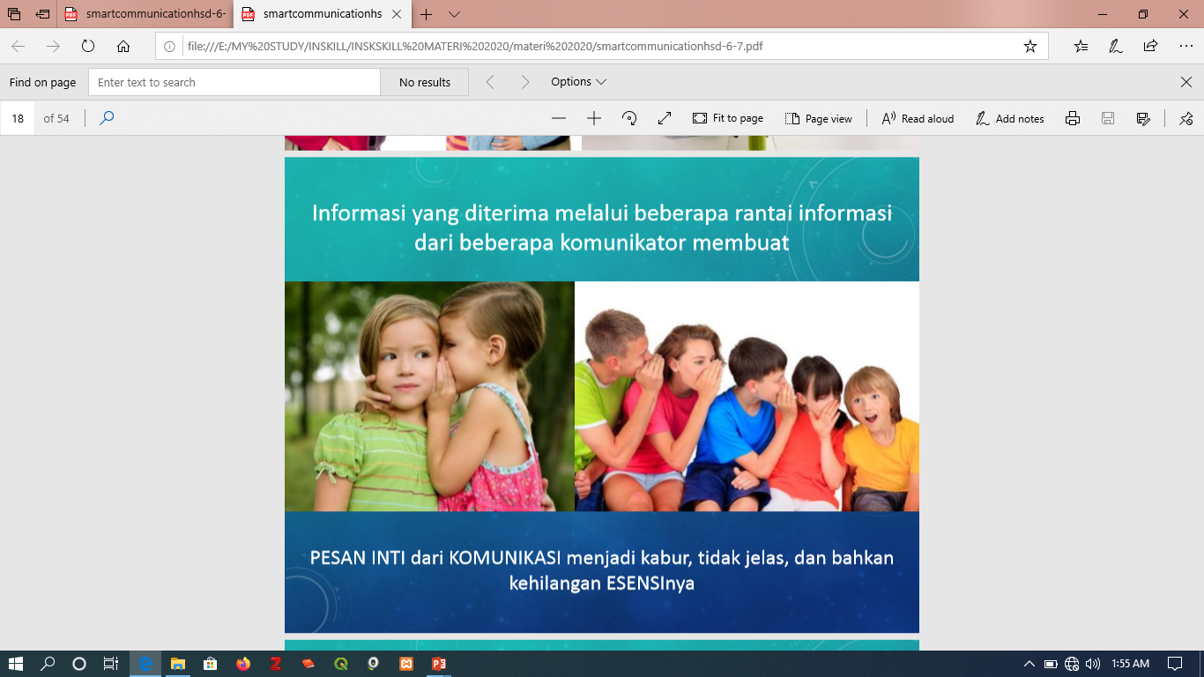

Slide 7
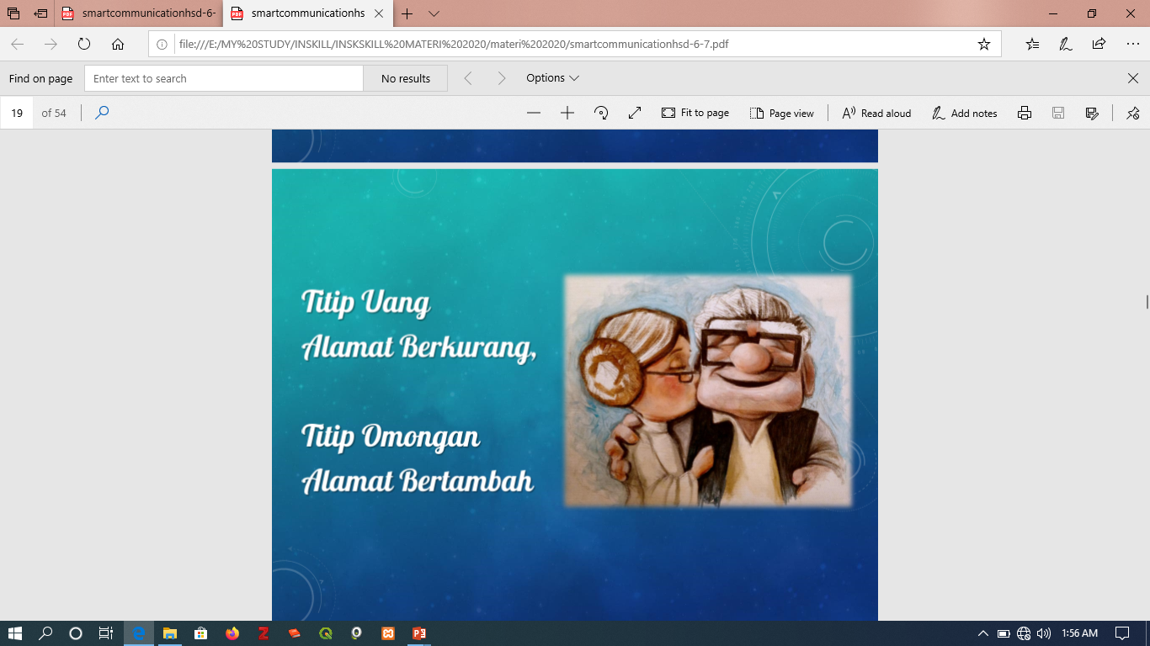

Slide 8
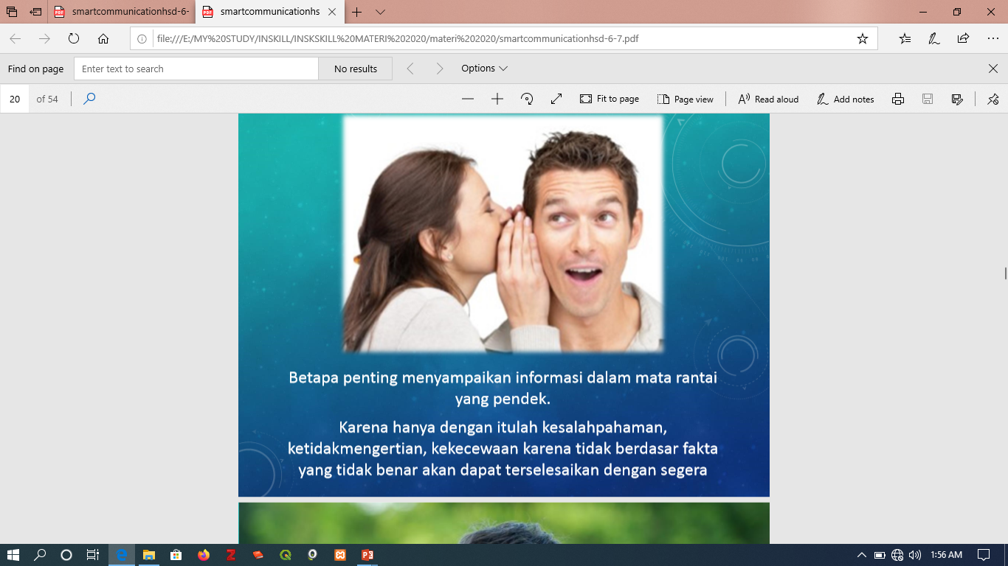

Slide 9


Slide 10
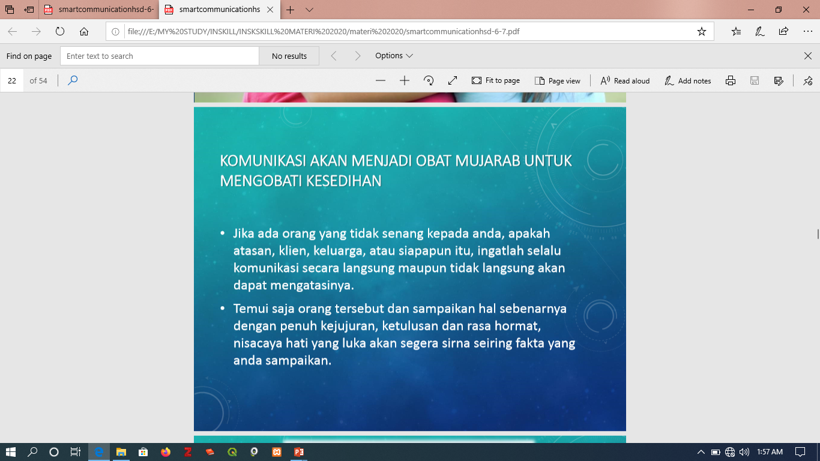

Slide 11
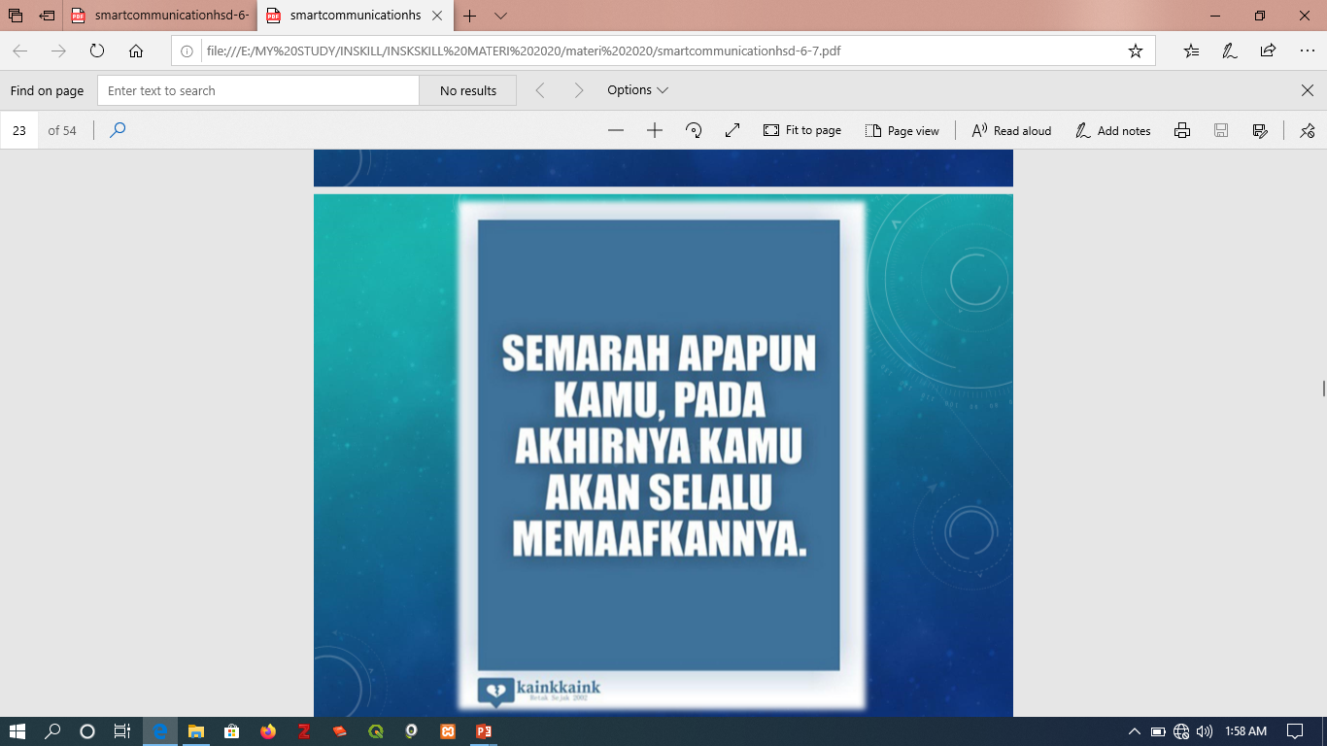

Slide 12
