Slide 1
RESEARCH GAP
Saide
https://saide-sank.blogspot.com email: saide@uin-suska.ac.id youtube: saiderherza journal

Slide 2
Contents
CONCEPT:
WHAT IS RESEARCH.
WHAT IS INFORMATION SYSTEMS AND ITS FOUNDATION.
INFORMATION SYSTEMS (IS) RESEARCH.
ENGLISH FOR INFORMATION SYSTEMS.
WORLD’S INFORMATION SYSTEMS ORGANIZATIONS, &
IS JOURNALS, MAIN IS CONFERENCES, REFERENCES.
IS RESEARCH METHODS AND WRITING THE IDEA
IS FRAMEWORKS/THEORIES
CHOSING THE RIGHT IS JOURNAL FOR REFERENCES
RESEARCH GAPS
BACKGROUND/INTRODUCTION
HYPOTHESIS (DEVELOPMENT & HOW TO WRITE IT CORRECTLY)
METHODS
WRITING THE STATISTICS RESULTS
DISCUSSIONS (CONTRIBUTION TO KNOWLEDGE AND MANAGERIAL)
ABSTRACT
HOW TO RESPOND THE REVISIONS (BY ADVISOR, REVIEWER/EDITOR)
TECHNICAL & PROJECTS:
GROUP PROJECTS: - REVIEWING ARTICLES
- WRITING RESEARCH PROPOSAL/SHORT ARTICLE
- PRESENTING YOUR PROJECT (ALL MEMBERS MUST PRESENTS)
PERSONAL EXPERIENCE IN PUBLICATIONS

Slide 3


ABOUT ME
Researcher ID/Publons: H-2399-2018
Orcid ID: 0000-0002-1866-5305
Website: https://saide-sank.blogspot.com
S.Kom di UIN Suska Riau (2009-2013)
M.Kom di ITS Surabaya (2014-2016)
M.I.M di NTUST Taiwan (2014-2016)
Lecturer: Information System, UIN SUSKA Riau
Research: Knowledge Management, Information System, Business-IT alignment.
Chief Knowledge Officer: Pro-Knowledge Research Group
Project Management: Energy Research Centre (EnReach.or.id)
Ph.D. candidate: Information Management, NTUST Taiwan

Slide 4
RESEARCH GAP

Slide 5
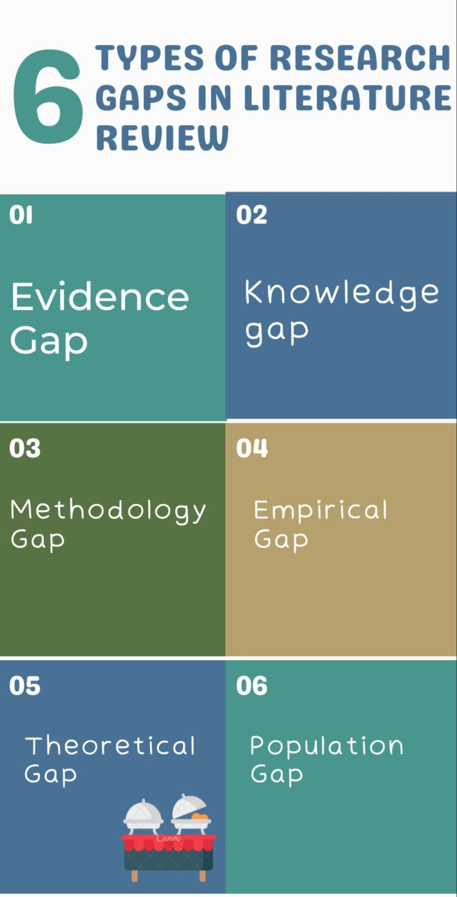
6 Types of Research Gaps in Literature Review 🟢What is Research Gap? Research gaps are untapped/Less explored research areas or research topics having good scope for further research. 🟢Different Types of Research Gaps in the Literature Review: 6 categories Research gap can be classified into six categories (Robinson, et al., (2011), Muller-Bloch, & Kranz (2015), and Miles (2017) #1. Evidence gap An evidence gap is type of research gap where there is no evidence to address the research problem or insufficient evidence to address the research problem. #2. Knowledge gap/Practical-Knowledge gap A knowledge gap is a type of research gap where Knowledge may not exist in the actual field. Or it might be insufficient knowledge of a study that differs from what was expected from a specific research study A practical Knowledge gap is a type of research gap where When professional practice/practical knowledge of research area/research topic deviate from already conducted research reports/findings

Slide 6
#3.Methodology gap Methodology gap is type of research gap where a new research method or distinction in already available research methods is needed to accurate results and new research insights. #4.Empirical gap The empirical gap is type of research gap where Research findings need to be evaluated or empirically verified. #5.Theoretical gap Theory gap is type of research gap where theory need to be applied in addressing certain research issues to get new research insights. Lack of theoretical research and knowledge leads to generate theoretical gap in research #6.Population gap Population gap is type of research gap that deals with a population which is not adequately depicted /researched in the prior research. For example age bracket of specific geographical zone with reference to any specific disease or role of ant specific race in disease epidemic

Slide 7
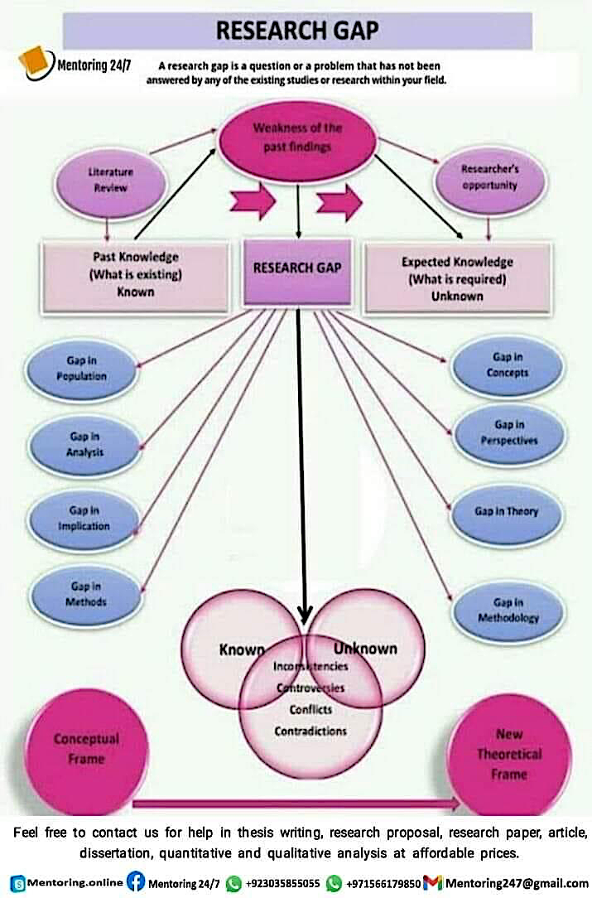

Slide 8
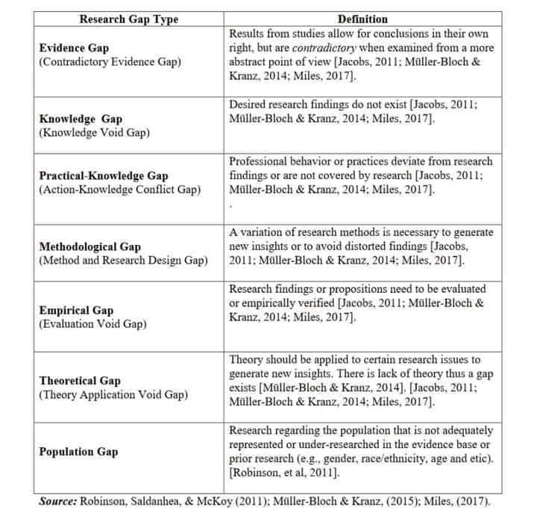

Slide 9
Menulis = Membaca

Slide 10
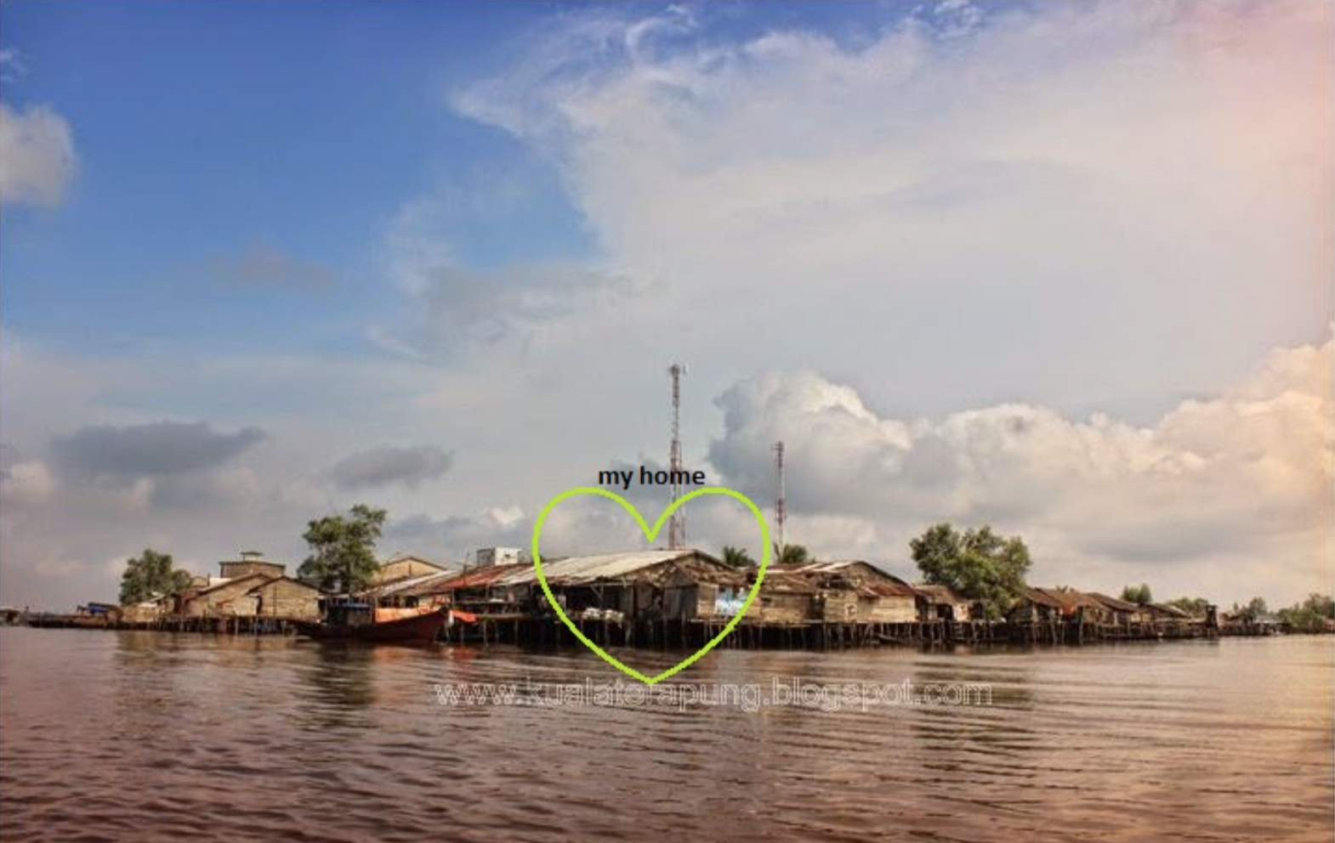
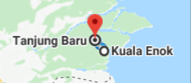

Slide 11
@ Copyright 2022
Disusun oleh:
Saide, S.Kom., M.Kom., M.I.M., Ph.D.
Ph.D. at Information Management, NTUST Taiwan
Lecturer at Dept. Information Systems, UIN SUSKA Riau.
Scholarship; LPDP, DIPA, Double Degree Master (ITS Surabaya & NTUST Taiwan), Taiwan`s scholarship, WTUN Grant Project (UK-Finland-Taiwan).
website: https://saide-sank.blogspot.com email: saide@uin-suska.ac.id youtube: saiderherza journal
Dokumen ini dan semua informasi yang terdapat didalamnya dilindungi hak cipta. Kecuali diijinkan oleh UU No. 28 Tahun 2014 tentang Hak Cipta, tidak ada bagian dari dokumen ini dapat direproduksi dengan cara apapun, tanpa izin tertulis dari penyusun. Isi dokumen ini sepenuhnya merupakan tanggungjawab penyusun.

