Slide 1
CHOSING THE RIGHT IS JOURNAL FOR RESEARCH
Saide
https://saide-sank.blogspot.com email: saide@uin-suska.ac.id youtube: saiderherza journal

Slide 2
Contents
CONCEPT:
WHAT IS RESEARCH.
WHAT IS INFORMATION SYSTEMS AND ITS FOUNDATION.
INFORMATION SYSTEMS (IS) RESEARCH.
ENGLISH FOR INFORMATION SYSTEMS.
WORLD’S INFORMATION SYSTEMS ORGANIZATIONS, &
IS JOURNALS, MAIN IS CONFERENCES, REFERENCES.
IS RESEARCH METHODS AND WRITING THE IDEA
IS FRAMEWORKS/THEORIES
CHOSING THE RIGHT IS JOURNAL FOR REFERENCES
RESEARCH GAPS
BACKGROUND/INTRODUCTION
HYPOTHESIS (DEVELOPMENT & HOW TO WRITE IT CORRECTLY)
METHODS
WRITING THE STATISTICS RESULTS
DISCUSSIONS (CONTRIBUTION TO KNOWLEDGE AND MANAGERIAL)
ABSTRACT
HOW TO RESPOND THE REVISIONS (BY ADVISOR, REVIEWER/EDITOR)
TECHNICAL & PROJECTS:
GROUP PROJECTS: - REVIEWING ARTICLES
- WRITING RESEARCH PROPOSAL/SHORT ARTICLE
- PRESENTING YOUR PROJECT (ALL MEMBERS MUST PRESENTS)
PERSONAL EXPERIENCE IN PUBLICATIONS

Slide 3
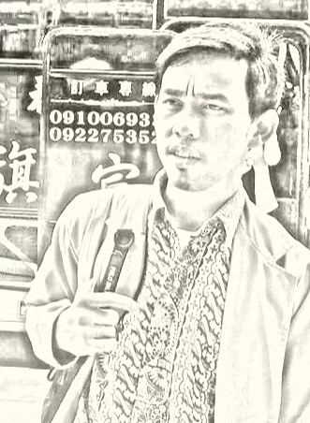
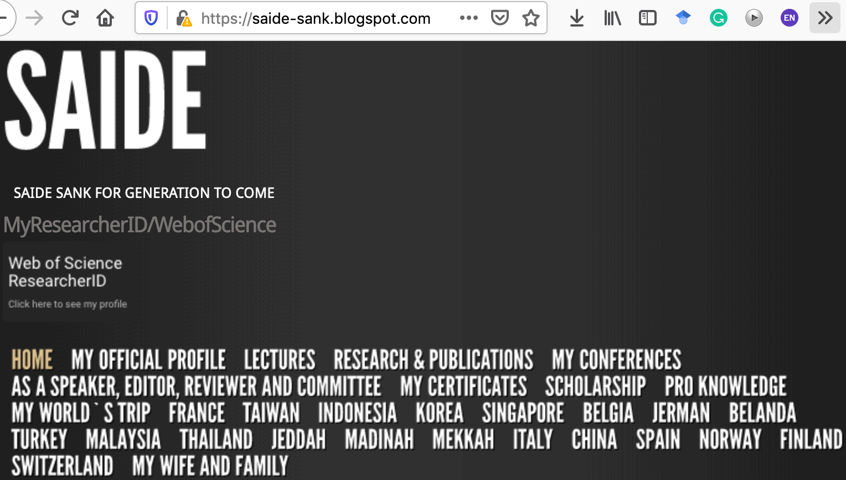
ABOUT ME
Researcher ID/Publons: H-2399-2018
Orcid ID: 0000-0002-1866-5305
Website: https://saide-sank.blogspot.com
S.Kom di UIN Suska Riau (2009-2013)
M.Kom di ITS Surabaya (2014-2016)
M.I.M di NTUST Taiwan (2014-2016)
Lecturer: Information System, UIN SUSKA Riau
Research: Knowledge Management, Information System, Business-IT alignment.
Chief Knowledge Officer: Pro-Knowledge Research Group
Project Management: Energy Research Centre (EnReach.or.id)
Ph.D. candidate: Information Management, NTUST Taiwan

Slide 4
CHOSING THE RIGHT IS JOURNAL FOR REFERENCES/ WRITING

Slide 5
The Important of Picking The Right Journal (Book Ref: writing your journal article in 12 weeks: a guide to academic publishing success (wendy laura belcher, 2009))

Slide 6
Outline
The Important of Picking The Right Journal
Good News about Journals
Non-recommended Publishing Outlets
Questionable Publishing Outlets
Preferred Publishing Outlets
Finding Suitable Academic Journals
Evaluation Process for Potential Journals
Matching Your Article to Suitable Journals
Making a Decision about Which Journal
Electronic Searching Tips

Slide 7
The Important of Picking The Right Journal
Can`t get published if we picking the wrong journal.
Submit to whichever journal is “the best” is not good advice.
Quality control: referee, peer review, blind review, blind double review.
Rejected, unmet journal requirements.
Submit more one journal at a time.

Slide 8
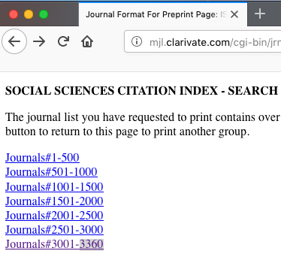
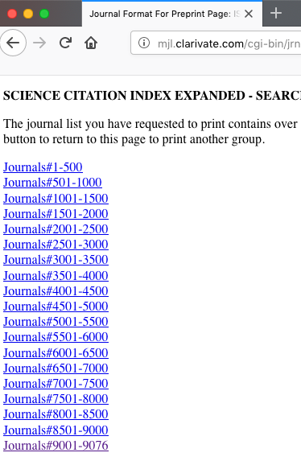
SSCI/SCI Journal
SCI: 9.076
“Good & Bad
News”
SSCI: 3.360

Slide 9

Non-recommended Publishing Outlet
Newspapers/magazines/trade journals
Society and conference proceedings

Slide 10

Questionable Publishing Outlets
Non peer-reviewed academic journal
Graduate student journals
Local journals
New journal

Slide 11

Preferred Publishing Outlets
Disciplinary & Field Journals
Interdisciplinary Journals

Slide 12

Finding Suitable Academic Journals
Ask senior researcher, advisor, and colleagues
Check citations and their bibliographies
Join an association
Search Electronic Database, Electronic Archives, Journal Database: Clarivate Analytic (WoS), Cambridge Univ. Press, Oxford Univ. Press, Sage, Elsevier, Wiley, Taylor & Francis, Springer.
writing your journal article in 12 weeks: a guide to academic publishing success (wendy laura belcher, 2009)
https://saide-sank.blogspot.com
youtube: saideherza journal

Slide 13

Evaluation Process for Potential Journals
Is the journal peer reviewed ?
Is the journal in the recommended publishing ?
Does the journal have a reputable publisher?
Has the journal been around for a while?
Is the journal carefully produced?
Is the journal online or indexed ? Where?
Time to get published ?

Slide 14

Matching Your Article to Suitable Journals
Does the journal have theme or special issue?
Word & page length limits?
Article match the journal`s style?
Journal`s editors?

Slide 15
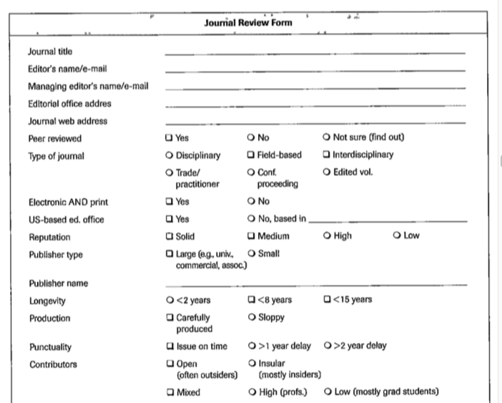
Making a Decision about Which Journal

Slide 16
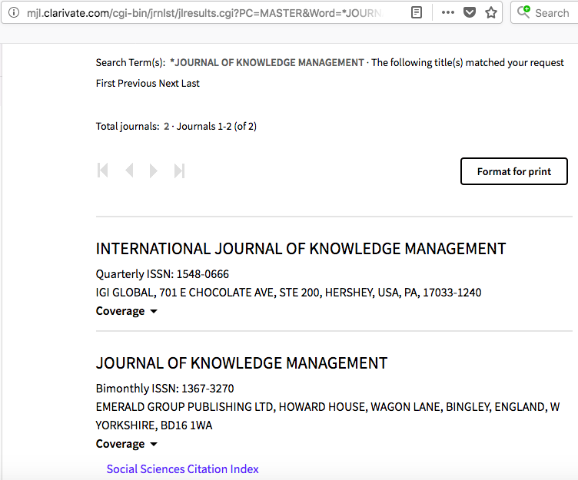
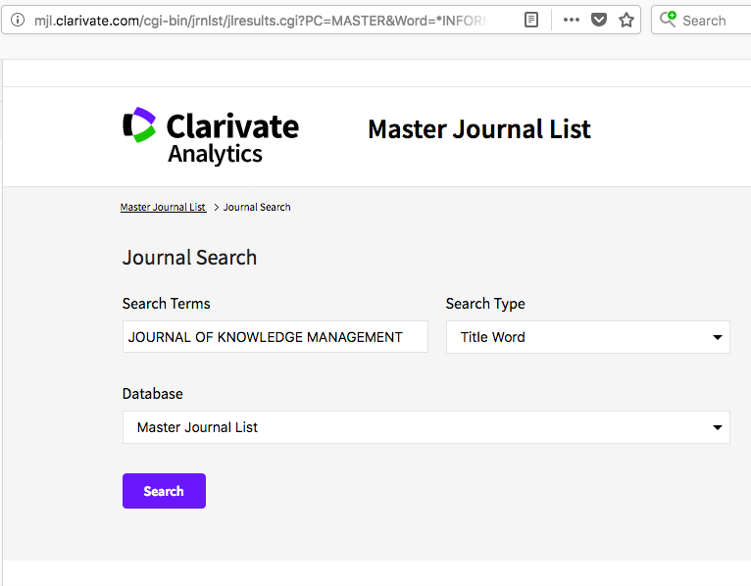
Ex: SCI/SCCI Journal
Electronic Searching
Link: http://mjl.clarivate.com/

Slide 17
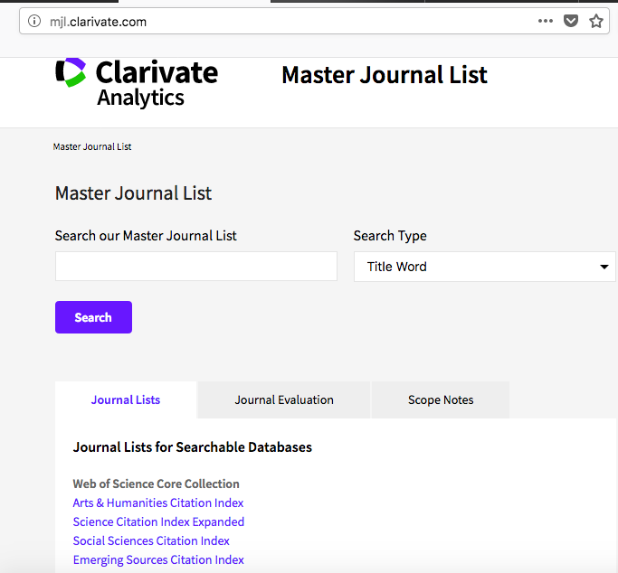
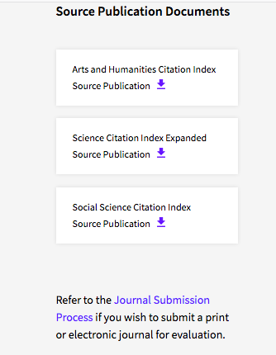
Download journal list

Slide 18
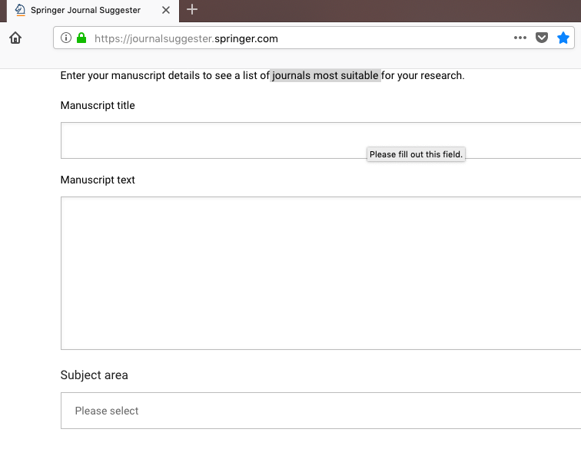

Slide 19
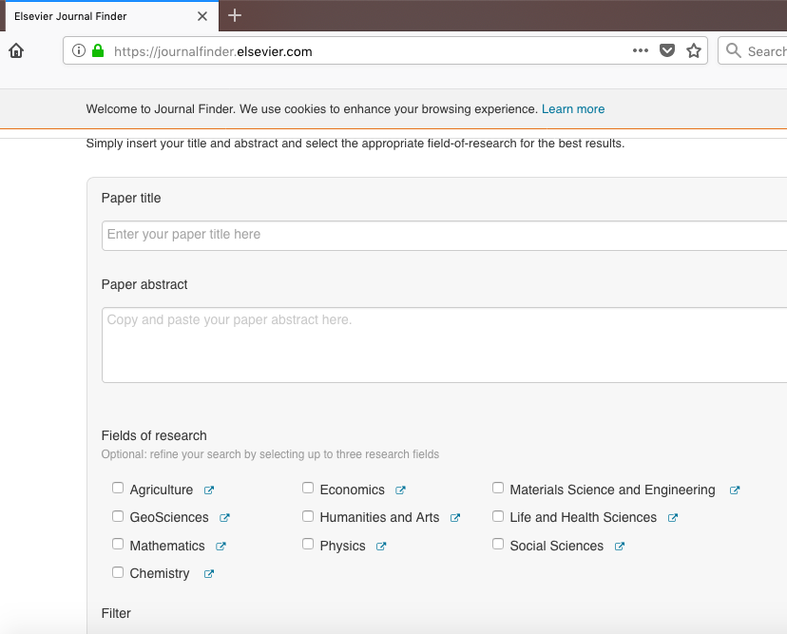

Slide 20
Menulis = Membaca

Slide 21
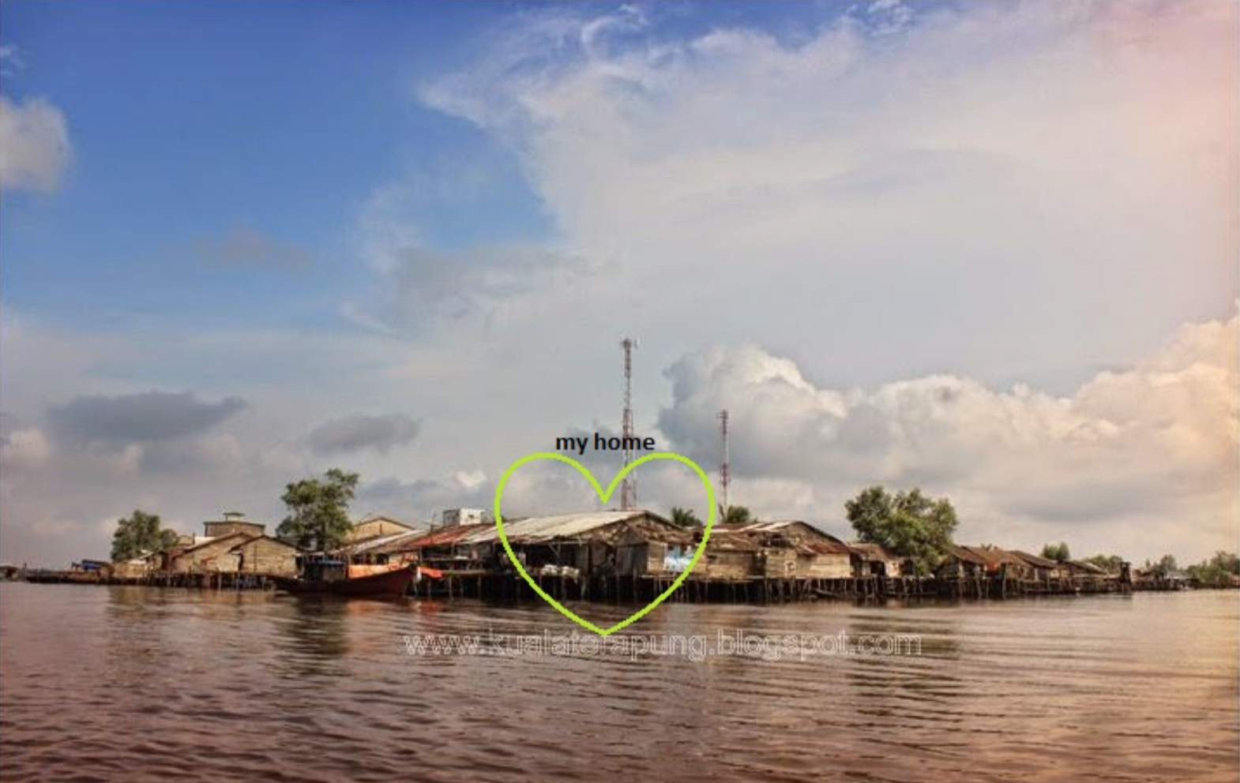
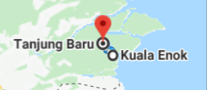

Slide 22
@ Copyright 2022
Disusun oleh:
Saide, S.Kom., M.Kom., M.I.M., Ph.D.
Ph.D. at Information Management, NTUST Taiwan
Lecturer at Dept. Information Systems, UIN SUSKA Riau.
Scholarship; LPDP, DIPA, Double Degree Master (ITS Surabaya & NTUST Taiwan), Taiwan`s scholarship, WTUN Grant Project (UK-Finland-Taiwan).
website: https://saide-sank.blogspot.com email: saide@uin-suska.ac.id youtube: saiderherza journal
Dokumen ini dan semua informasi yang terdapat didalamnya dilindungi hak cipta. Kecuali diijinkan oleh UU No. 28 Tahun 2014 tentang Hak Cipta, tidak ada bagian dari dokumen ini dapat direproduksi dengan cara apapun, tanpa izin tertulis dari penyusun. Isi dokumen ini sepenuhnya merupakan tanggungjawab penyusun.

