Slide 1
IS JOURNALS, CONFERENCES, ORGANIZATIONS
Saide
https://saide-sank.blogspot.com
email: saide@uin-suska.ac.id
youtube: saiderherza journal

Slide 2
Contents
CONCEPT:
WHAT IS RESEARCH.
WHAT IS INFORMATION SYSTEMS AND ITS FOUNDATION.
INFORMATION SYSTEMS (IS) RESEARCH.
ENGLISH FOR INFORMATION SYSTEMS.
WORLD’S INFORMATION SYSTEMS ORGANIZATIONS, &
IS JOURNALS, MAIN IS CONFERENCES, REFERENCES.
IS RESEARCH METHODS AND WRITING THE IDEA
IS FRAMEWORKS/THEORIES
CHOSING THE RIGHT IS JOURNAL FOR REFERENCES
RESEARCH GAPS
BACKGROUND/INTRODUCTION
HYPOTHESIS (DEVELOPMENT & HOW TO WRITE IT CORRECTLY)
METHODS
WRITING THE STATISTICS RESULTS
DISCUSSIONS (CONTRIBUTION TO KNOWLEDGE AND MANAGERIAL)
ABSTRACT
HOW TO RESPOND THE REVISIONS (BY ADVISOR, REVIEWER/EDITOR)
TECHNICAL & PROJECTS:
GROUP PROJECTS:
- REVIEWING ARTICLES
- WRITING RESEARCH PROPOSAL/SHORT ARTICLE
- PRESENTING YOUR PROJECT (ALL MEMBERS MUST PRESENTS)
PERSONAL EXPERIENCE IN PUBLICATIONS

Slide 3
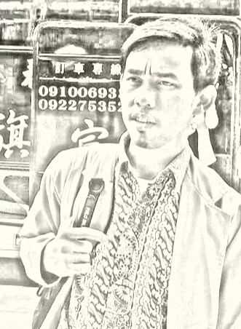
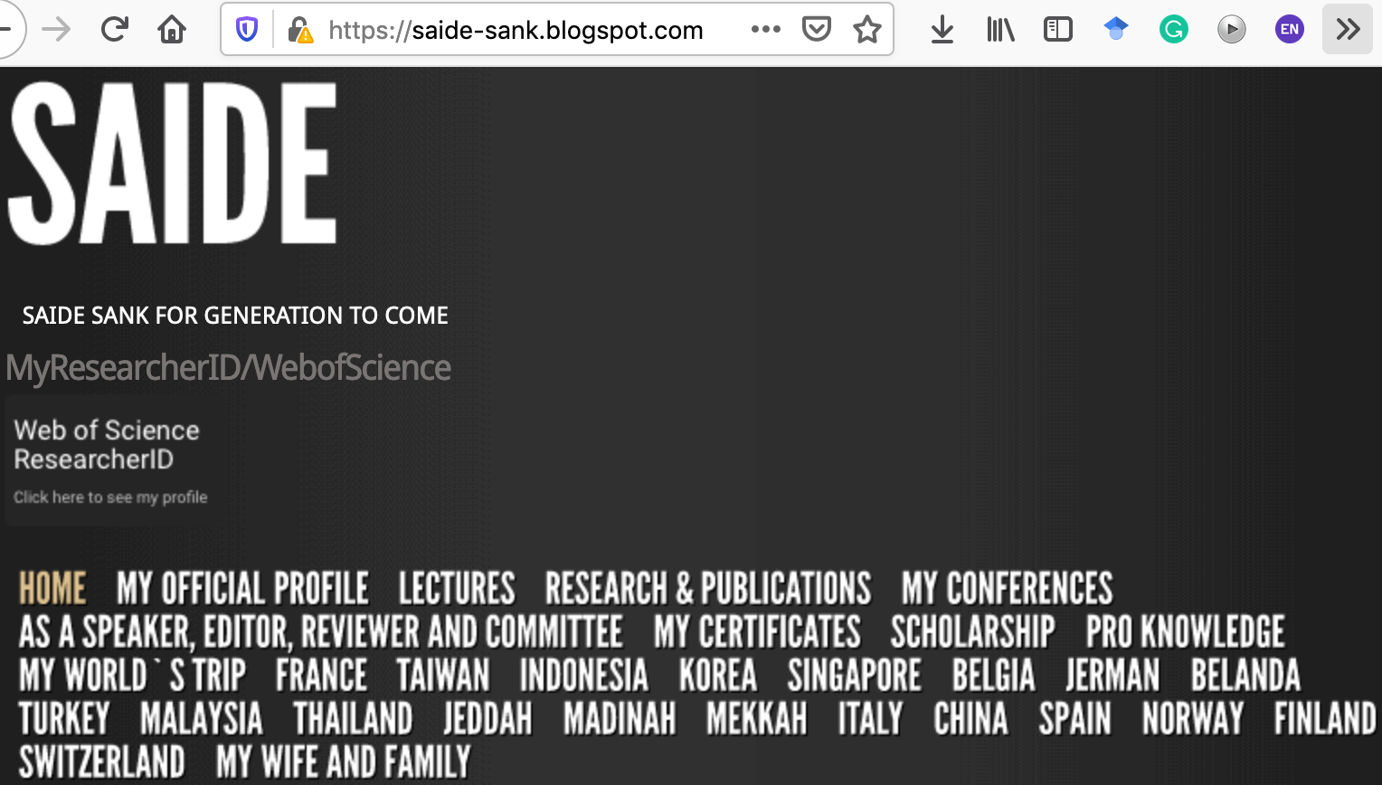
ABOUT ME
Researcher ID/Publons: H-2399-2018
Orcid ID: 0000-0002-1866-5305
Website: https://saide-sank.blogspot.com
S.Kom di UIN Suska Riau (2009-2013)
M.Kom di ITS Surabaya (2014-2016)
M.I.M di NTUST Taiwan (2014-2016)
Lecturer: Information System, UIN SUSKA Riau
Research: Knowledge Management, Information System, Business-IT alignment.
Chief Knowledge Officer: Pro-Knowledge Research Group
Project Management: Energy Research Centre (EnReach.or.id)
Ph.D. candidate: Information Management, NTUST Taiwan

Slide 4


SIMULASI CEK LEVEL JURNAL

Slide 5
IS JOURNALS & WORLD’S IS ORGANIZATIONS

Slide 6

Top basket of IS journals
Ref: Association for Information Systems-AIS (https://aisnet.org/)

Slide 7

Apa saja yaa !!!

Slide 8
Top basket of IS journals
MIS Quarterly
European Journal of Information Systems
Information Systems Journal
Information Systems Research
Journal of the Association for Information Systems
Journal of Information Technology
Journal of Management Information Systems
Journal of Strategic Information Systems

Slide 9
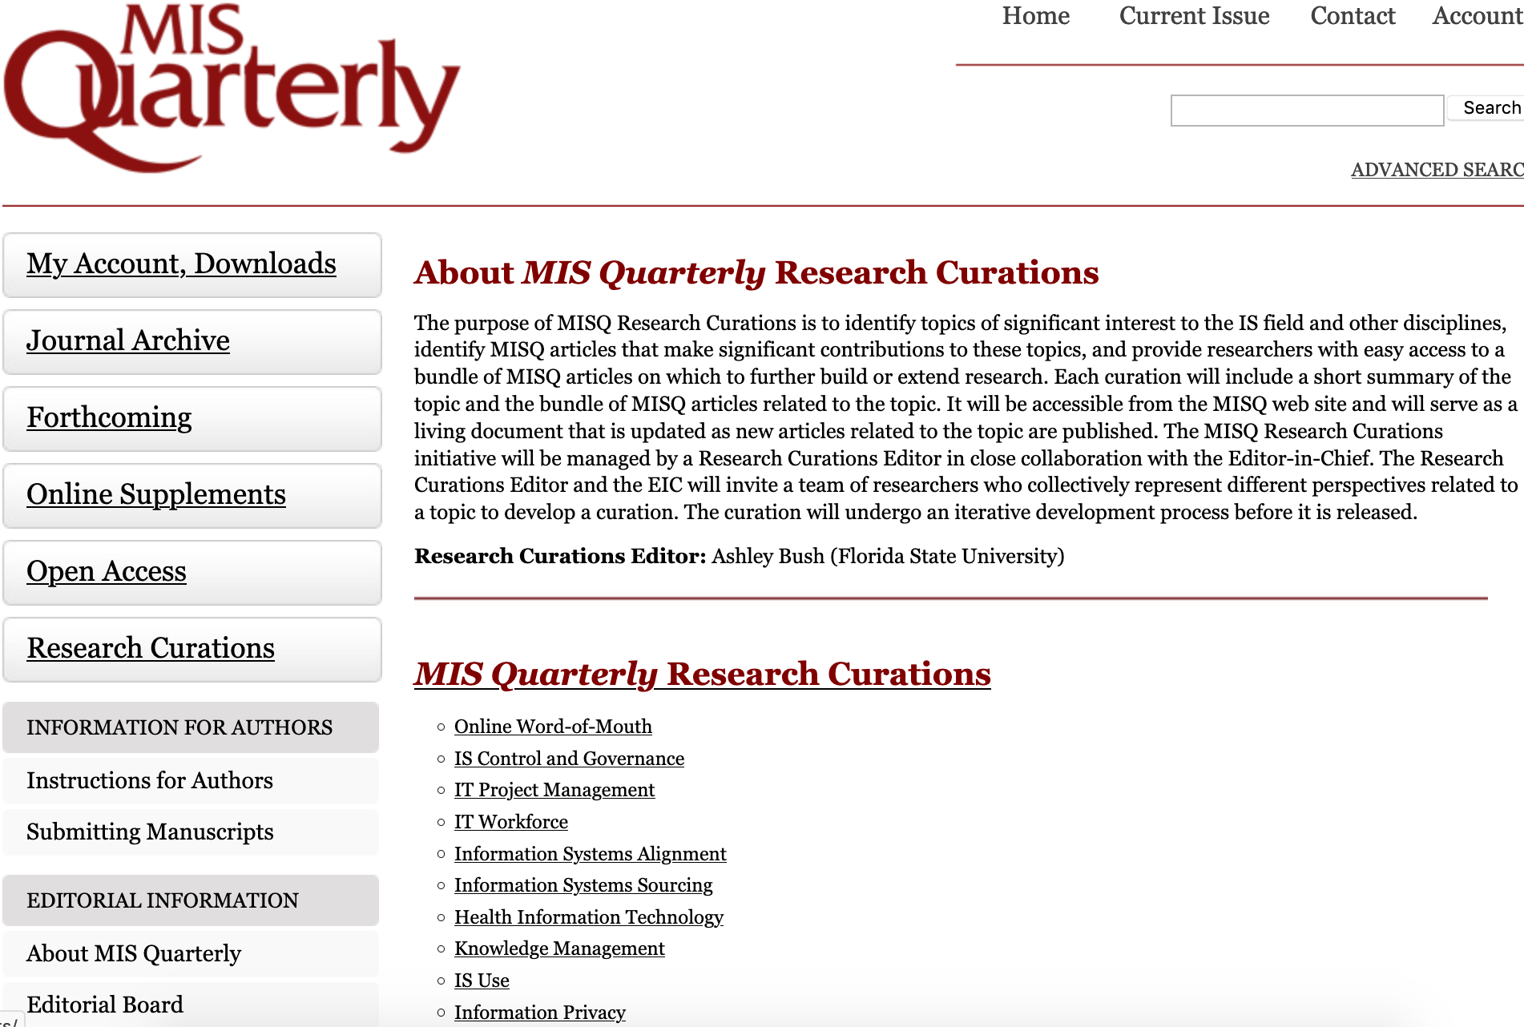

Management Information Systems (MIS) Quarterly

Slide 10
INGIN MENYELESAIKAN MASALAH TERBESAR DI MUKA BUMI

Slide 11
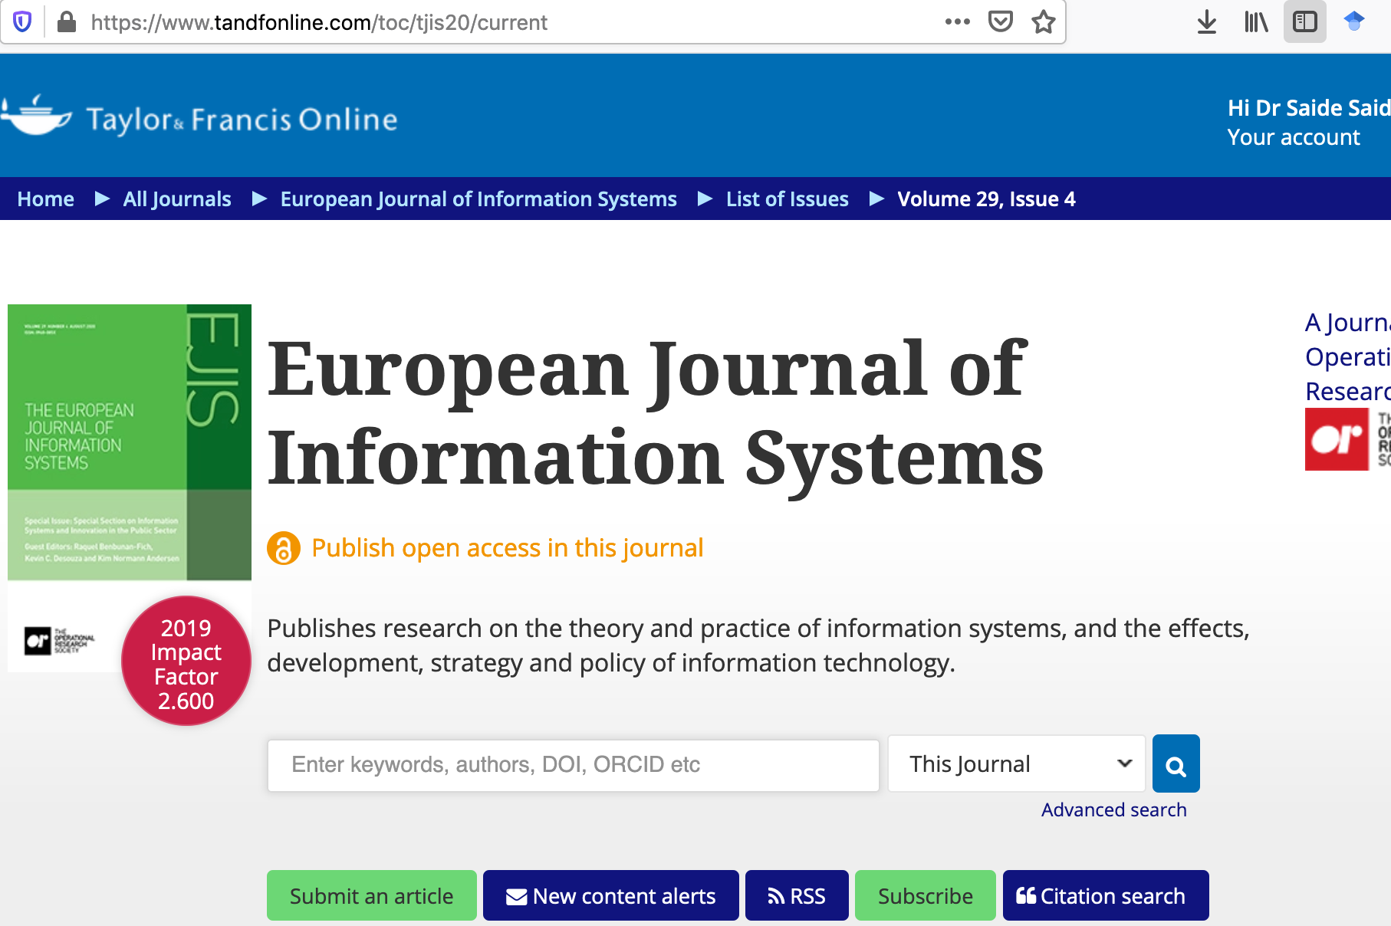
European Journal of Information Systems

Slide 12
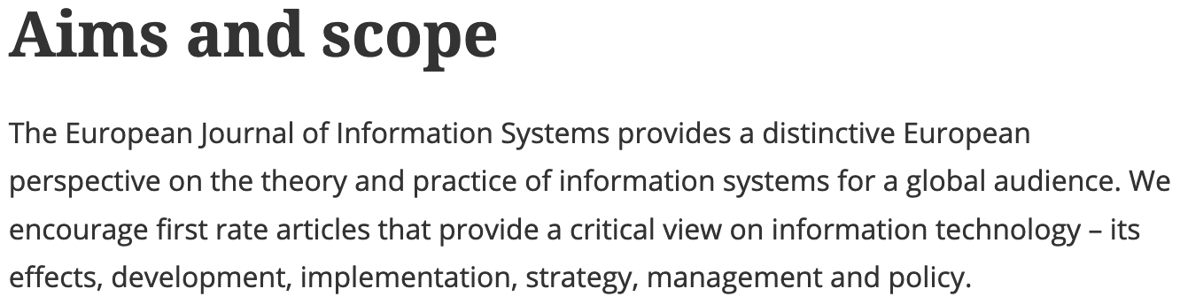
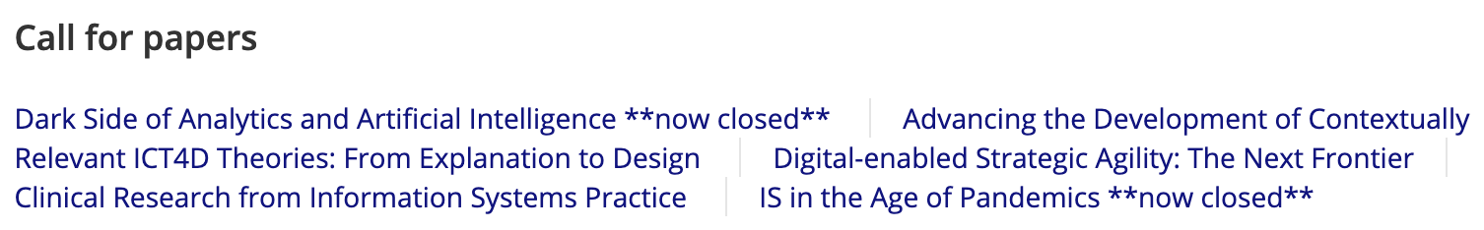
European Journal of Information Systems

Slide 13
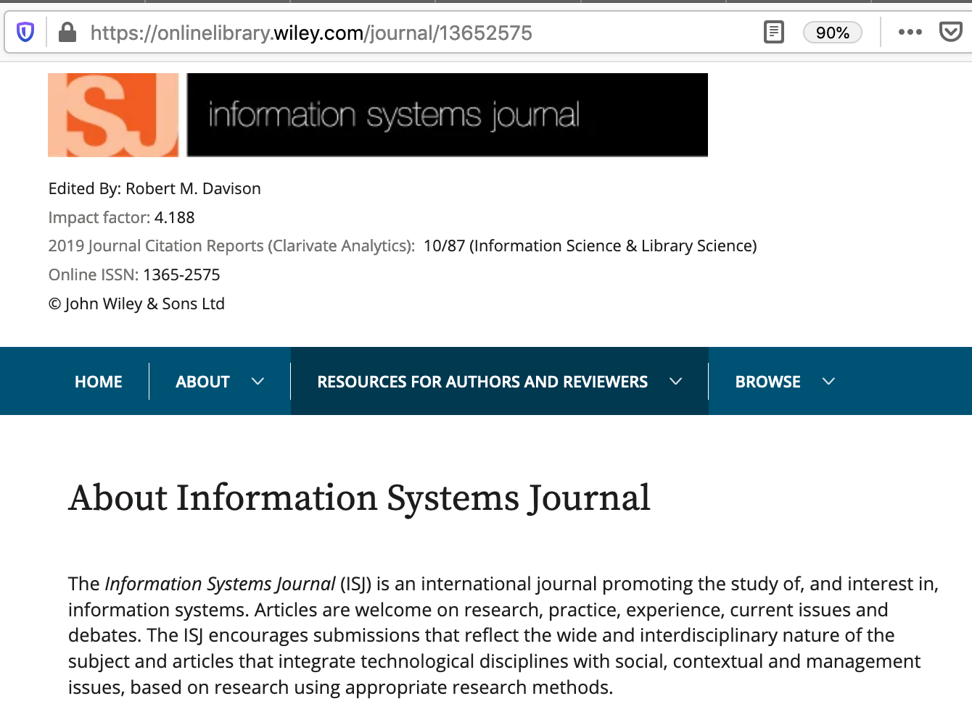
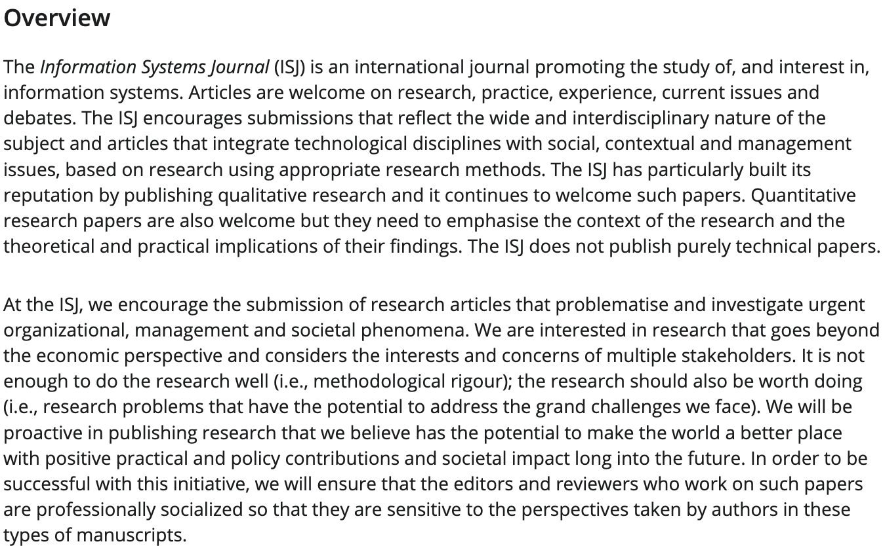
Information Systems Journal

Slide 14
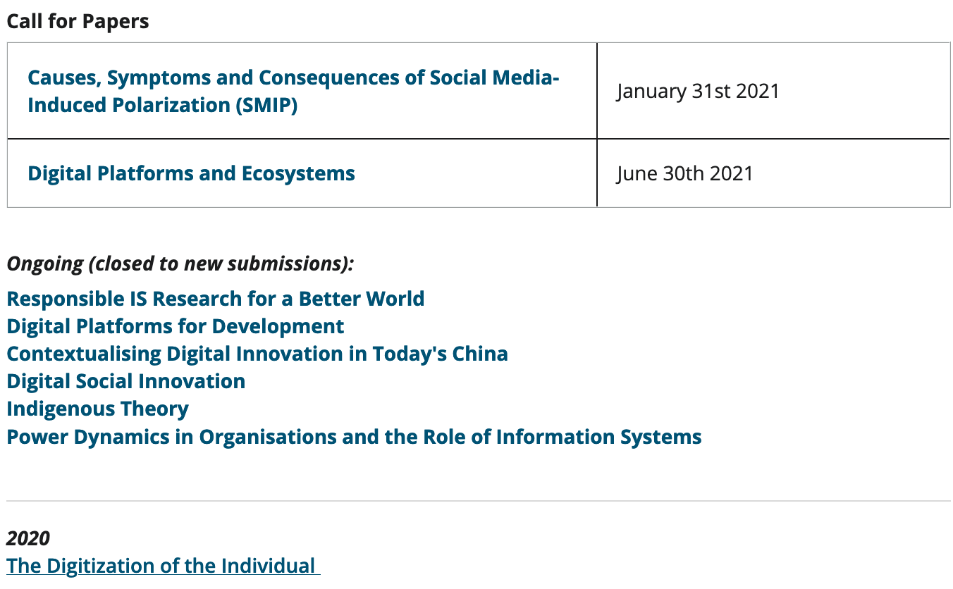
Information Systems Journal

Slide 15
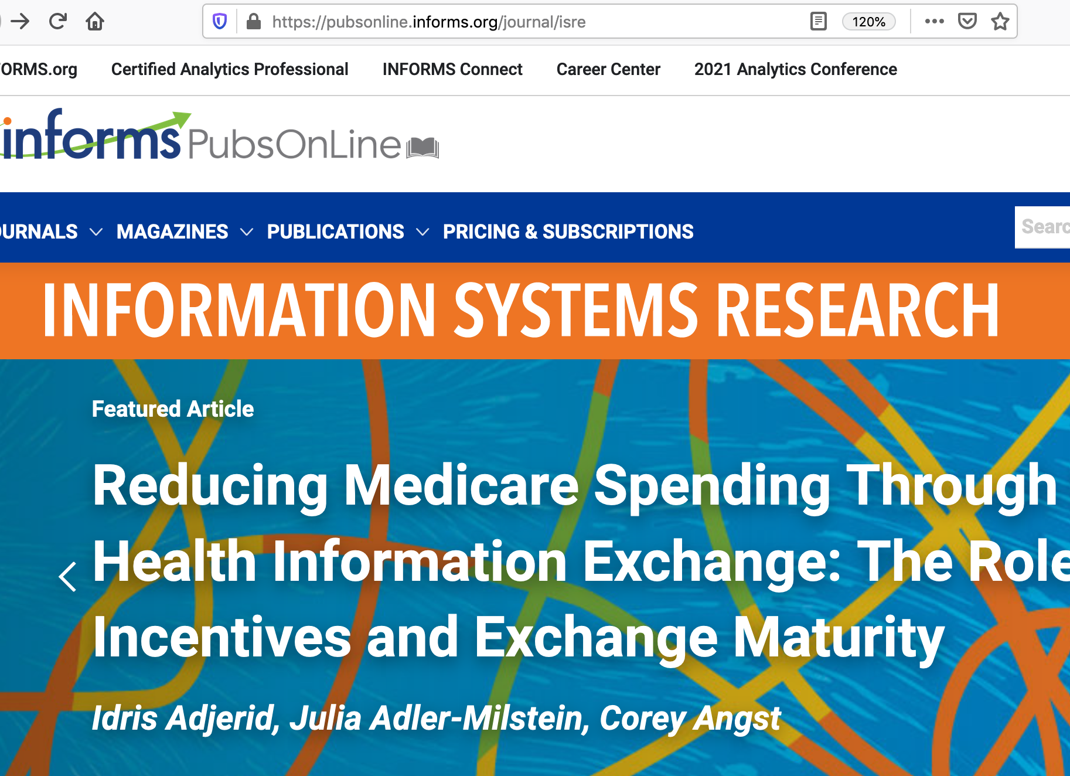
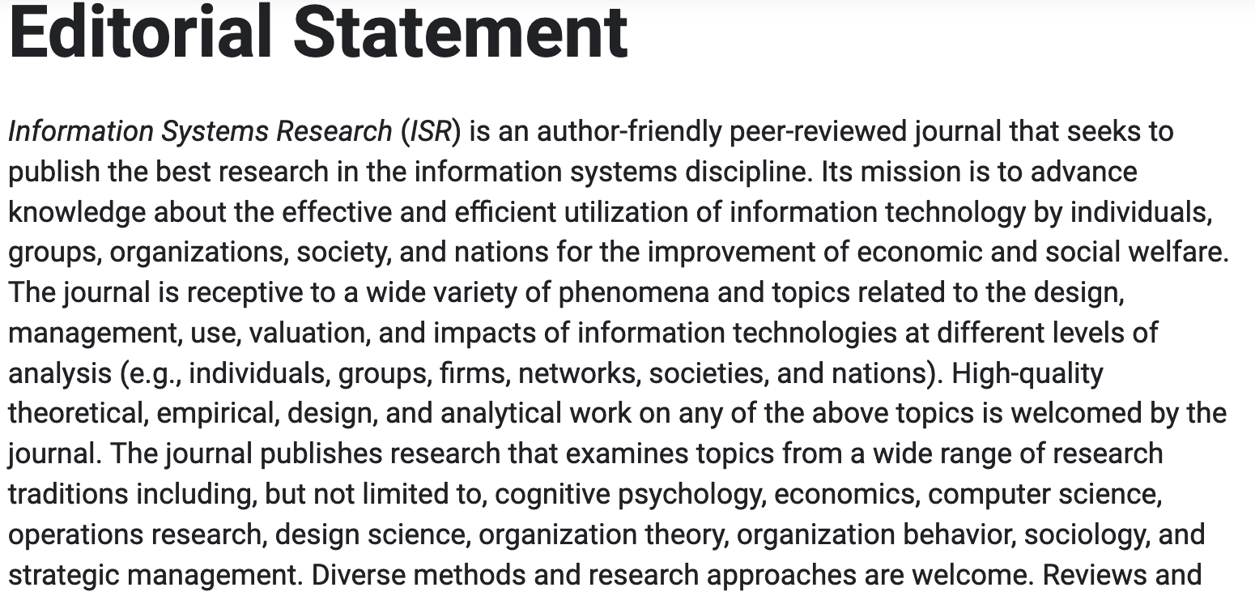
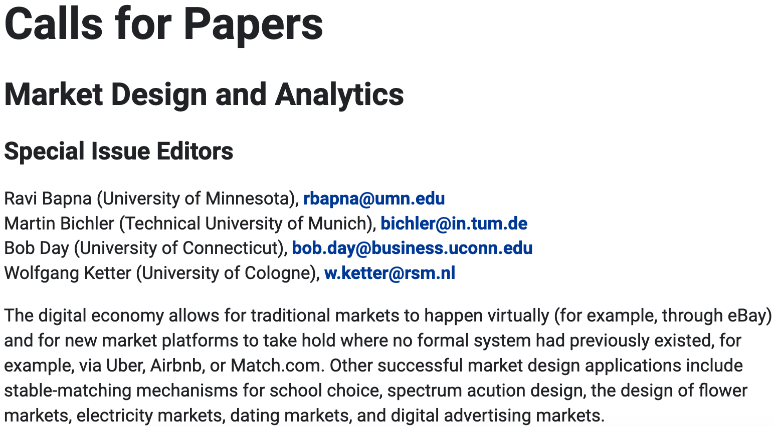
Information Systems Research

Slide 16
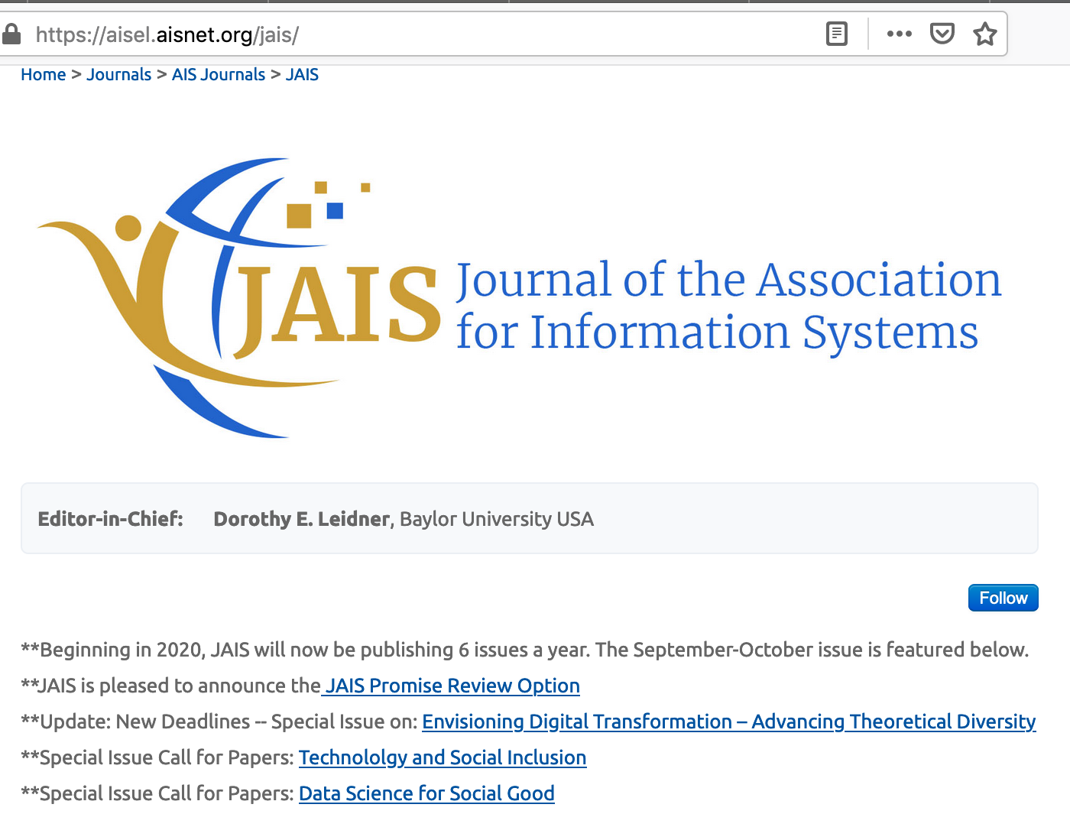
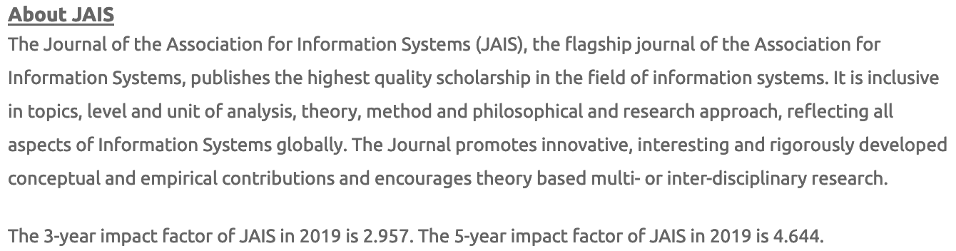
Journal of the Association for Information Systems

Slide 17
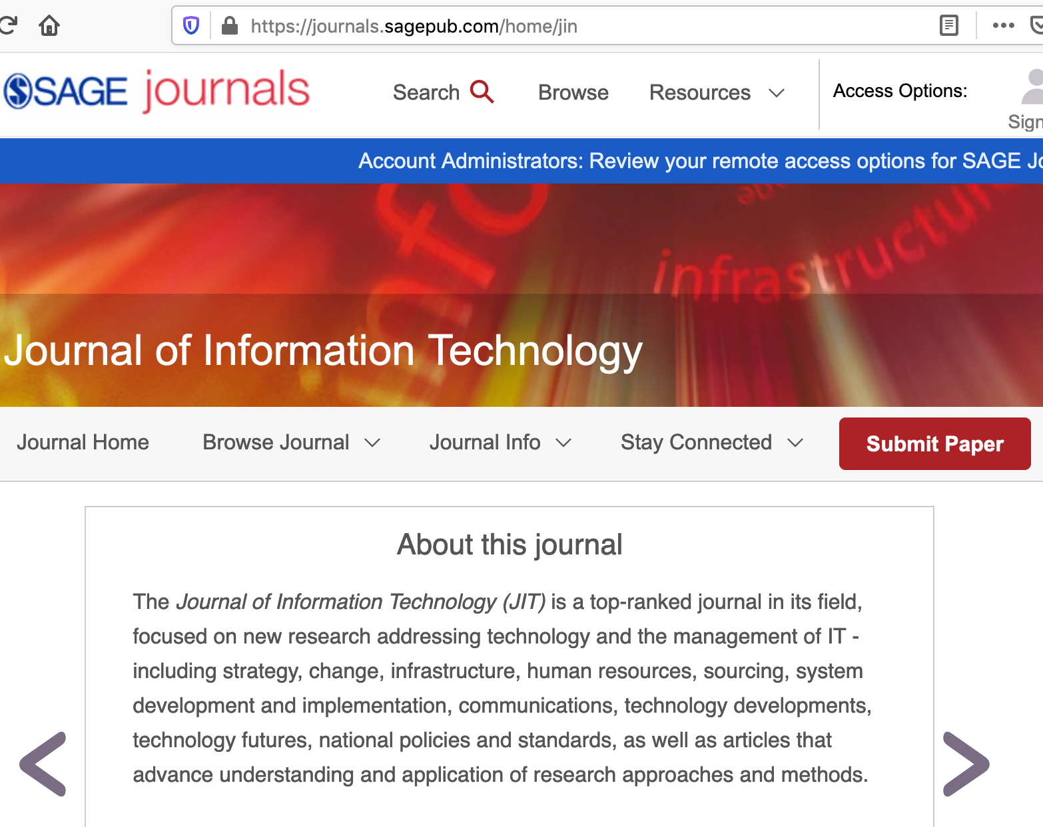
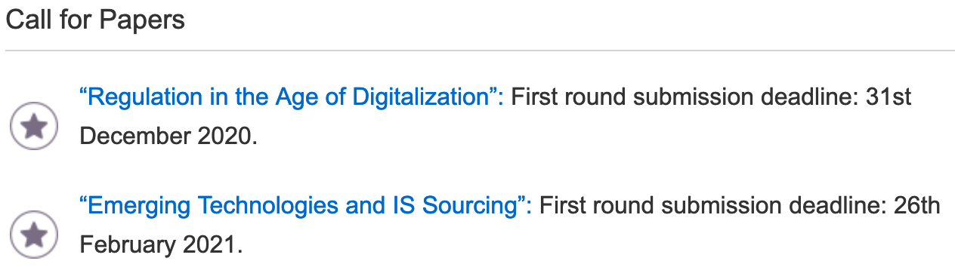
Journal of Information Technology

Slide 18
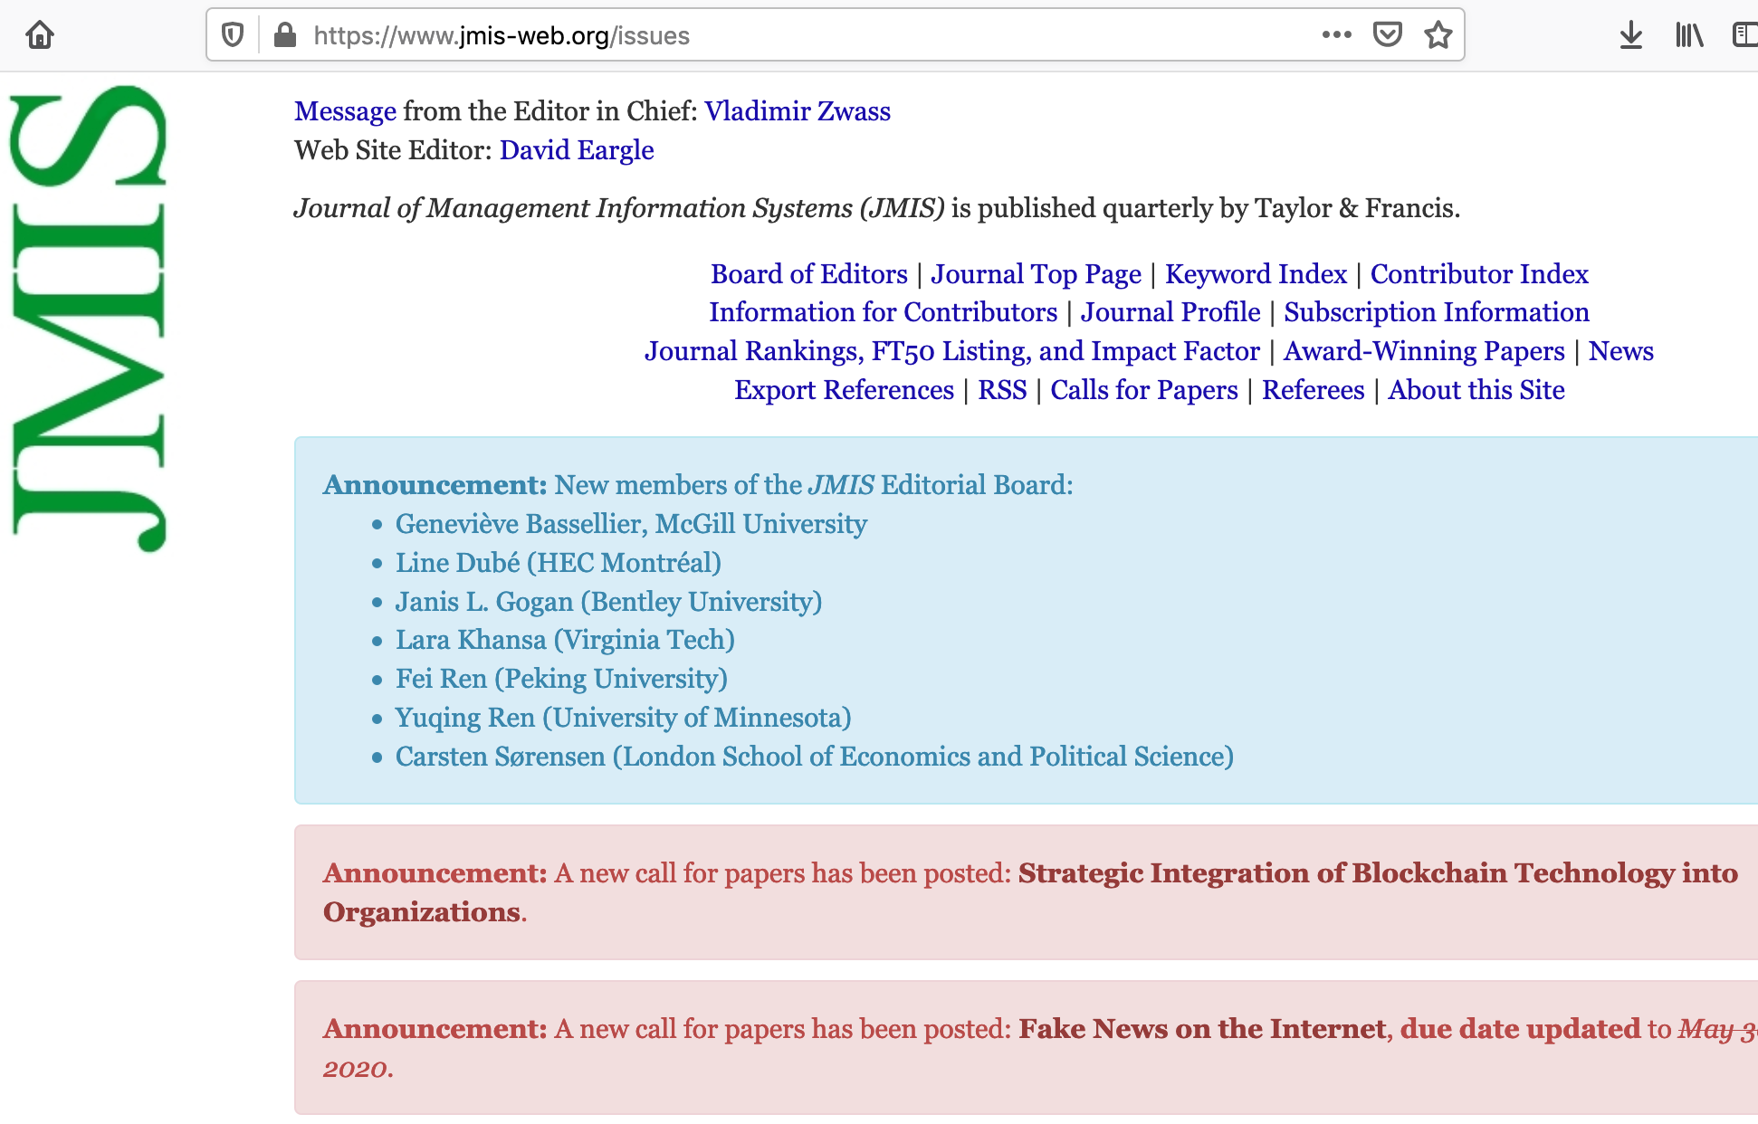
Journal of Management Information Systems

Slide 19
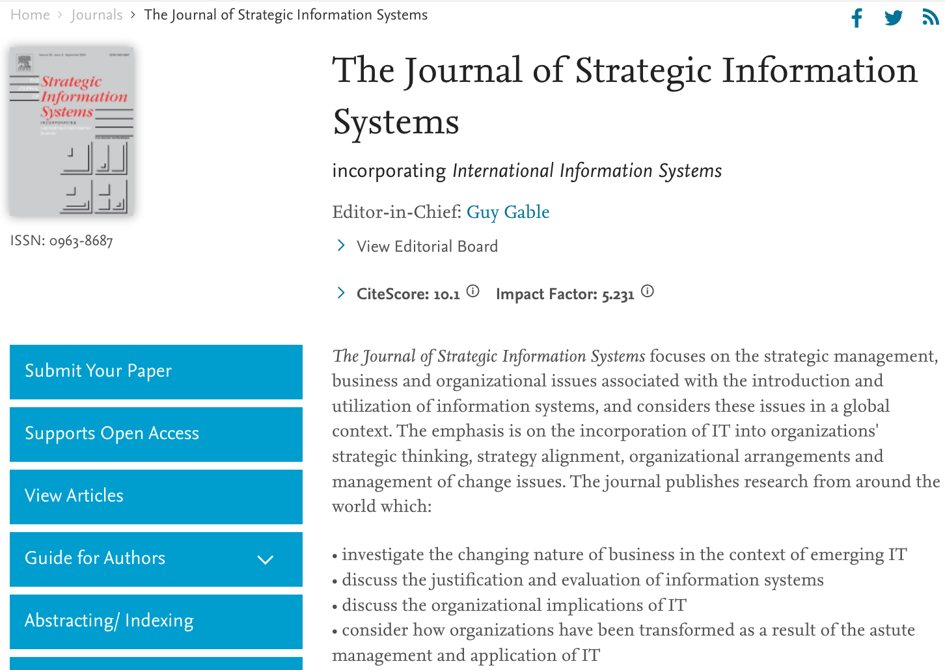
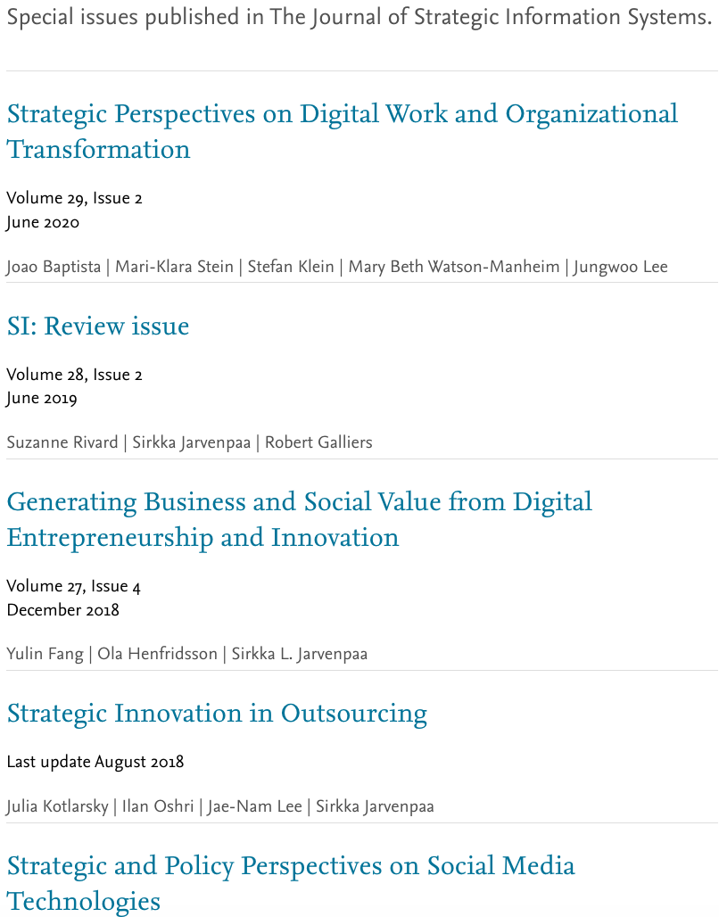
Journal of Strategic Information Systems

Slide 20
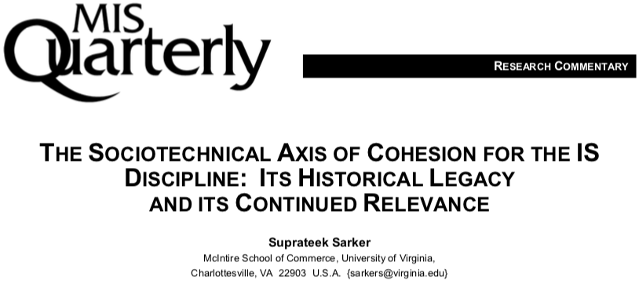
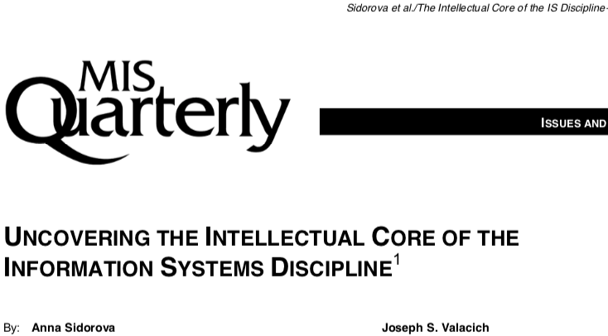
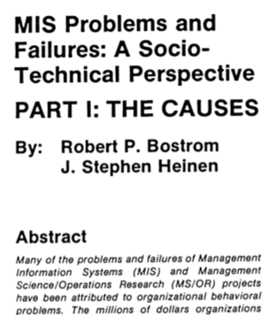
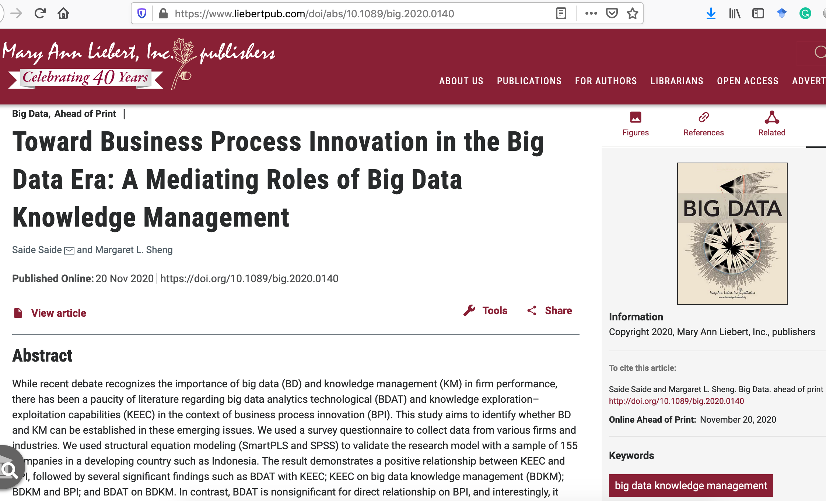
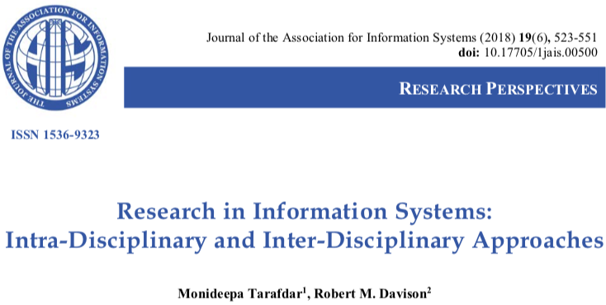
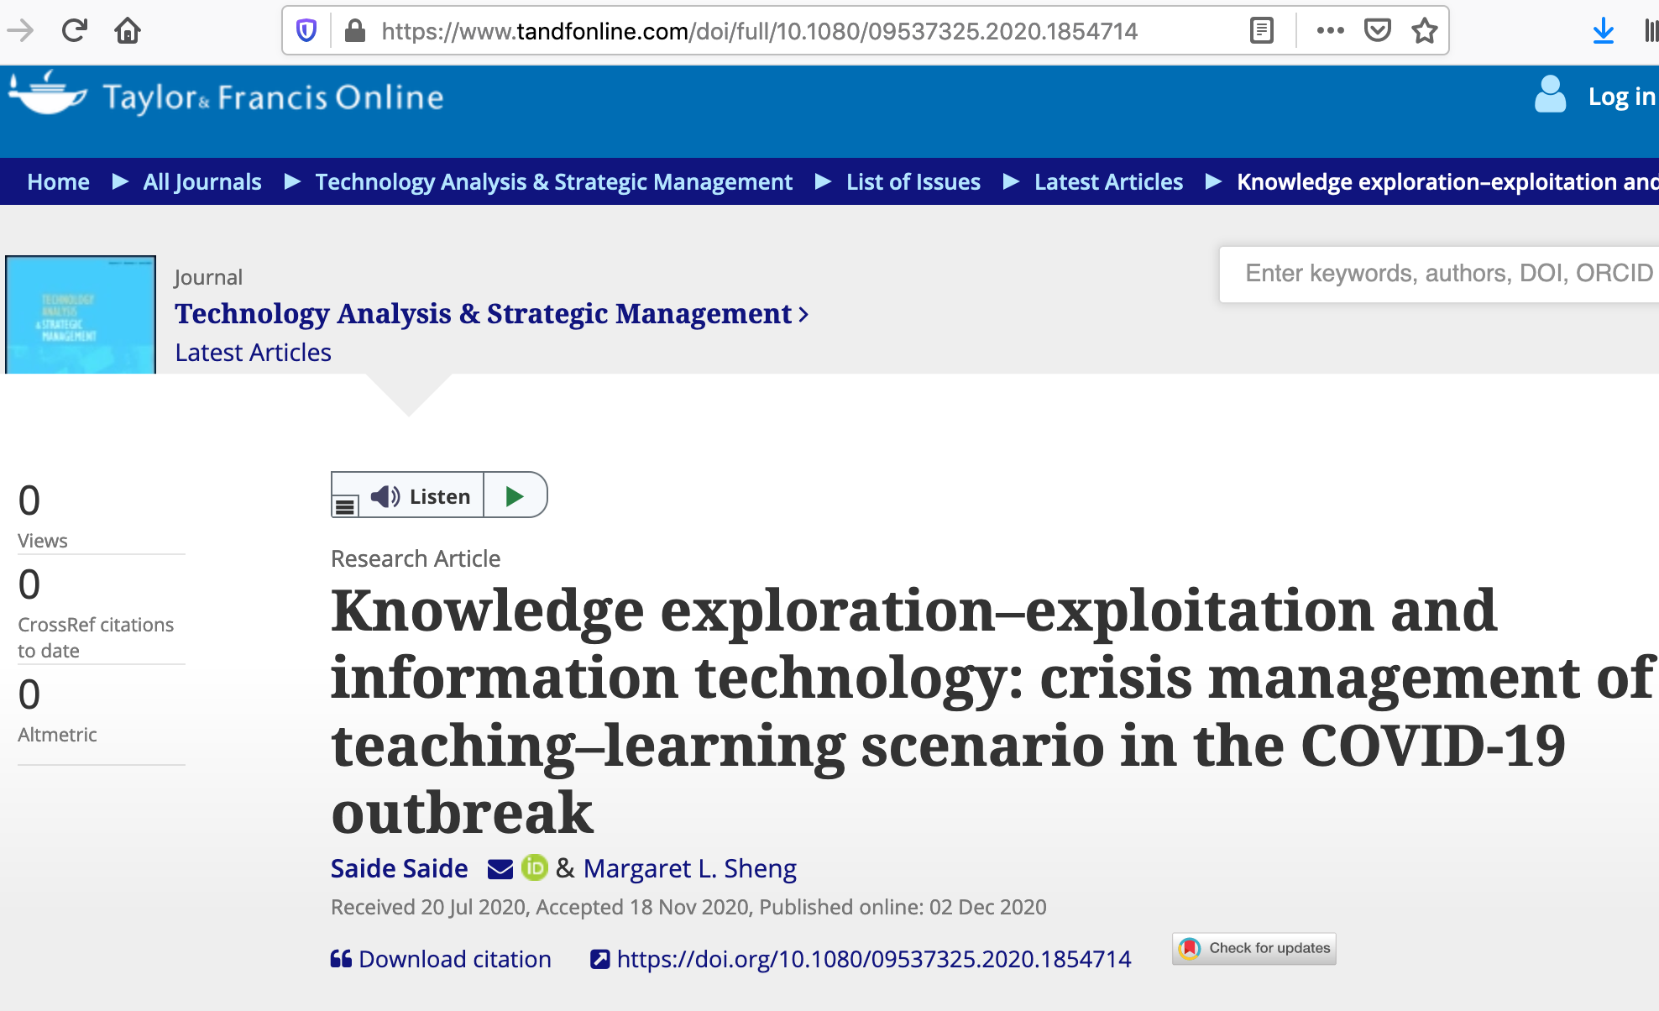
Published articles (Technical-Socio Perspective)

Slide 21
MAIN IS CONFERENCES

Slide 22
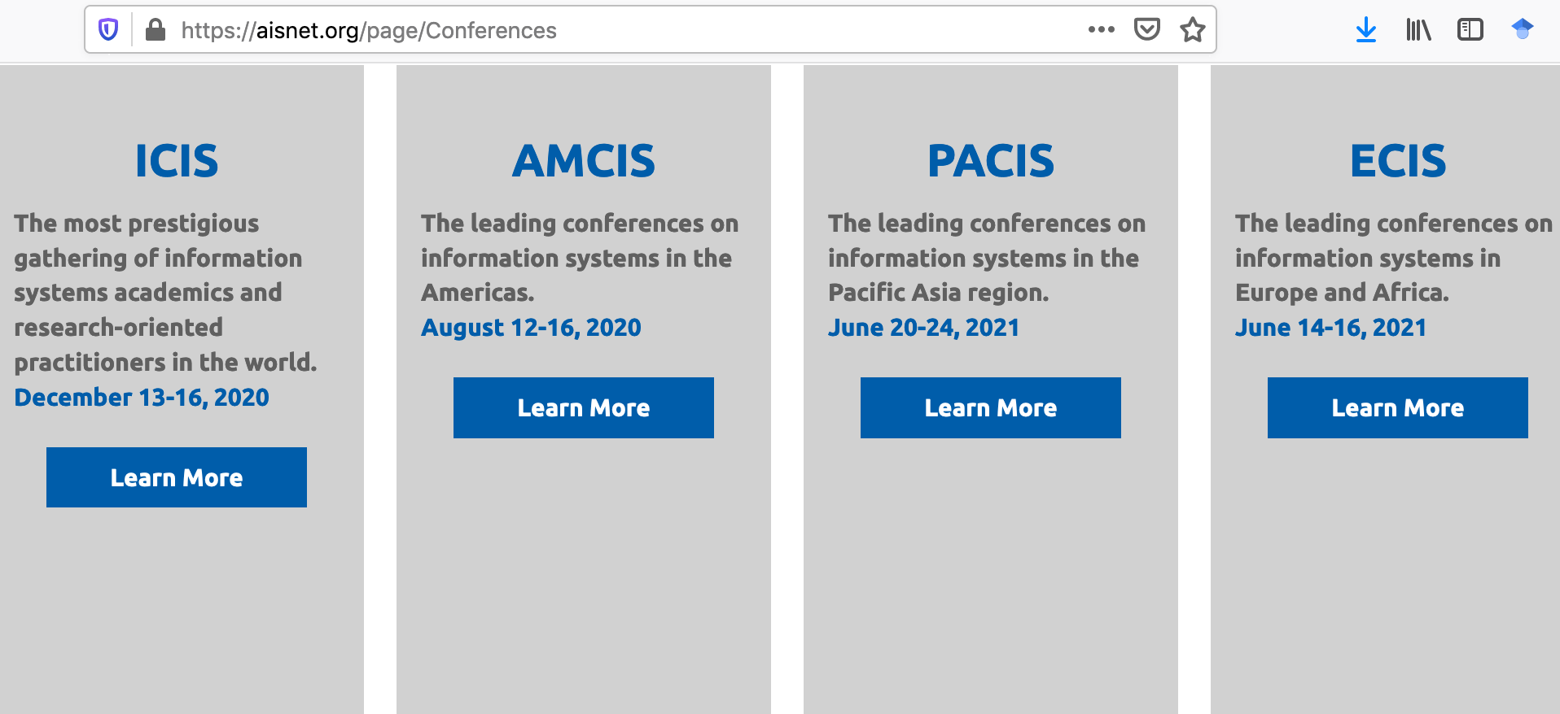
IS conferences
https://aisnet.org/page/Conferences :
International Conference on Information Systems (ICIS)
Americas Conference on Information Systems (AMCIS)
Pacific Asia Conference on Information Systems (PACIS)
European Conference on Information Systems (ECIS)

Slide 23
GROUP PROJECTS:
- REVIEWING ARTICLES
- WRITING RESEARC PROPOSAL/ SHORT ARTICLE
- PRESENTING YOUR PROJECT (ALL MEMBERS MUST PRESENTS)
MULAI ANGSUR GROUP PROJECT

Slide 24
Menulis = Membaca

Slide 25
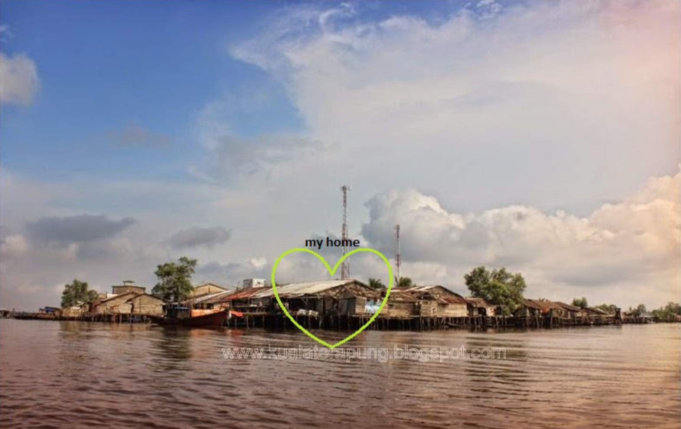
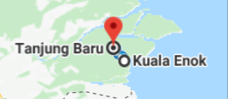

Slide 26
@ Copyright 2022
Disusun oleh:
Saide, S.Kom., M.Kom., M.I.M., Ph.D.
Ph.D. at Information Management, NTUST Taiwan
Lecturer at Dept. Information Systems, UIN SUSKA Riau.
Scholarship; LPDP, DIPA, Double Degree Master (ITS Surabaya & NTUST Taiwan), Taiwan`s scholarship, WTUN Grant Project (UK-Finland-Taiwan).
website: https://saide-sank.blogspot.com
email: saide@uin-suska.ac.id
youtube: saiderherza journal
Dokumen ini dan semua informasi yang terdapat didalamnya dilindungi hak cipta. Kecuali diijinkan oleh UU No. 28 Tahun 2014 tentang Hak Cipta, tidak ada bagian dari dokumen ini dapat direproduksi dengan cara apapun, tanpa izin tertulis dari penyusun. Isi dokumen ini sepenuhnya merupakan tanggungjawab penyusun.

