Slide 1
IS STRATEGY PLAN
Saide
https://saide-sank.blogspot.com email: saide@uin-suska.ac.id youtube: saiderherza journal

Slide 2
Contents
CONCEPT:
WHAT IS RESEARCH.
WHAT IS INFORMATION SYSTEMS AND ITS FOUNDATION.
INFORMATION SYSTEMS (IS) RESEARCH.
ENGLISH FOR INFORMATION SYSTEMS.
WORLD’S INFORMATION SYSTEMS ORGANIZATIONS, &
IS JOURNALS, MAIN IS CONFERENCES, REFERENCES.
IS RESEARCH METHODS AND WRITING THE IDEA
IS FRAMEWORKS/THEORIES
CHOSING THE RIGHT IS JOURNAL FOR REFERENCES
RESEARCH GAPS
BACKGROUND/INTRODUCTION
HYPOTHESIS (DEVELOPMENT & HOW TO WRITE IT CORRECTLY)
METHODS
WRITING THE STATISTICS RESULTS
DISCUSSIONS (CONTRIBUTION TO KNOWLEDGE AND MANAGERIAL)
ABSTRACT
HOW TO RESPOND THE REVISIONS (BY ADVISOR, REVIEWER/EDITOR)
TECHNICAL & PROJECTS:
GROUP PROJECTS: - REVIEWING ARTICLES
- WRITING RESEARCH PROPOSAL/SHORT ARTICLE
- PRESENTING YOUR PROJECT (ALL MEMBERS MUST PRESENTS)
PERSONAL EXPERIENCE IN PUBLICATIONS

Slide 3
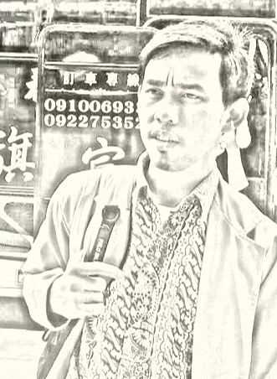
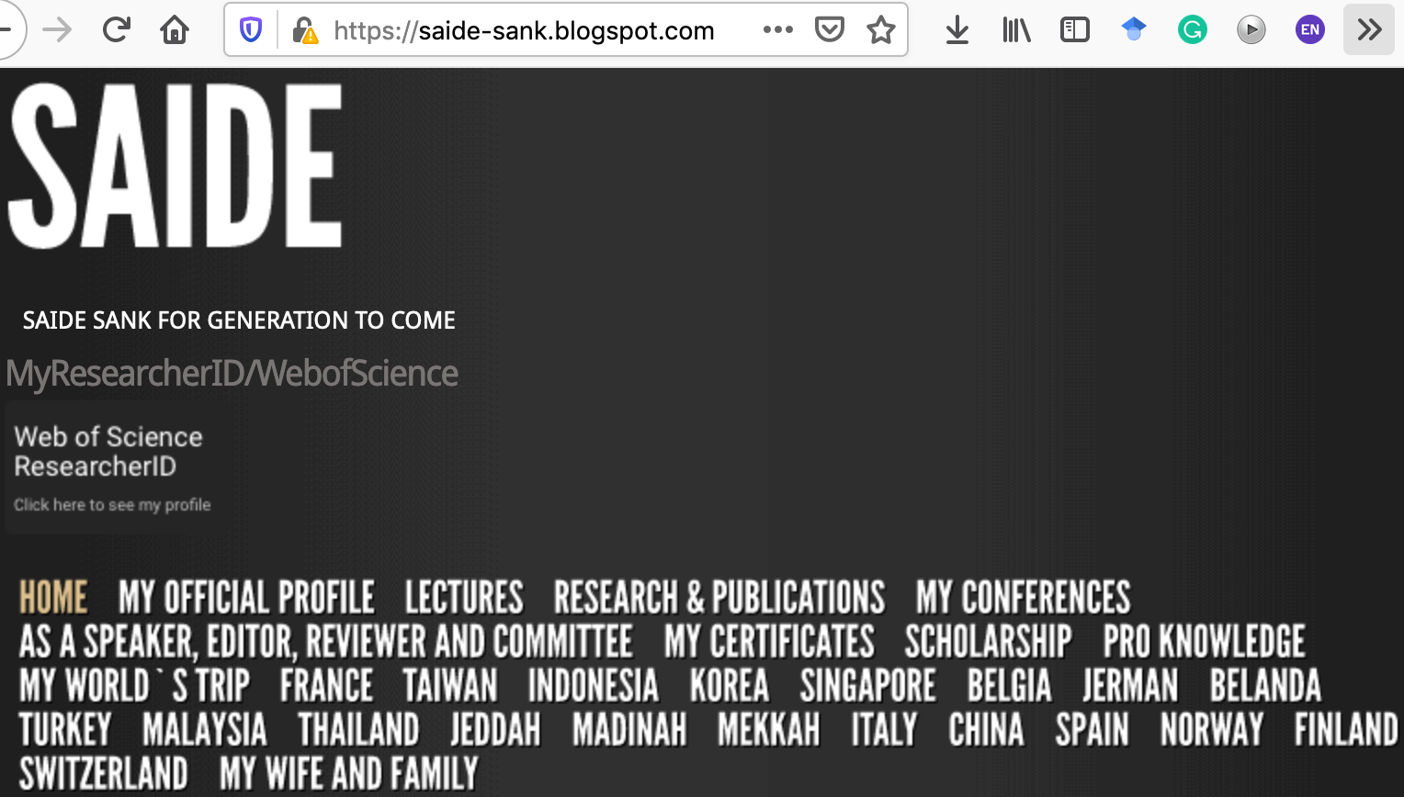
ABOUT ME
Researcher ID/Publons: H-2399-2018
Orcid ID: 0000-0002-1866-5305
Website: https://saide-sank.blogspot.com
S.Kom di UIN Suska Riau (2009-2013)
M.Kom di ITS Surabaya (2014-2016)
M.I.M di NTUST Taiwan (2014-2016)
Lecturer: Information System, UIN SUSKA Riau
Research: Knowledge Management, Information System, Business-IT alignment.
Chief Knowledge Officer: Pro-Knowledge Research Group
Project Management: Energy Research Centre (EnReach.or.id)
Ph.D. candidate: Information Management, NTUST Taiwan

Slide 4
“RESEARCH”

Slide 5
ARTIKEL/PAPER TIDAK SAMA JURNAL/JOURNAL
basic knowledge

Slide 6
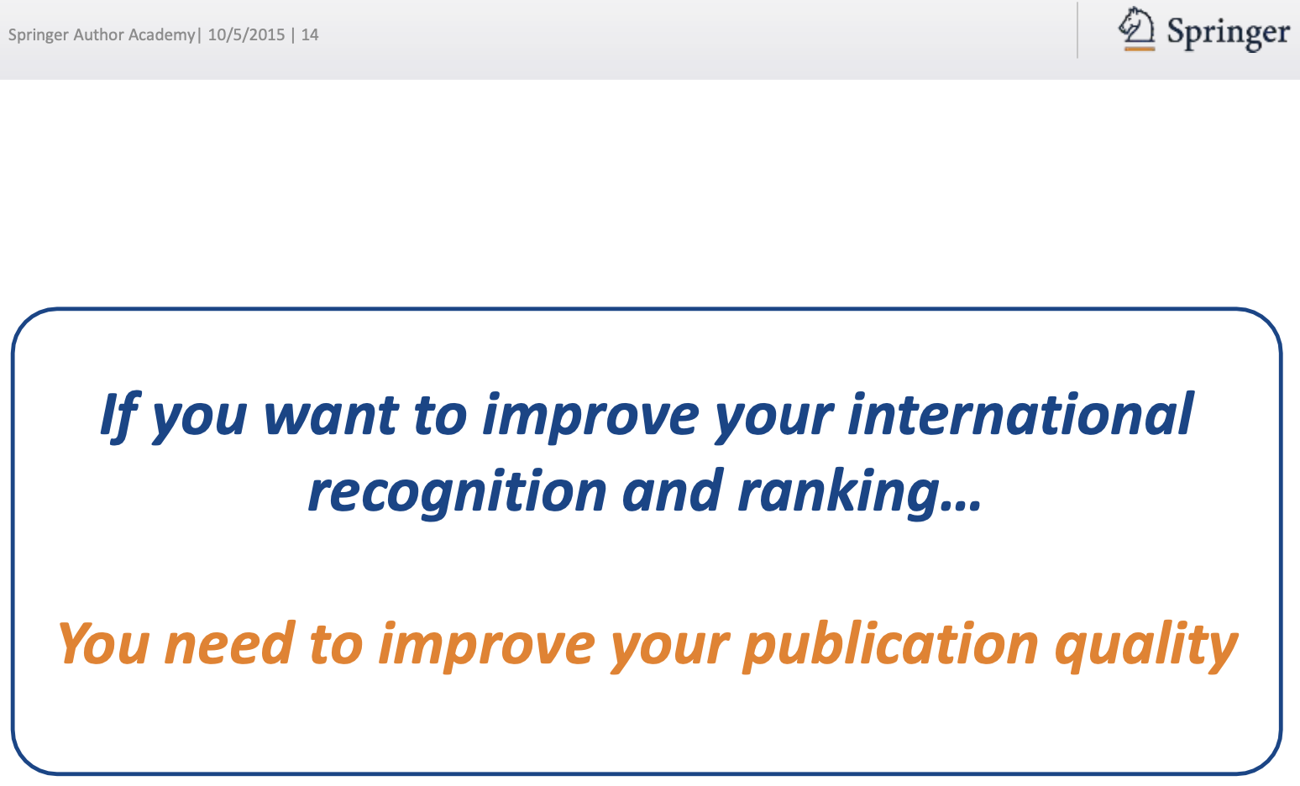

Slide 7
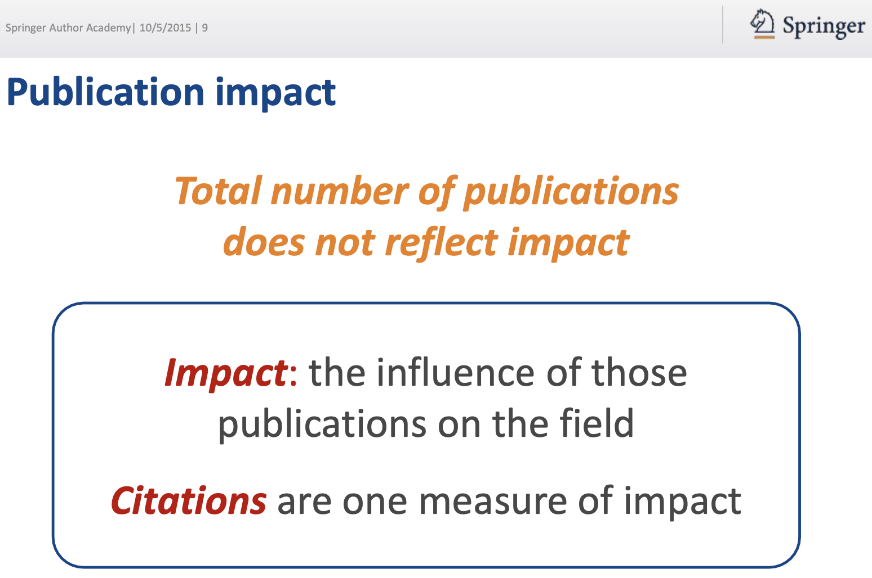

Slide 8
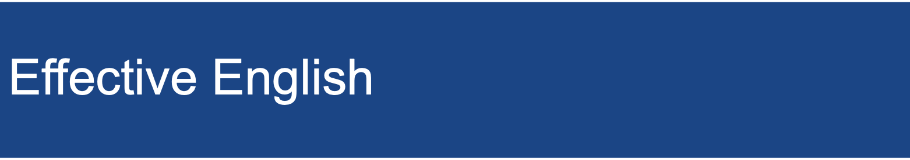

Slide 9
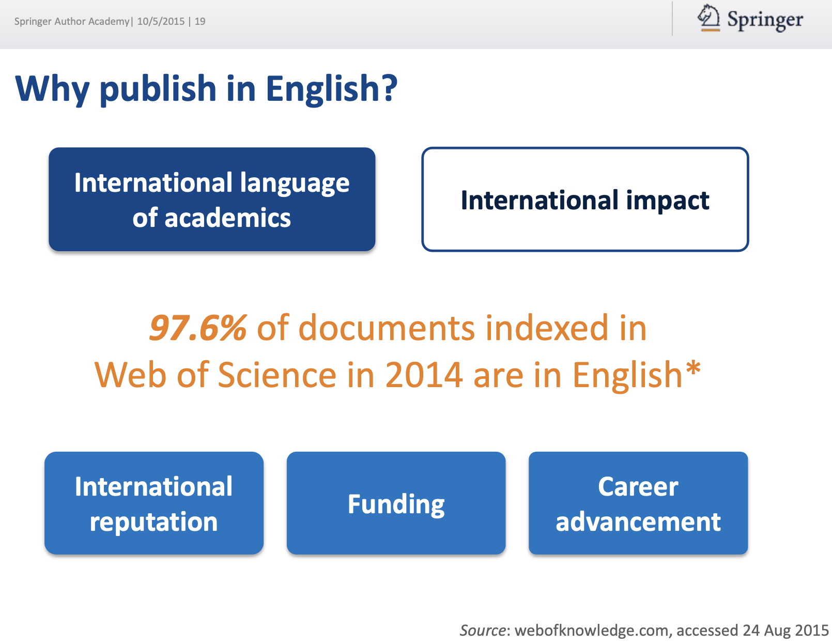

Slide 10
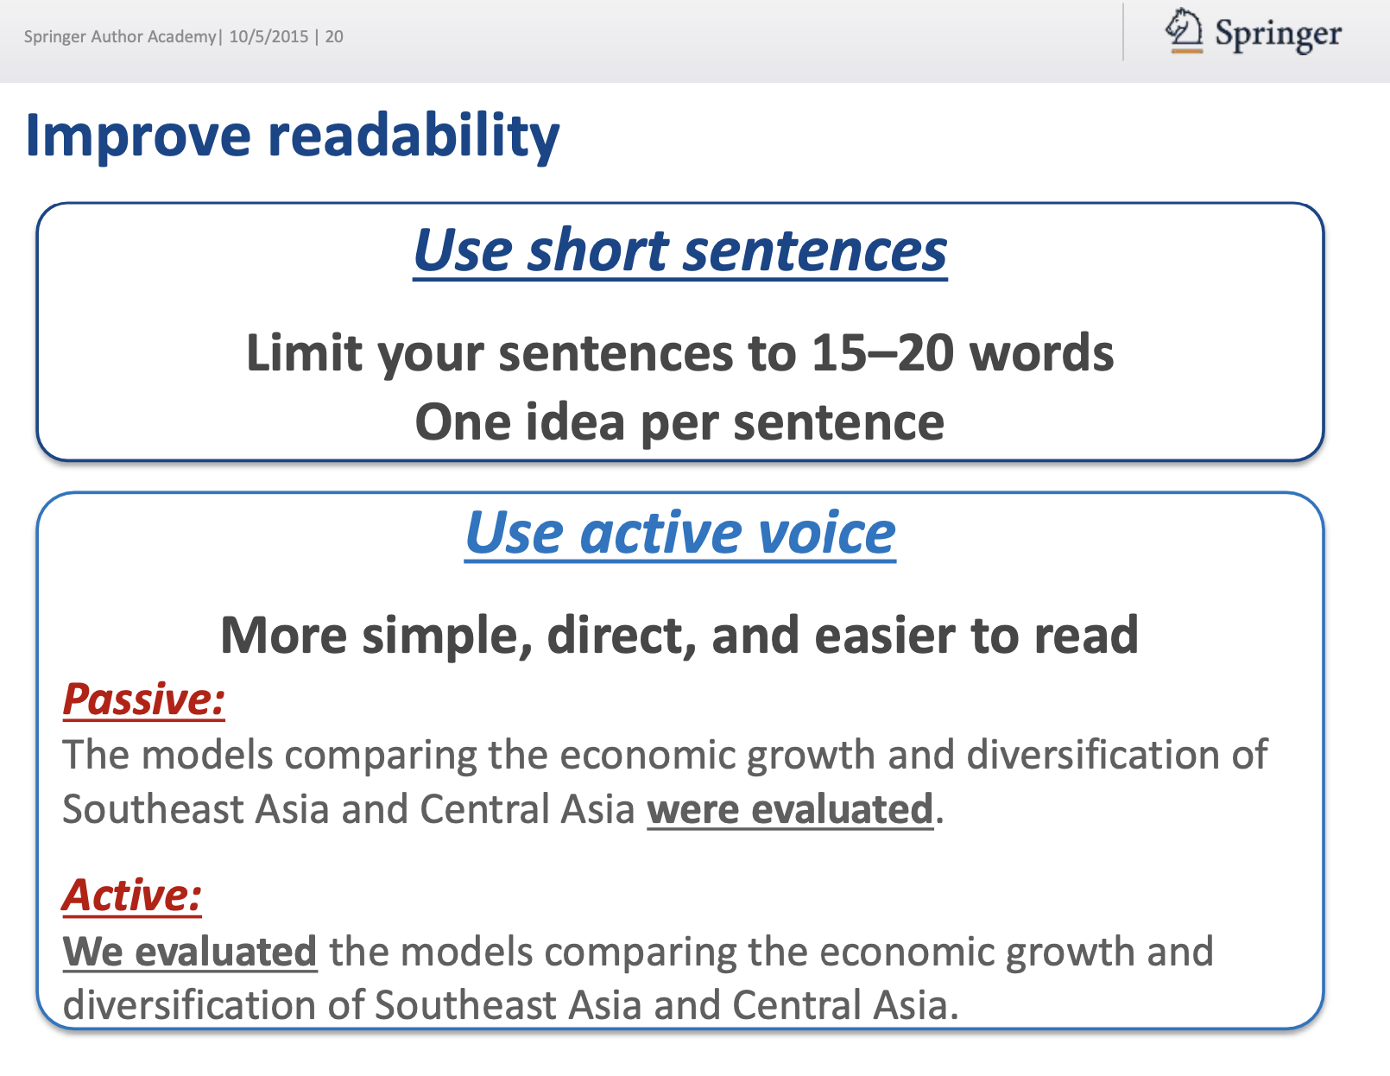

Slide 11
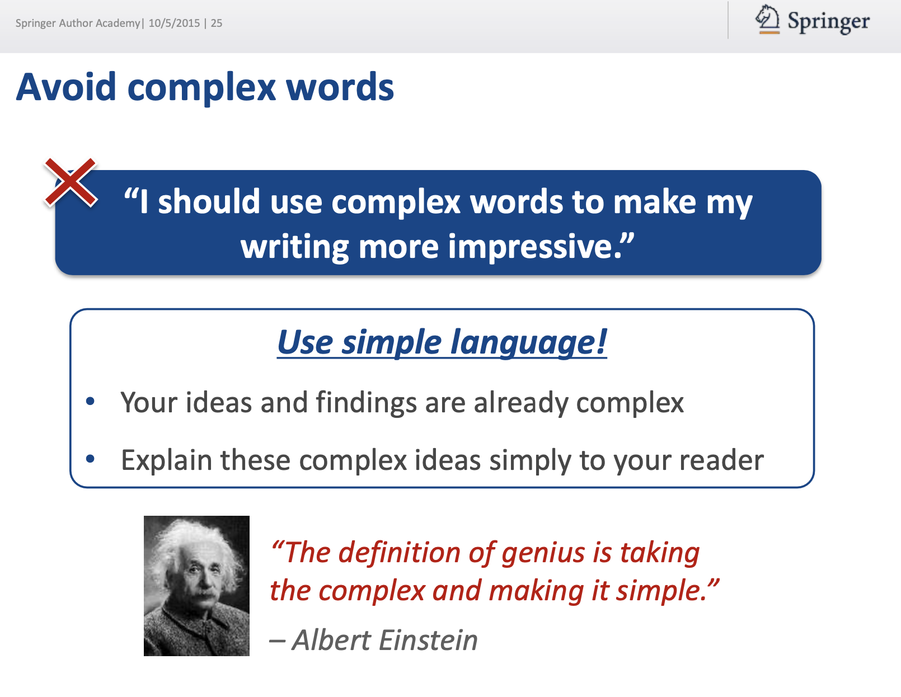

Slide 12
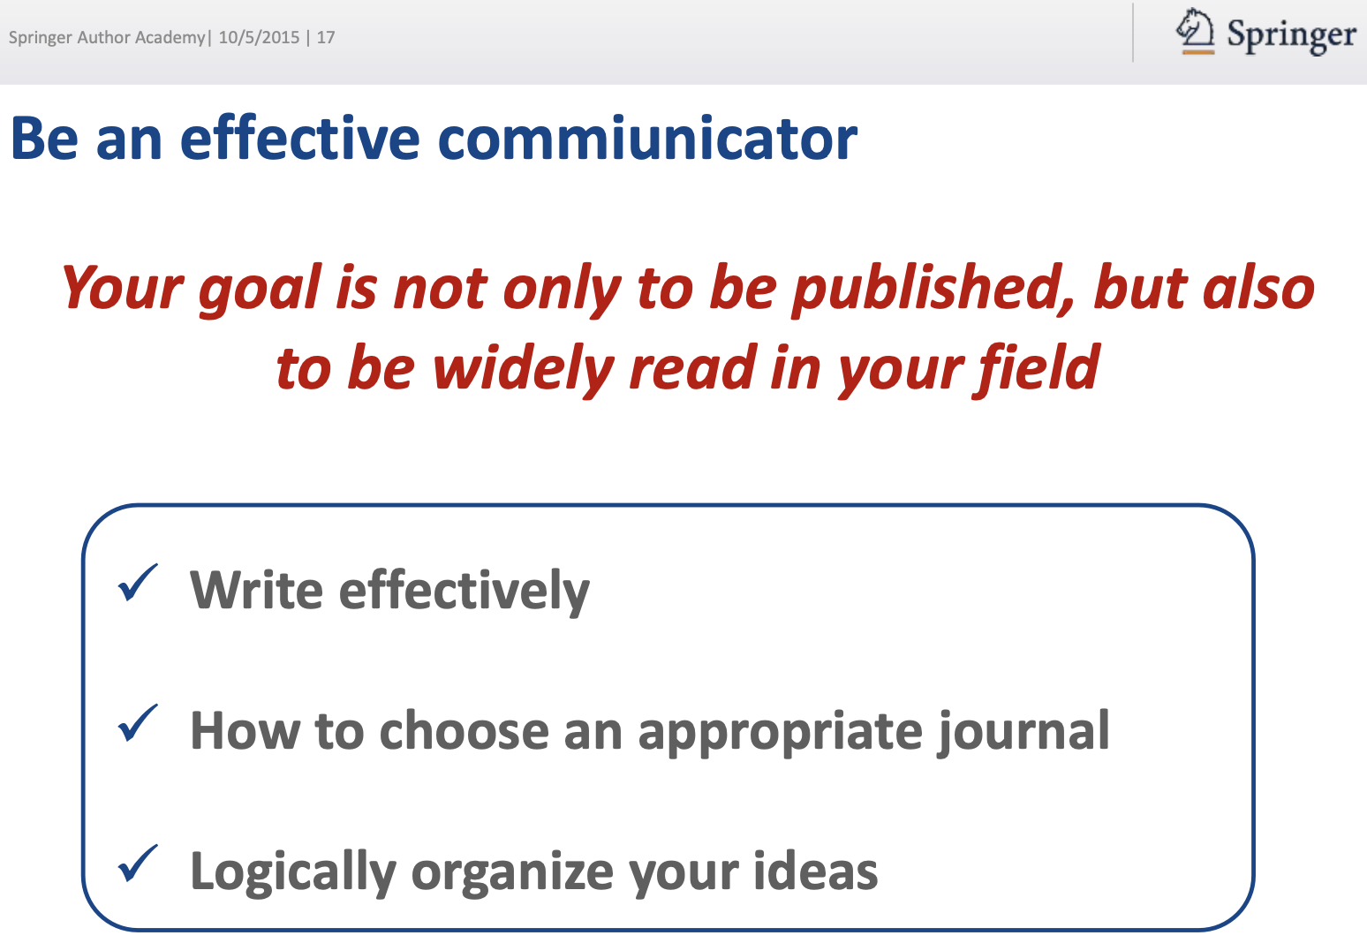

Slide 13

“INFORMATION SYSTEMS”
Information Systems, Information Management, Management Information Systems

Slide 14
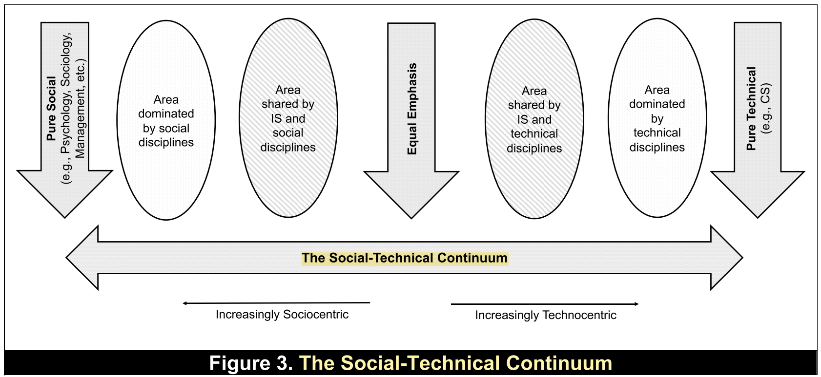
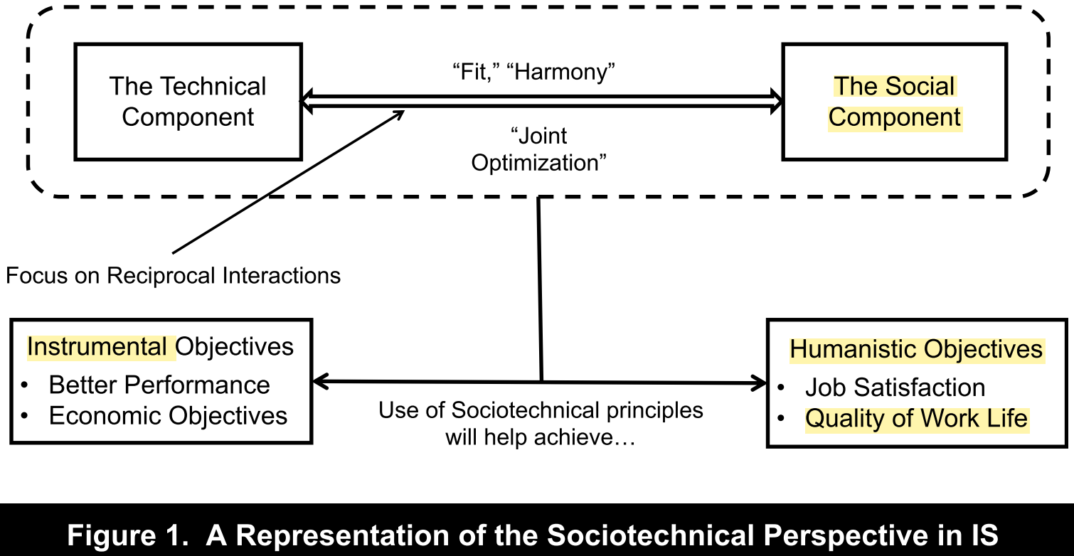
The Sociotechnical for the IS Discipline (Suprateek, 2019)

Slide 15
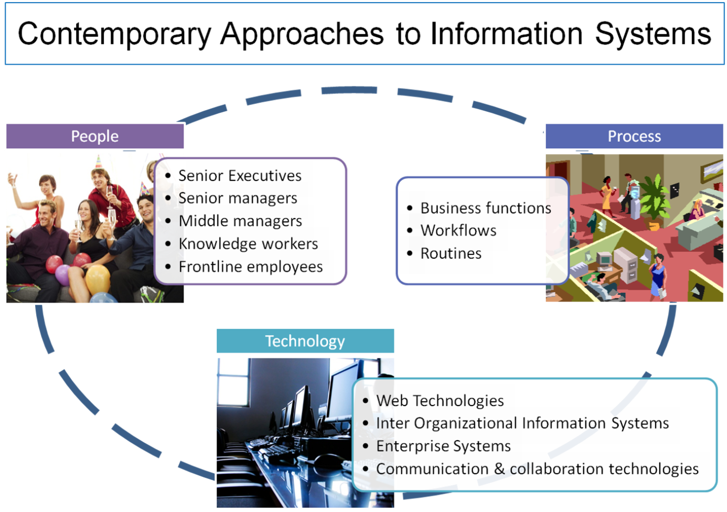

Slide 16
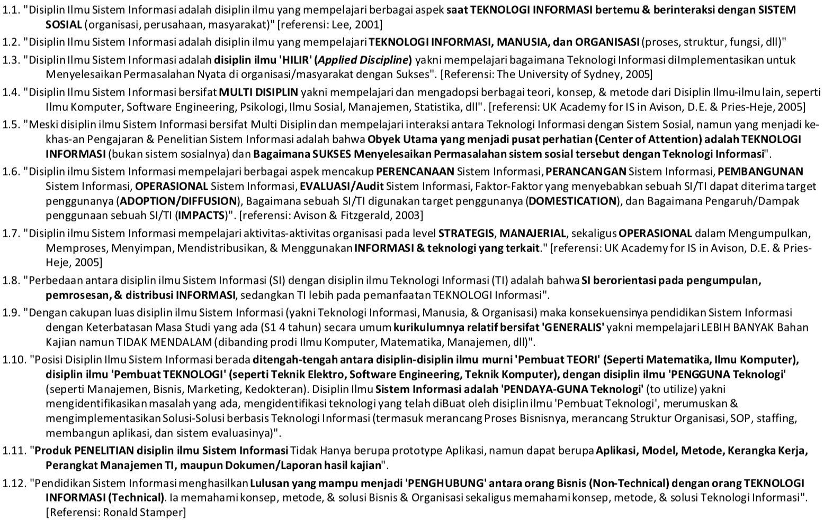
Forum SI Indonesia 2018 (AISINDO-APTIKOM)

Slide 17
Menulis = Membaca

Slide 18
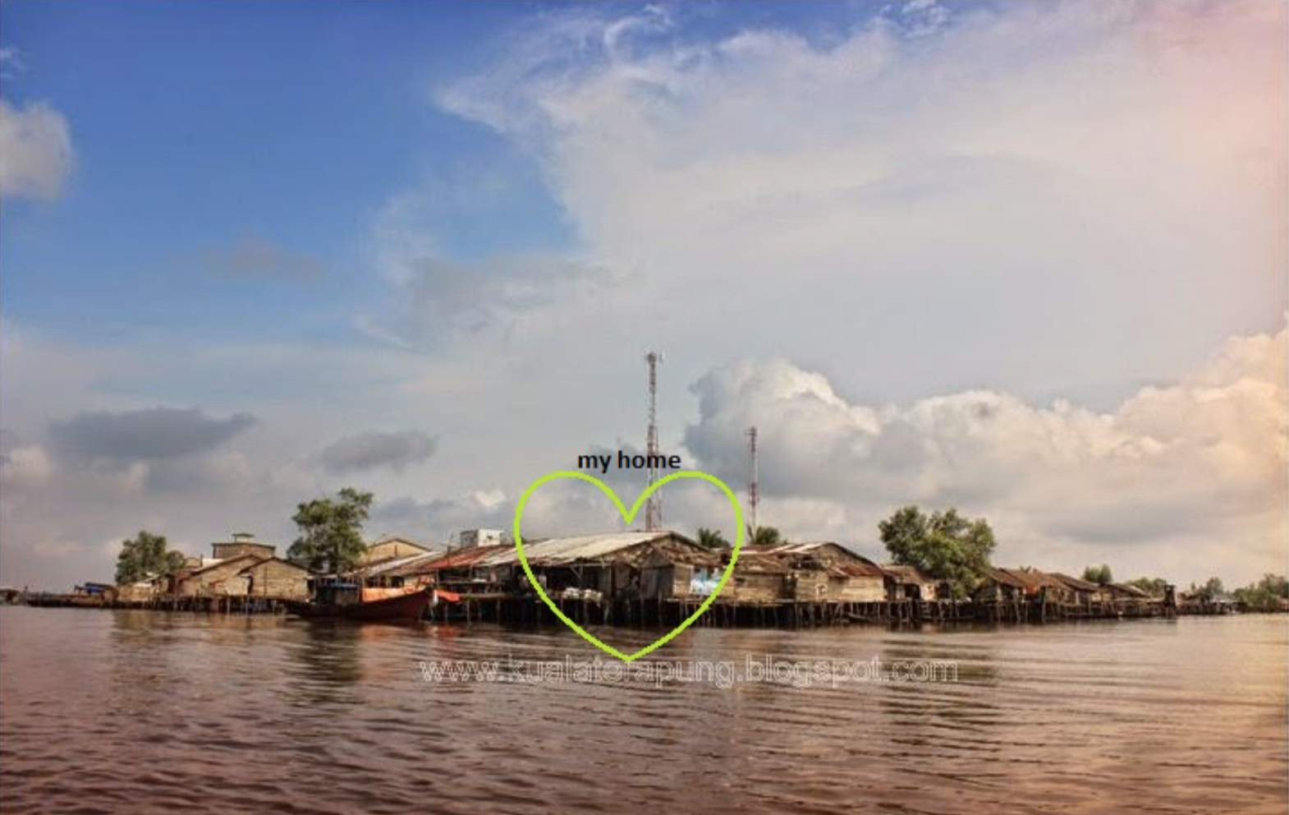
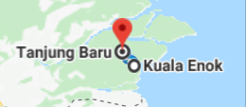

Slide 19
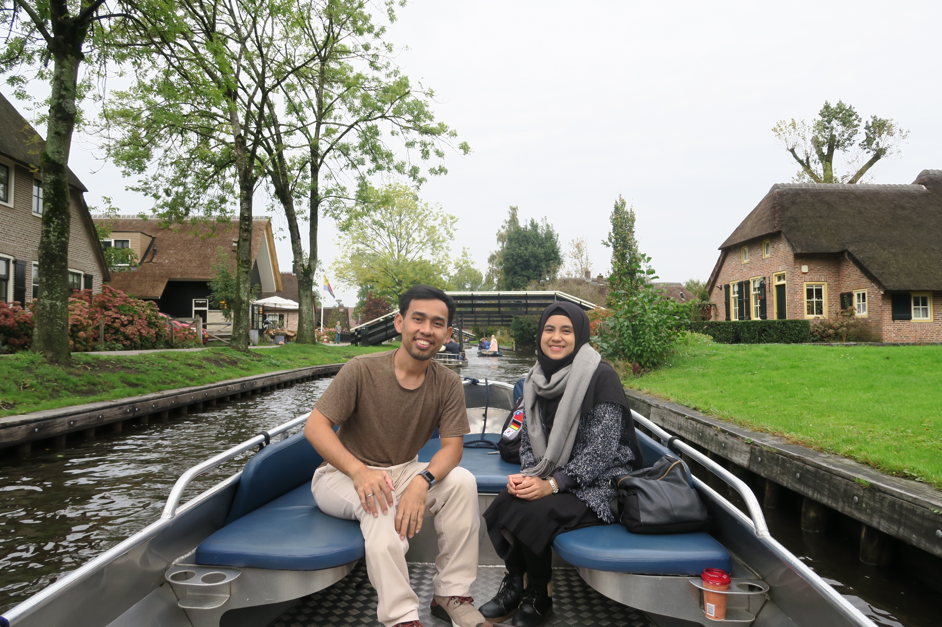

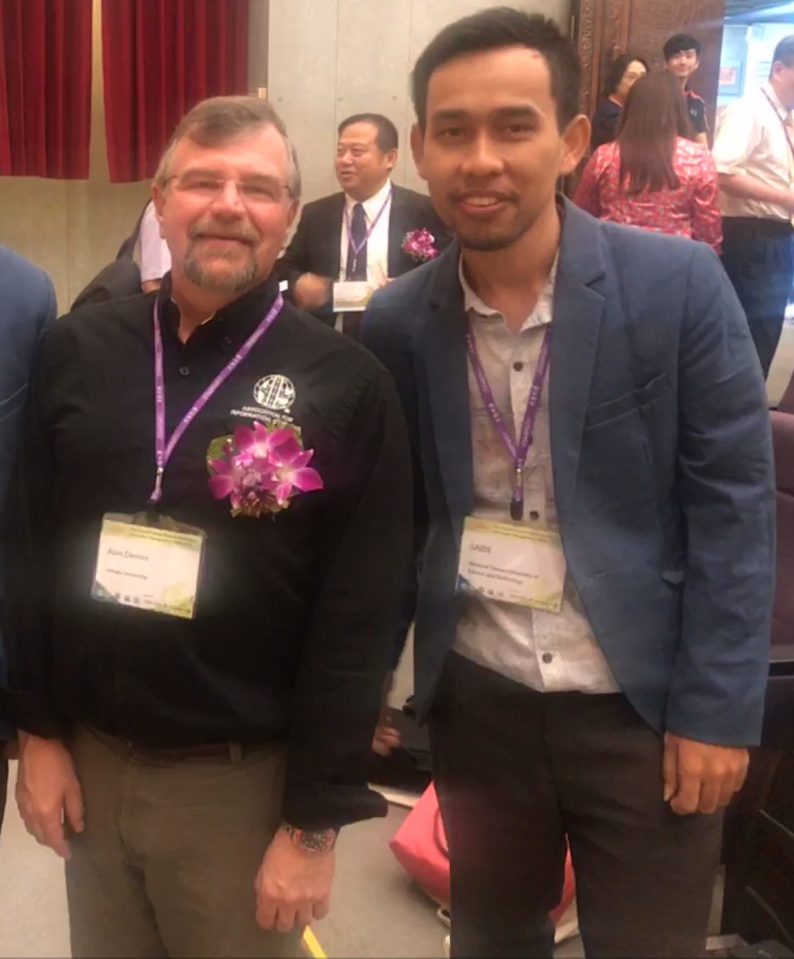
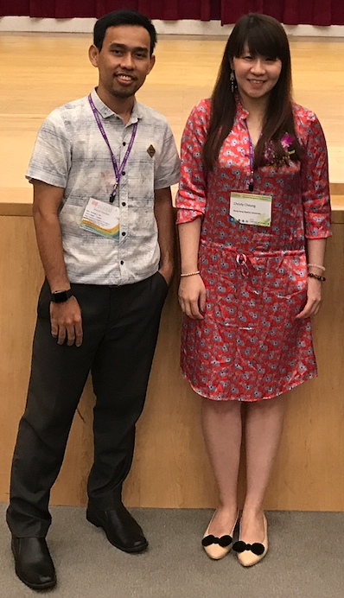
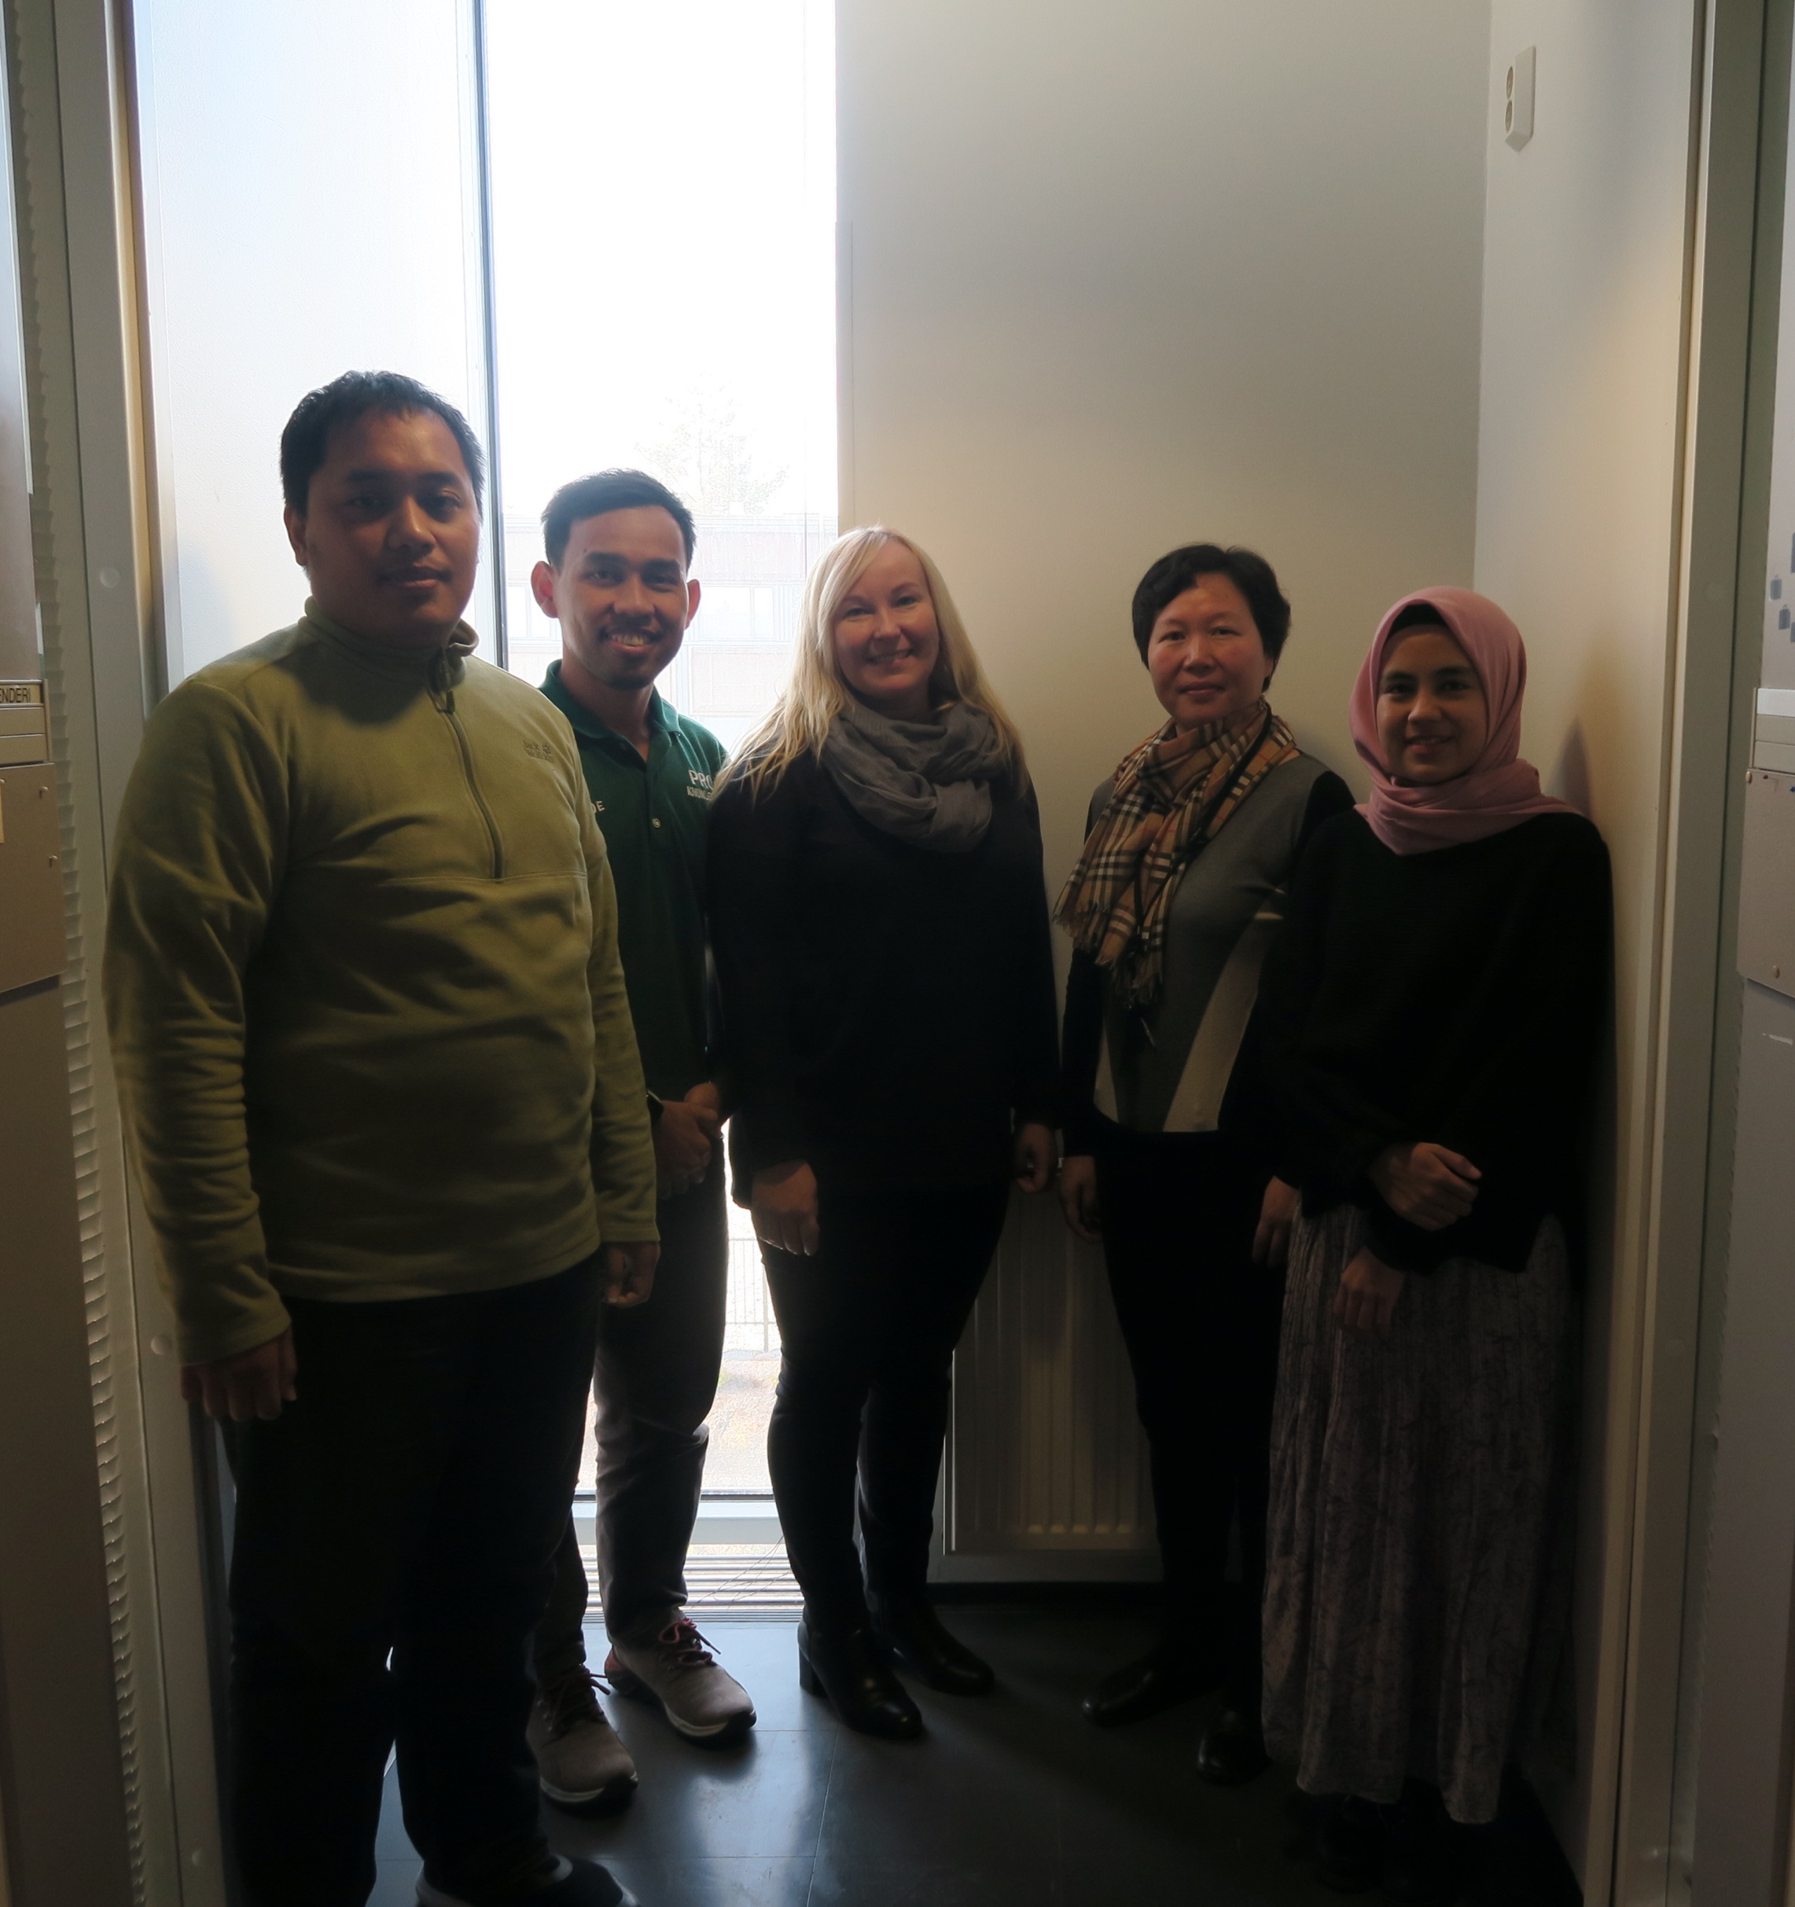
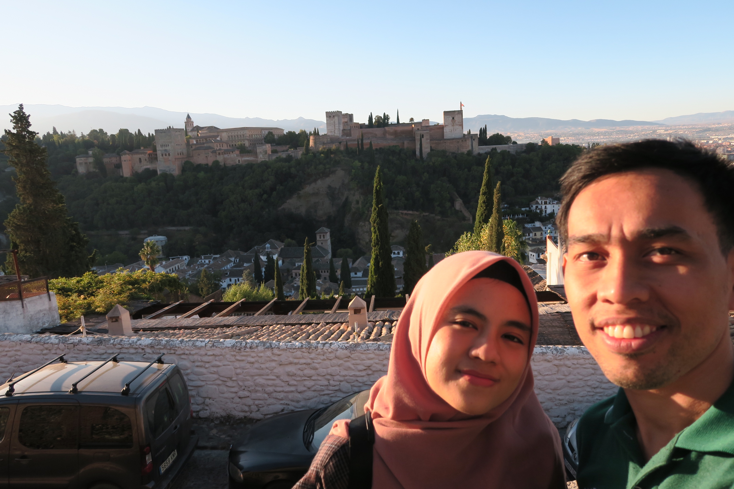

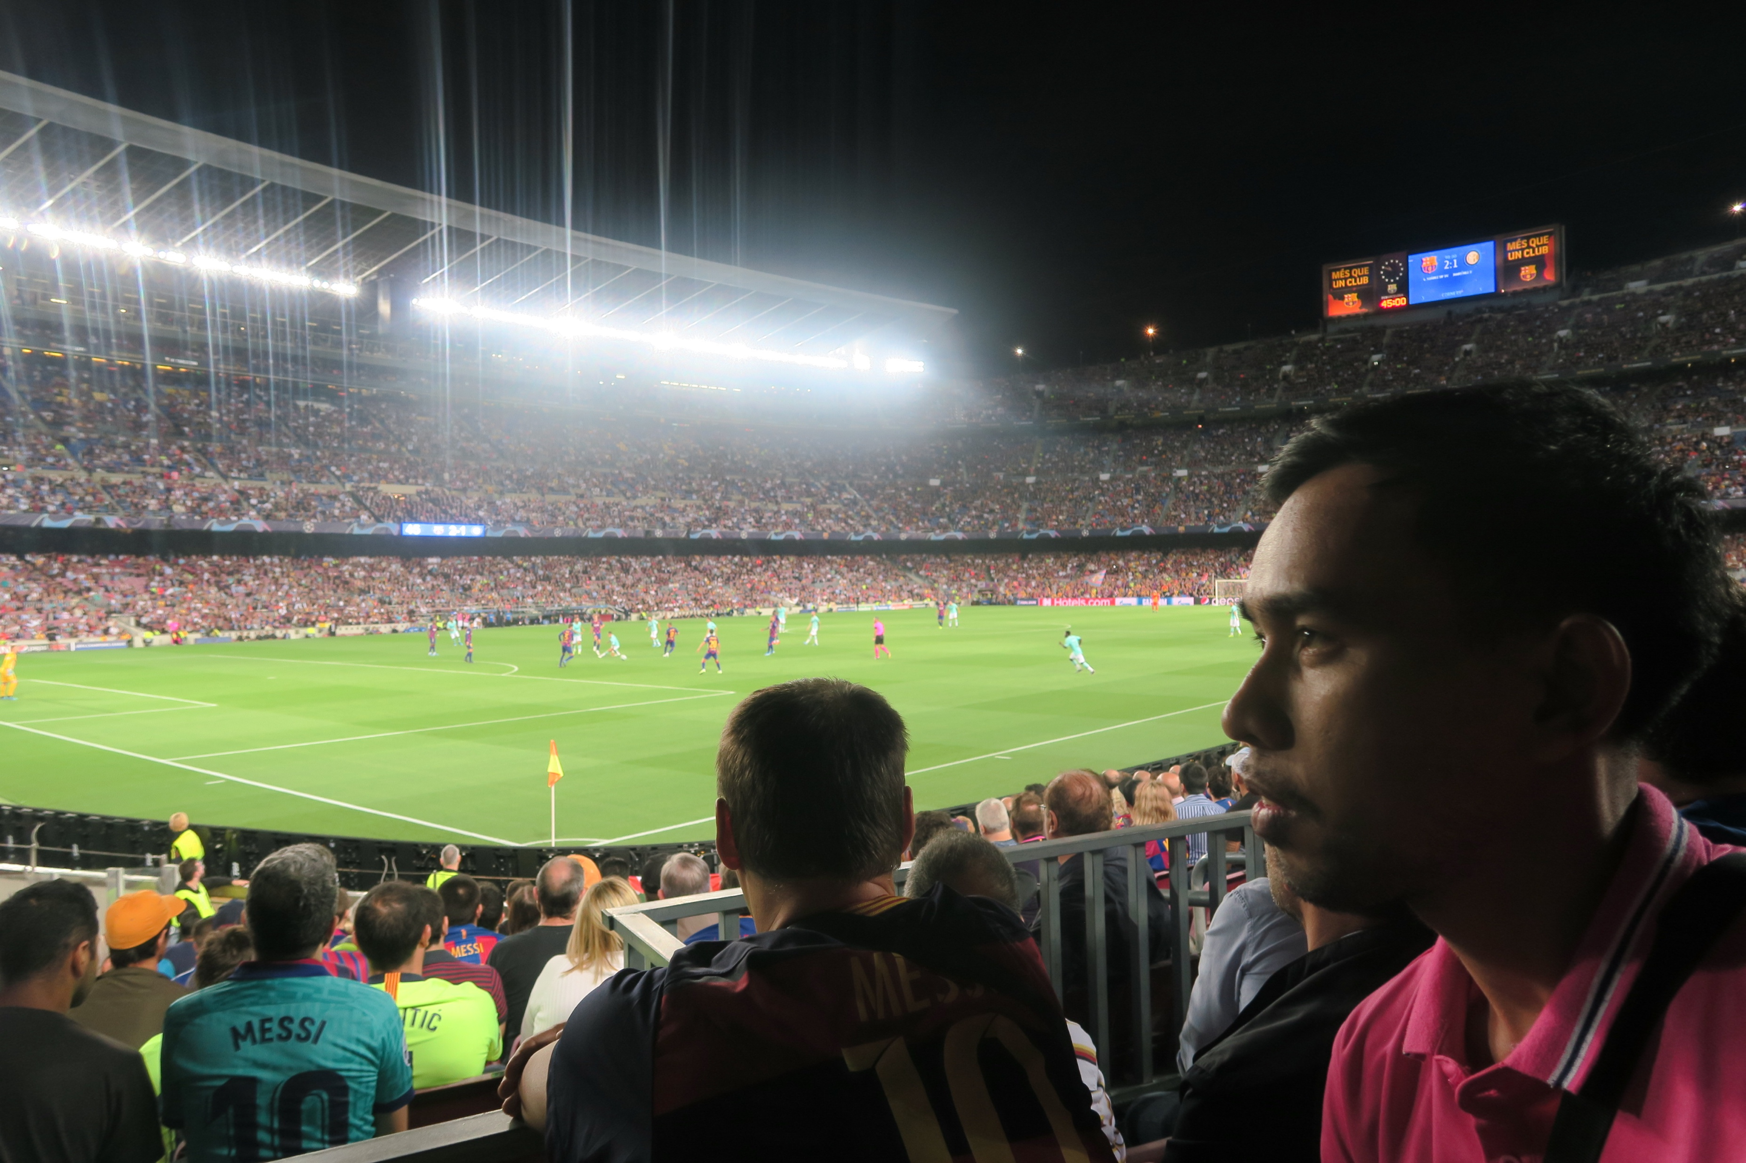



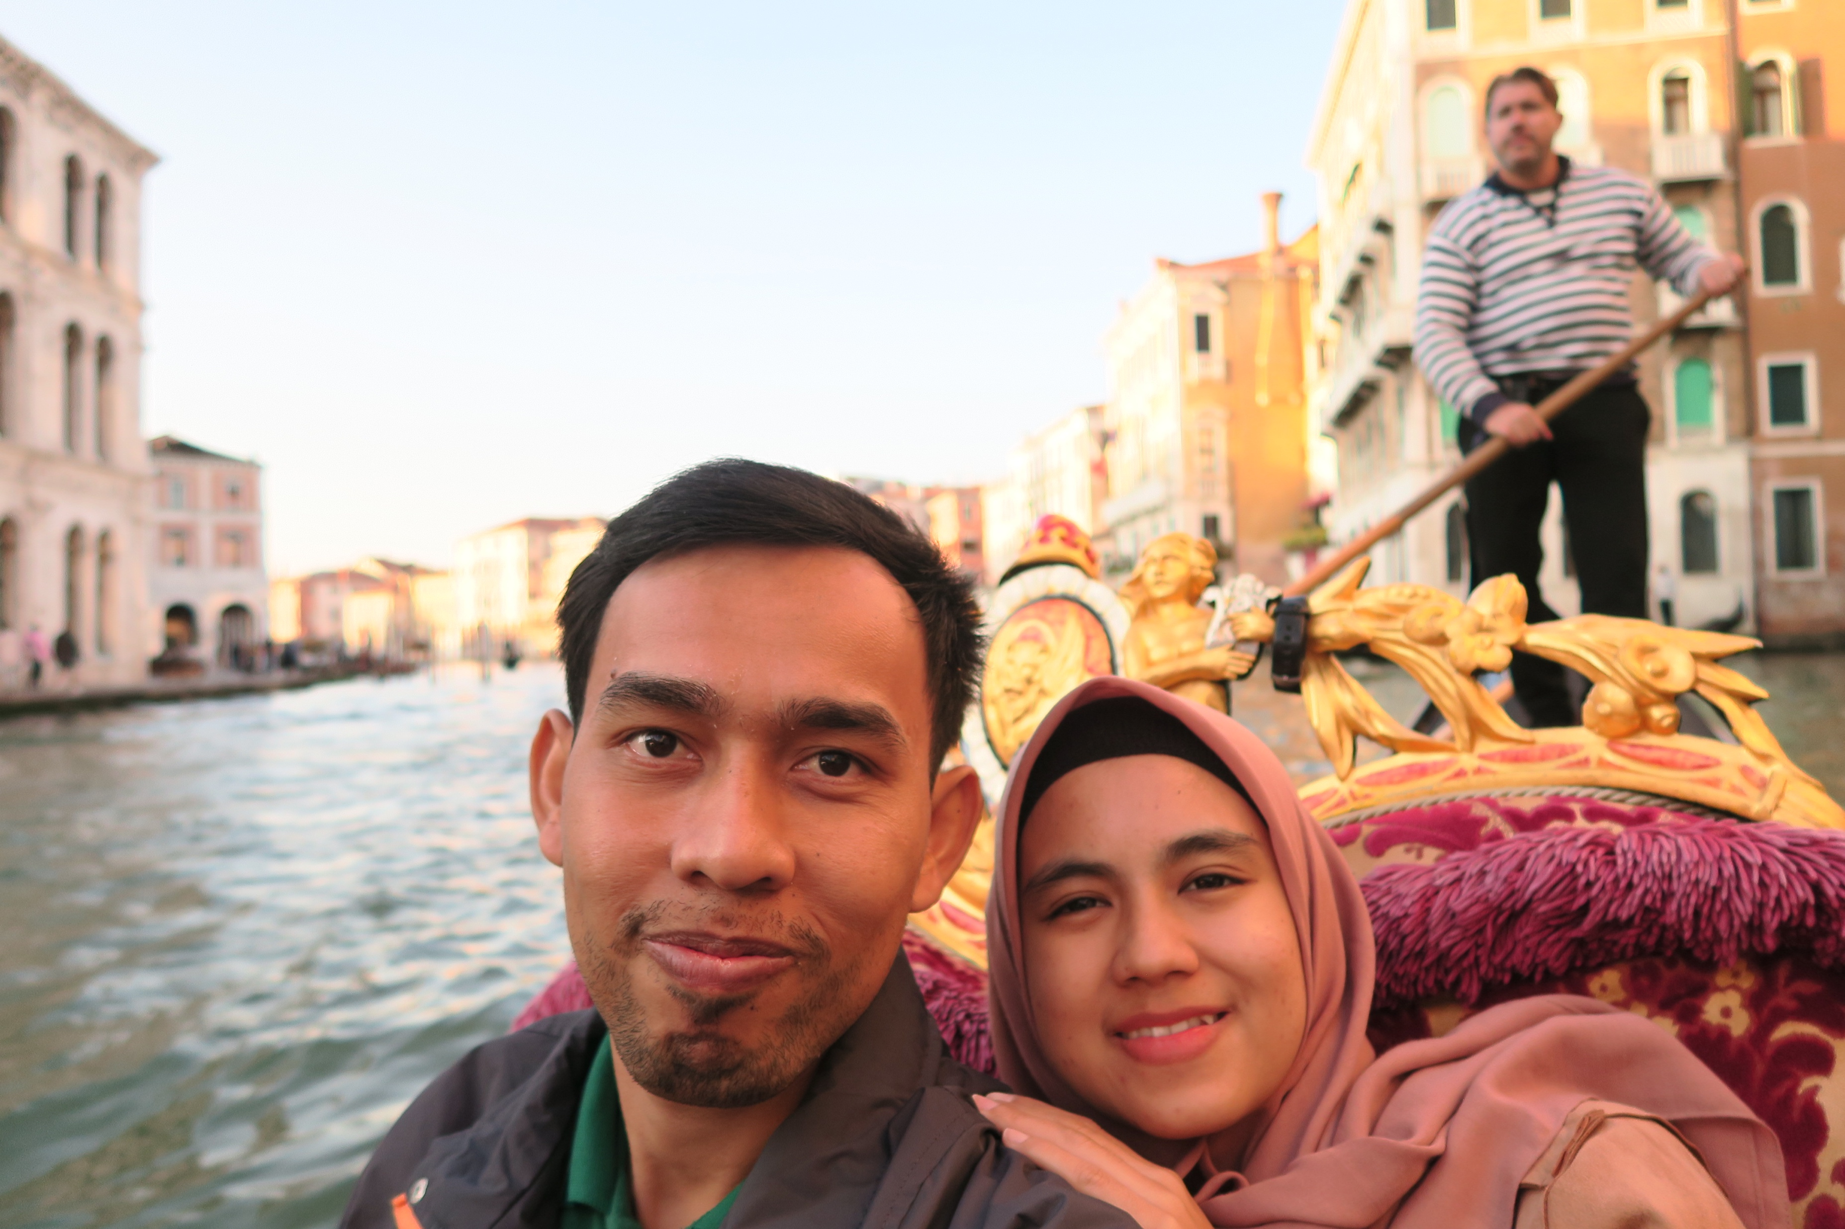
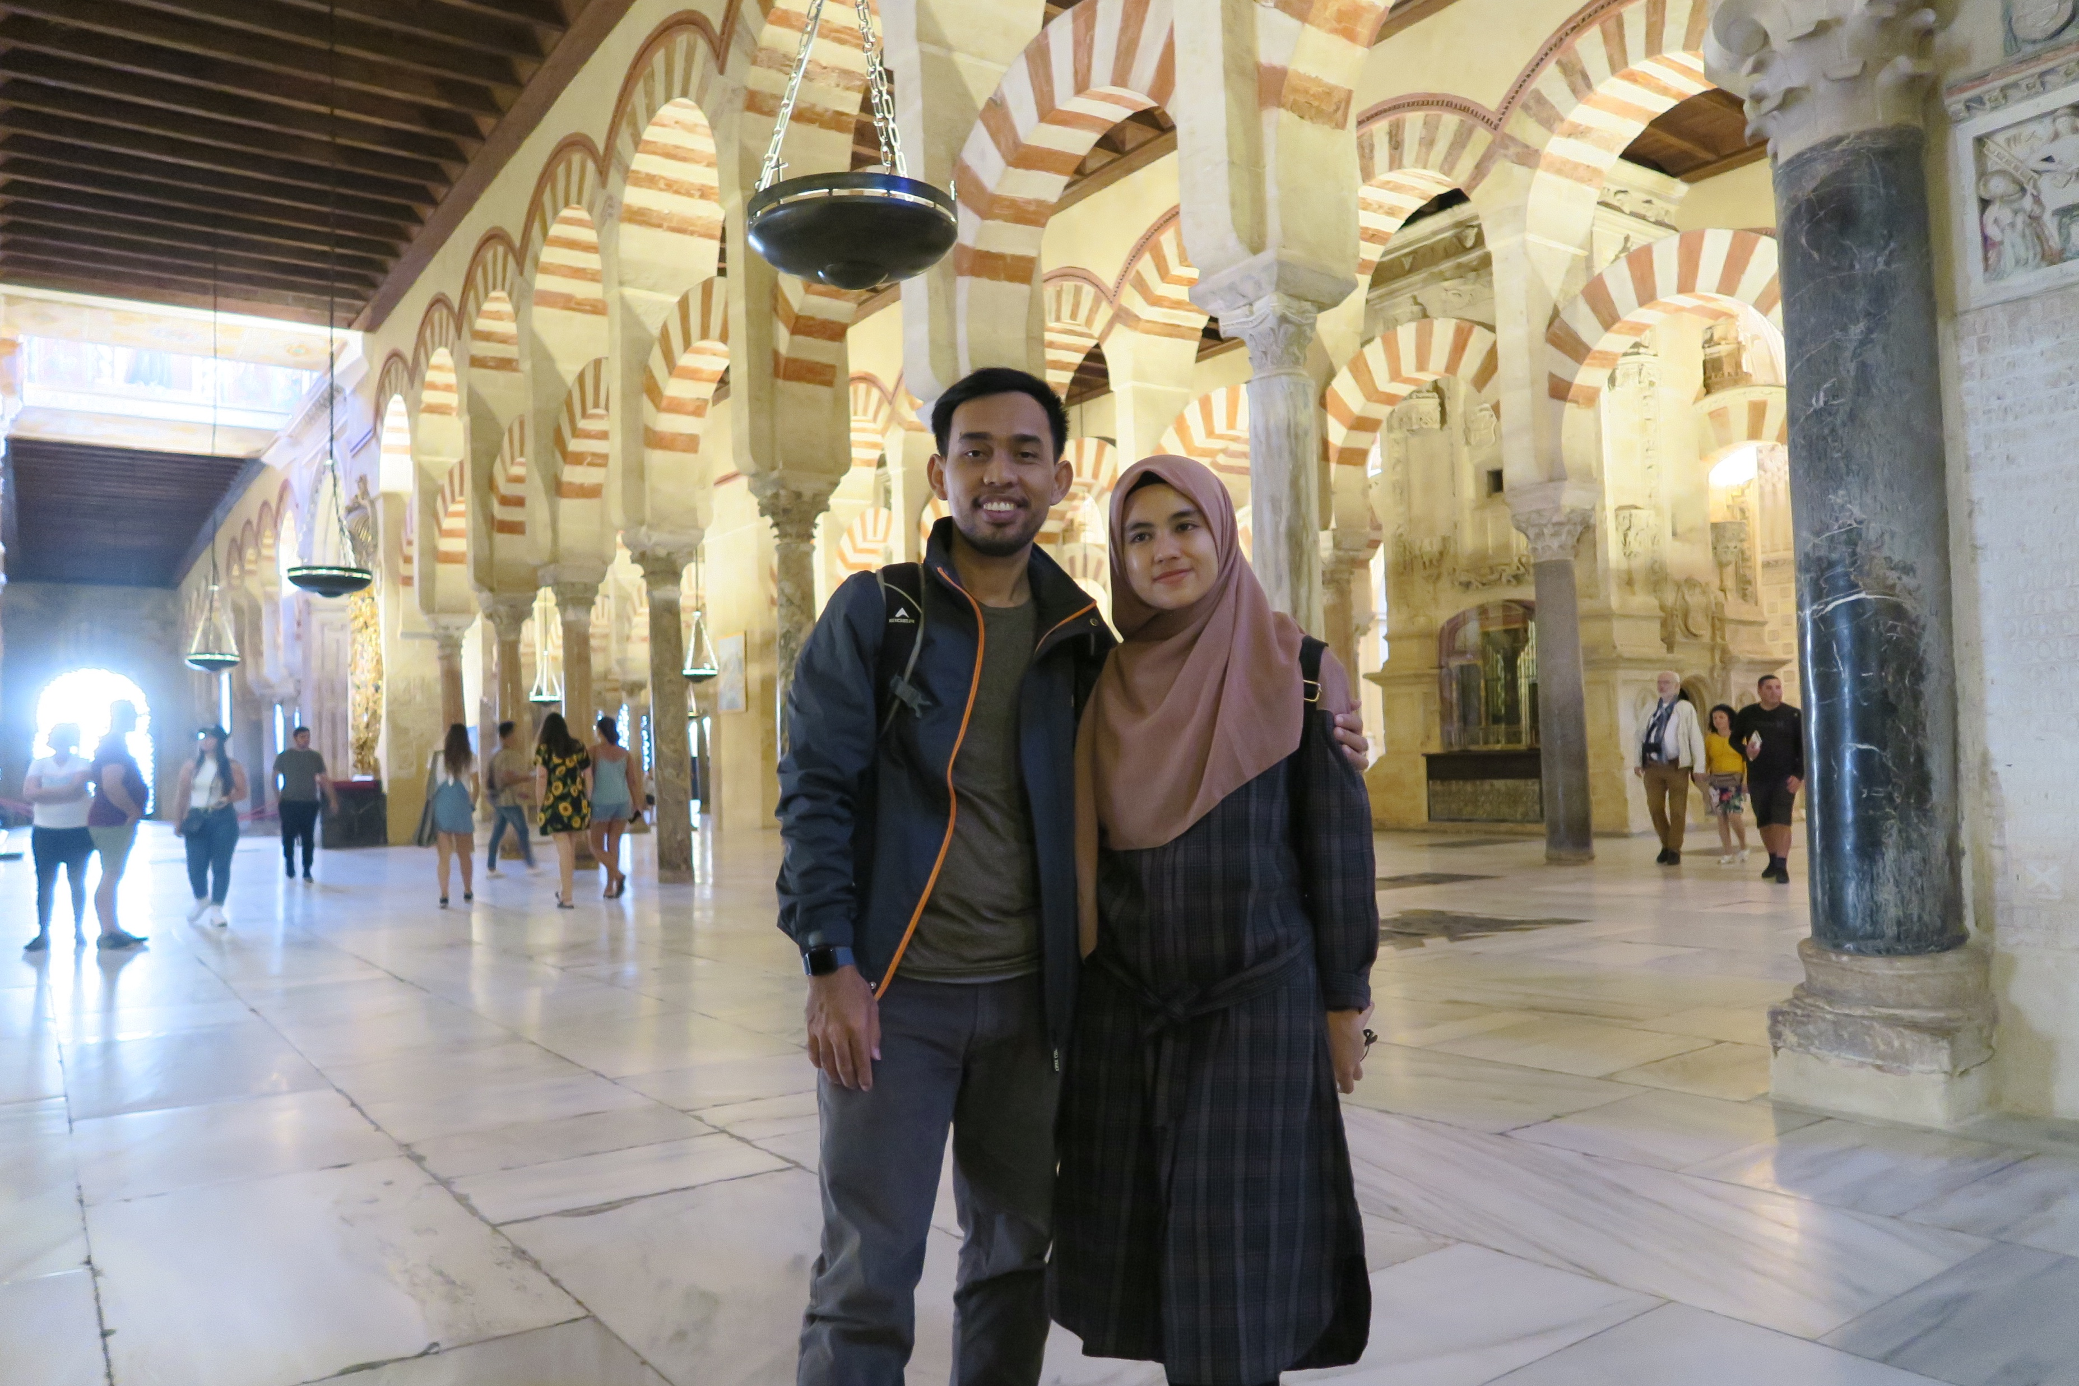
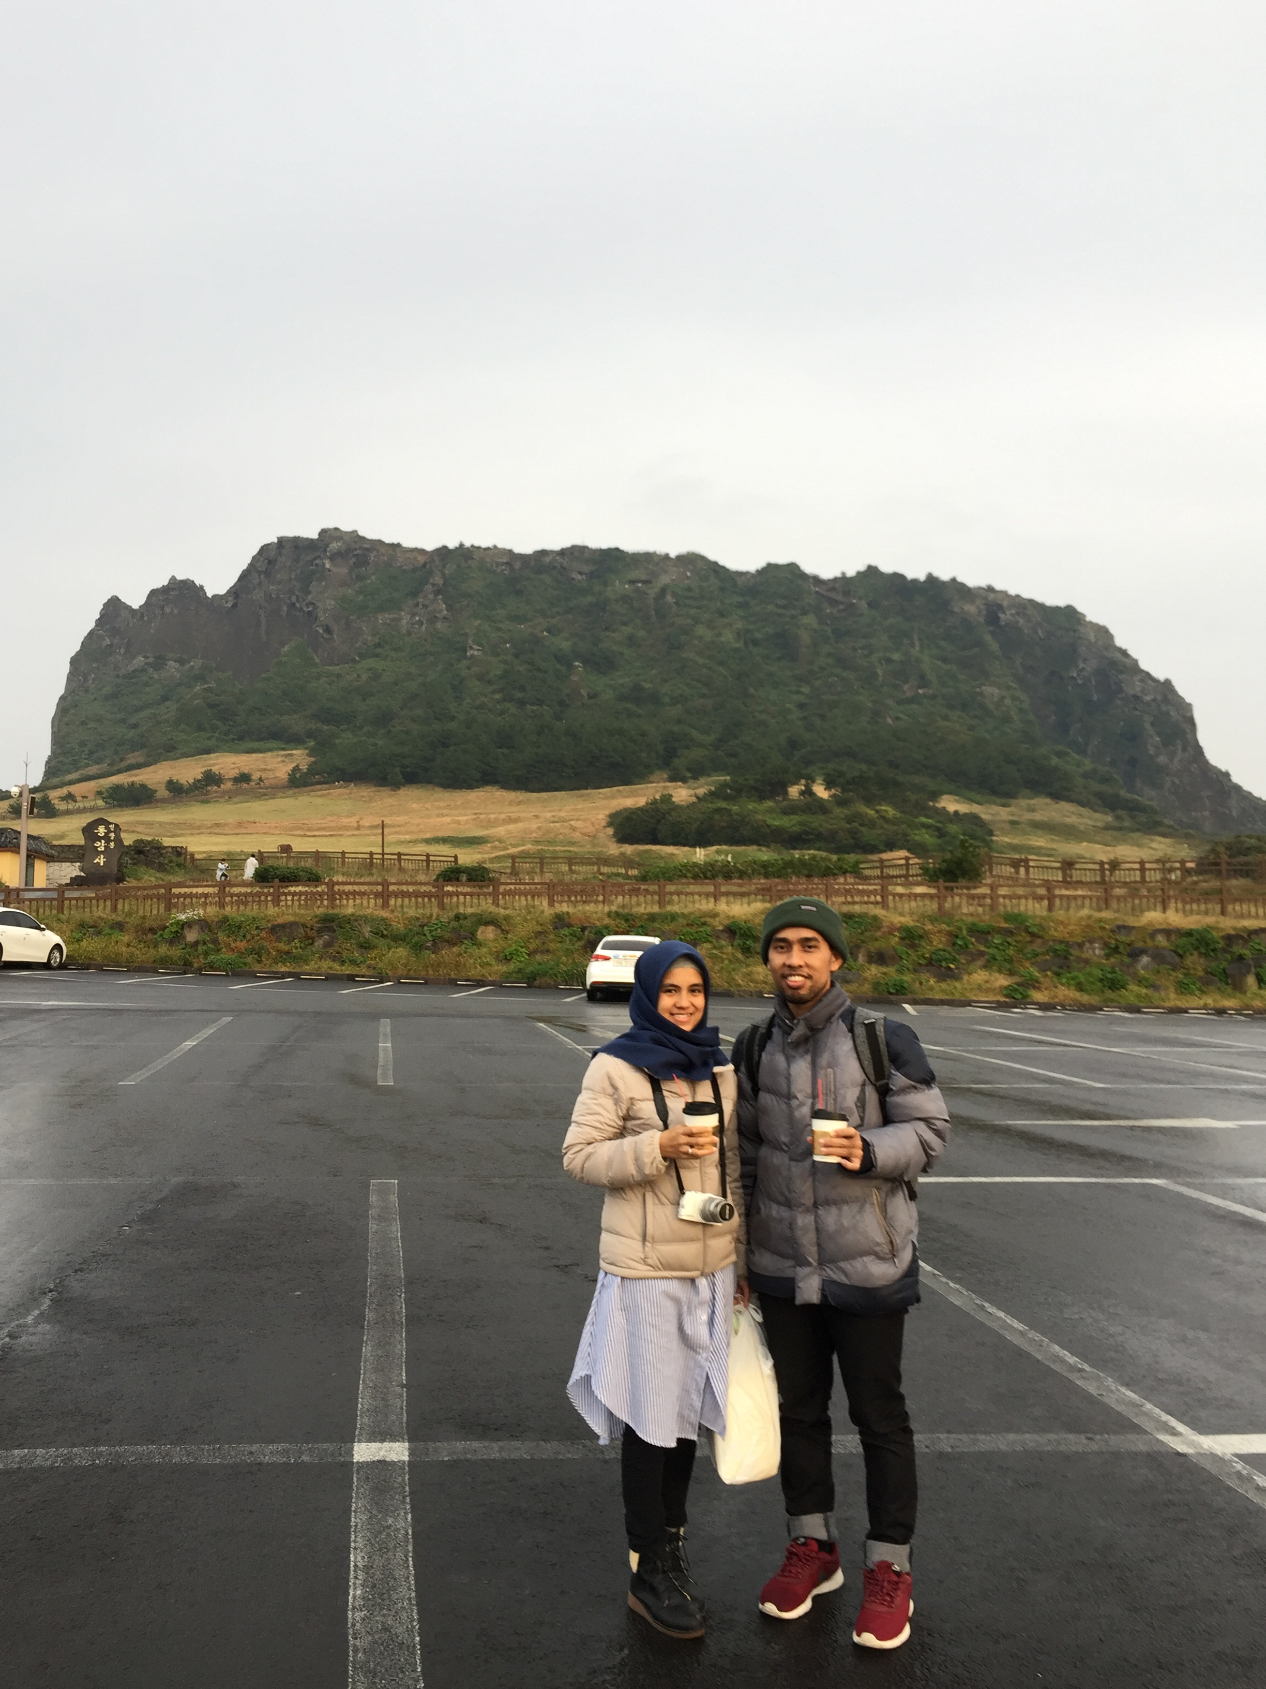
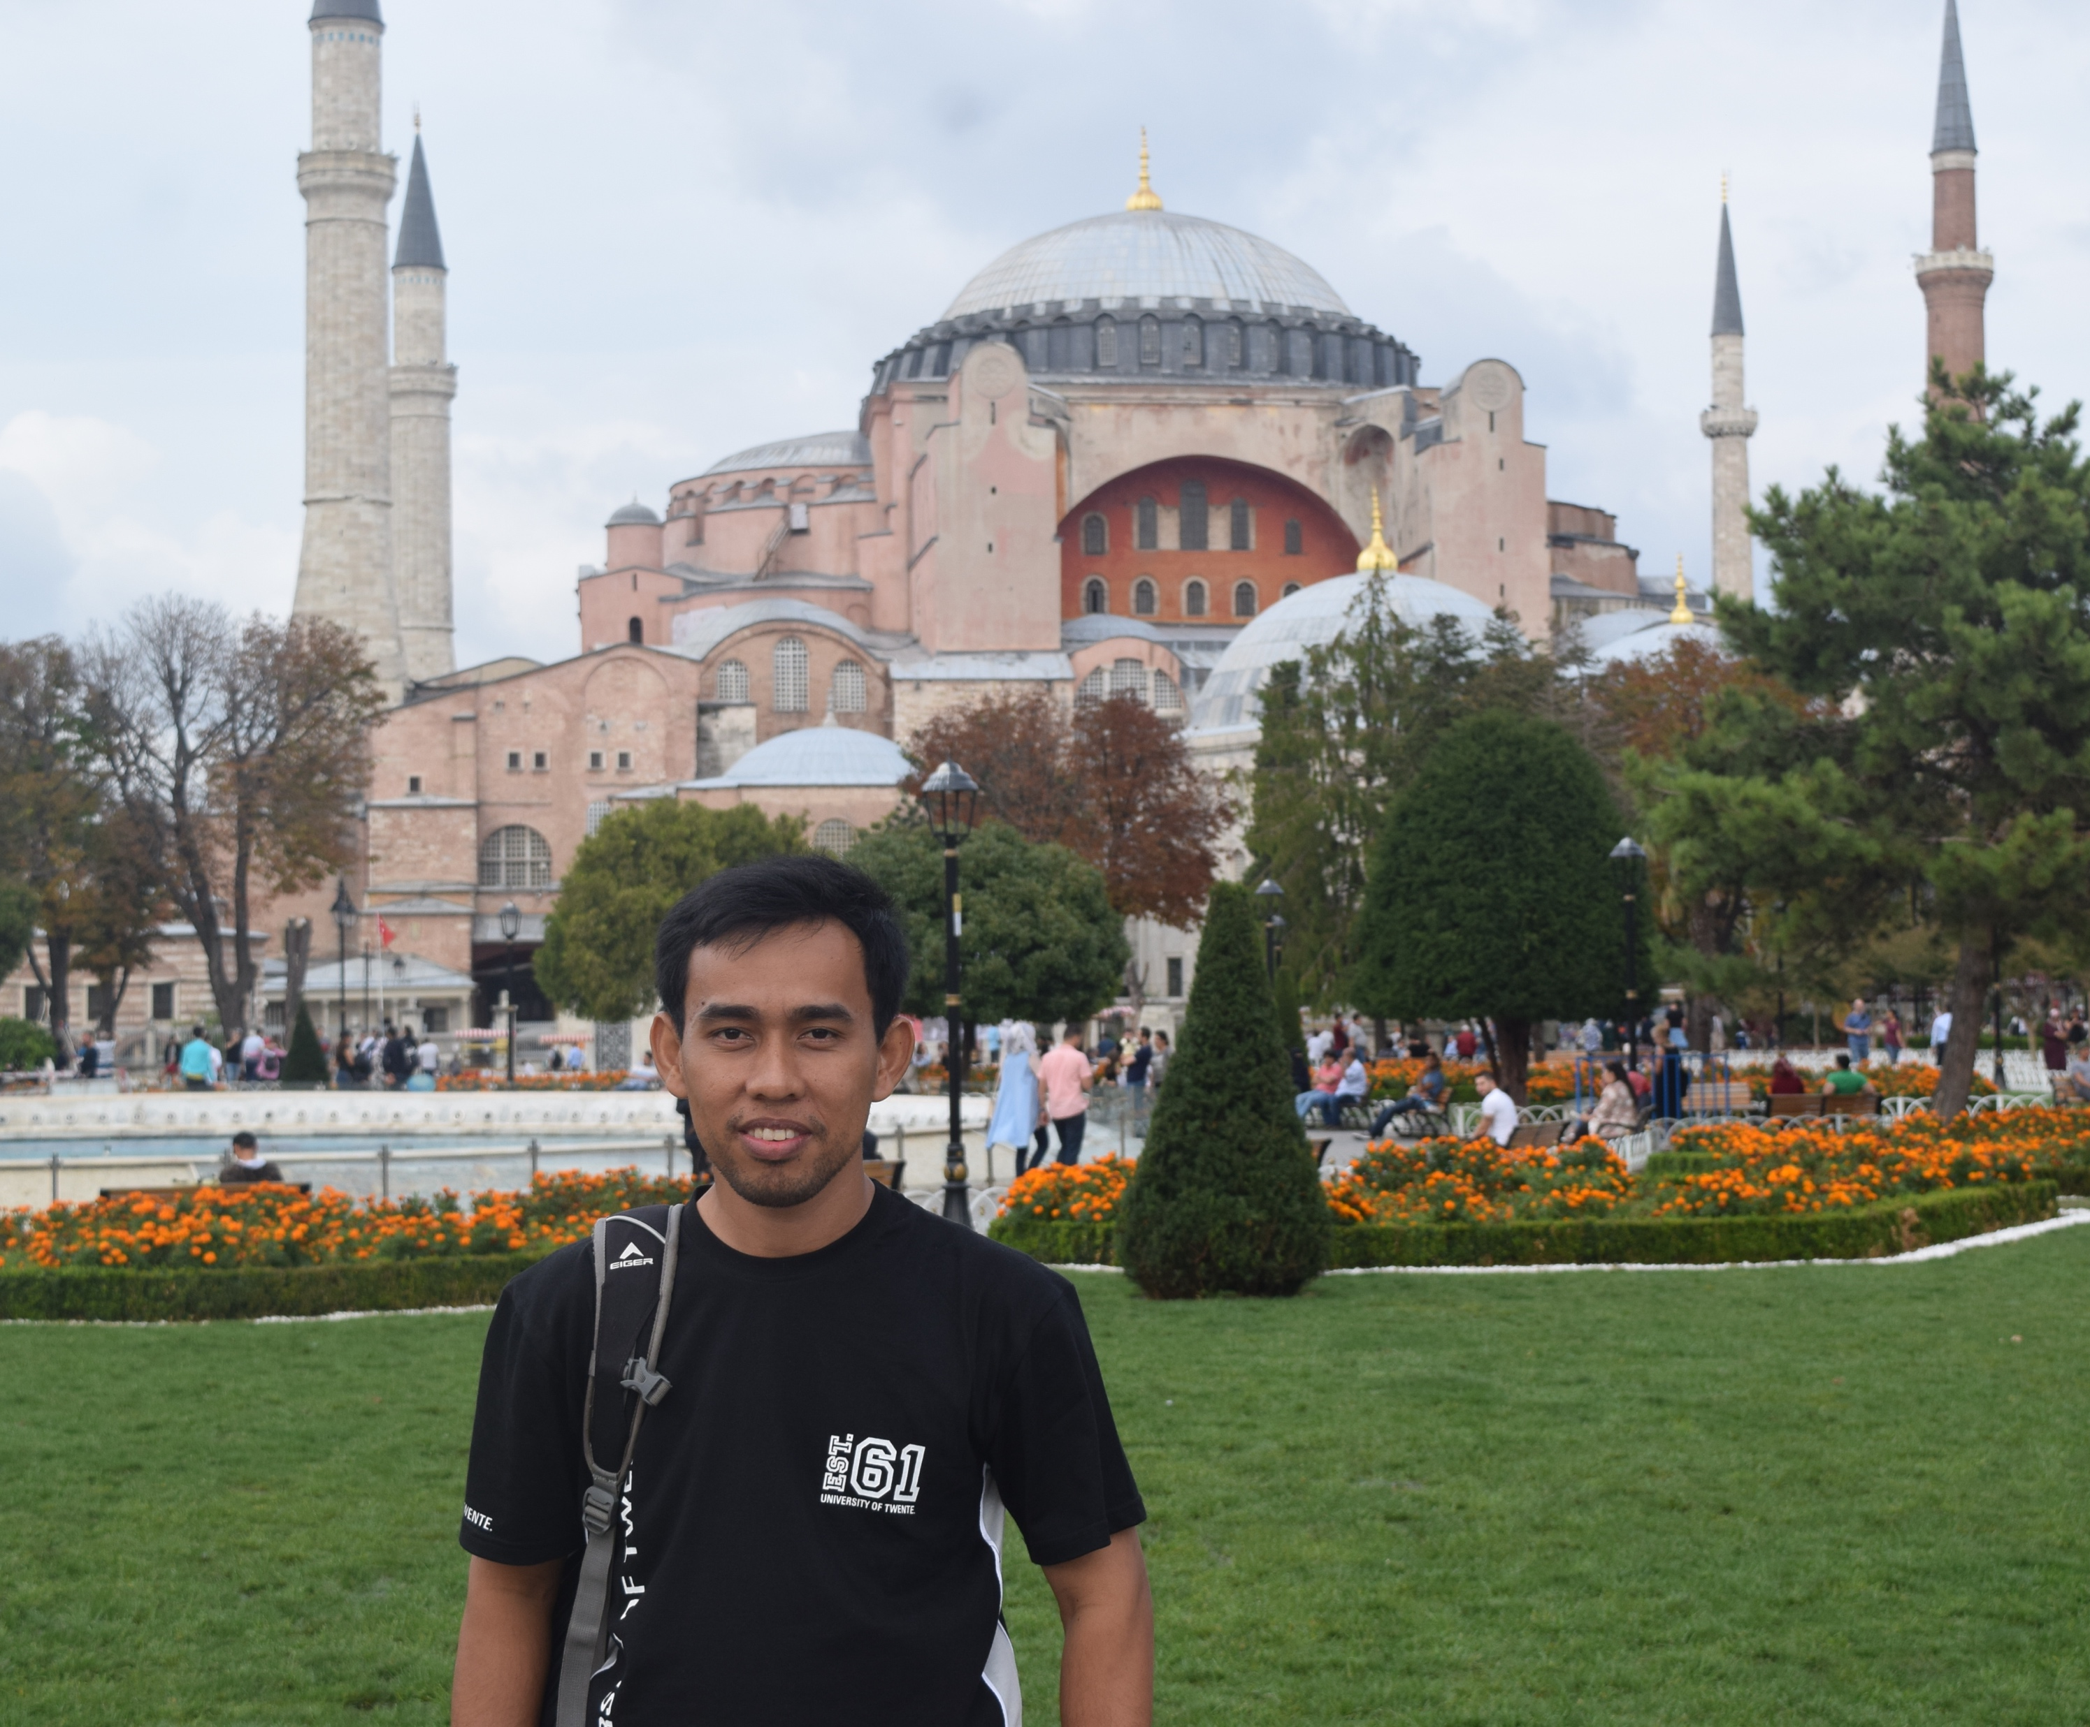
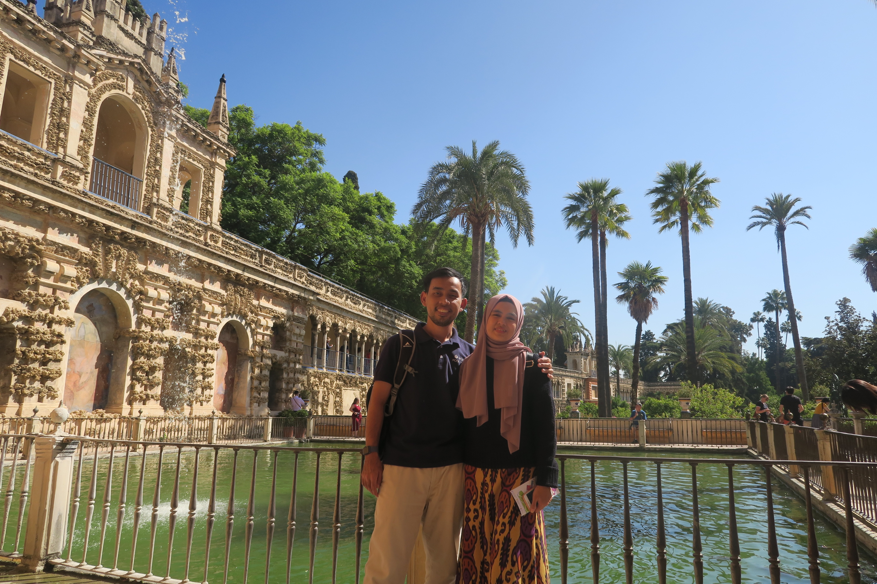



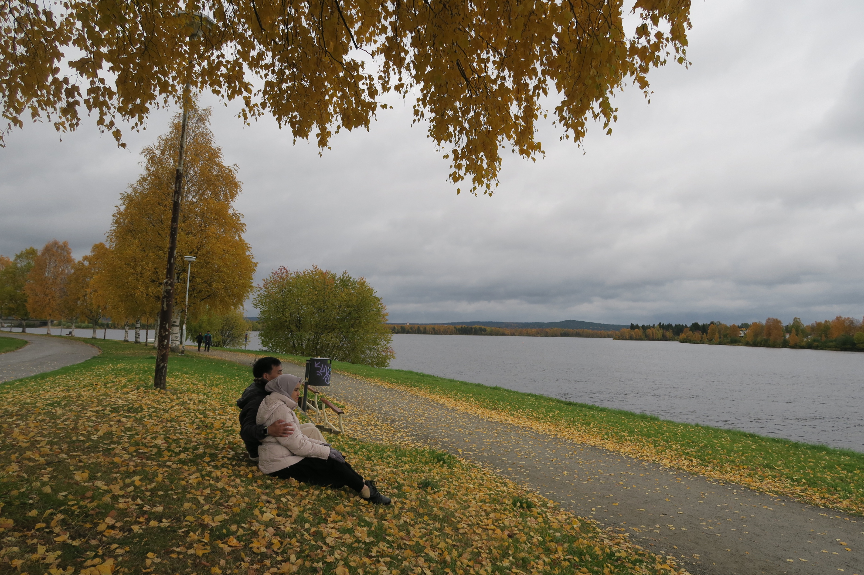

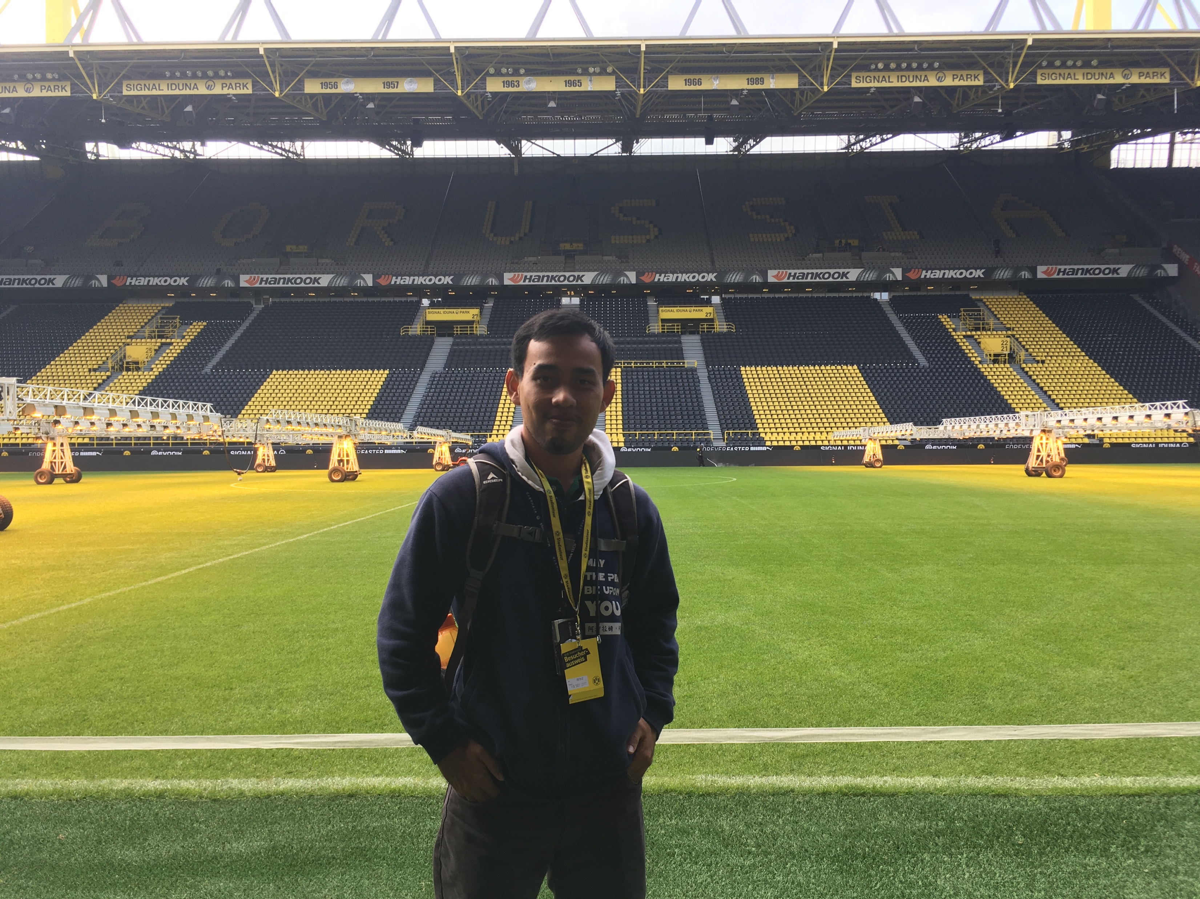
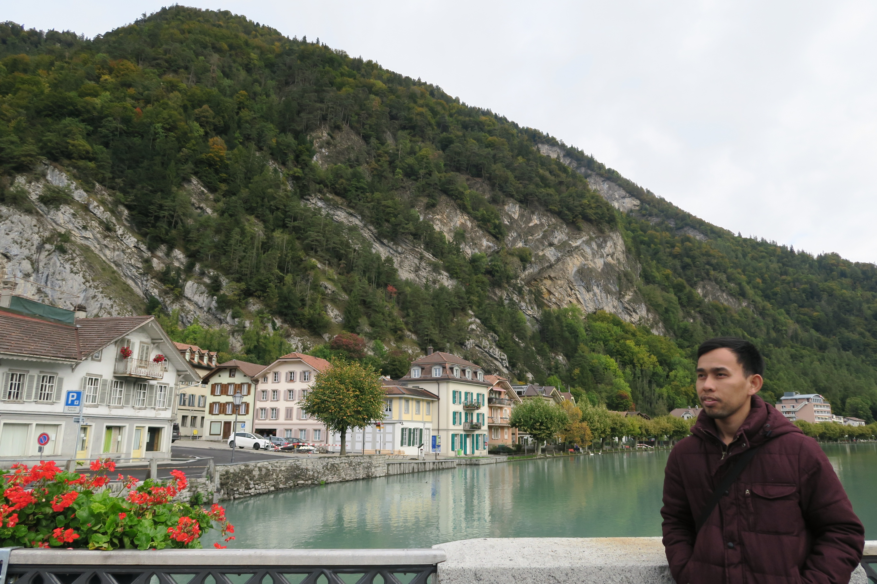

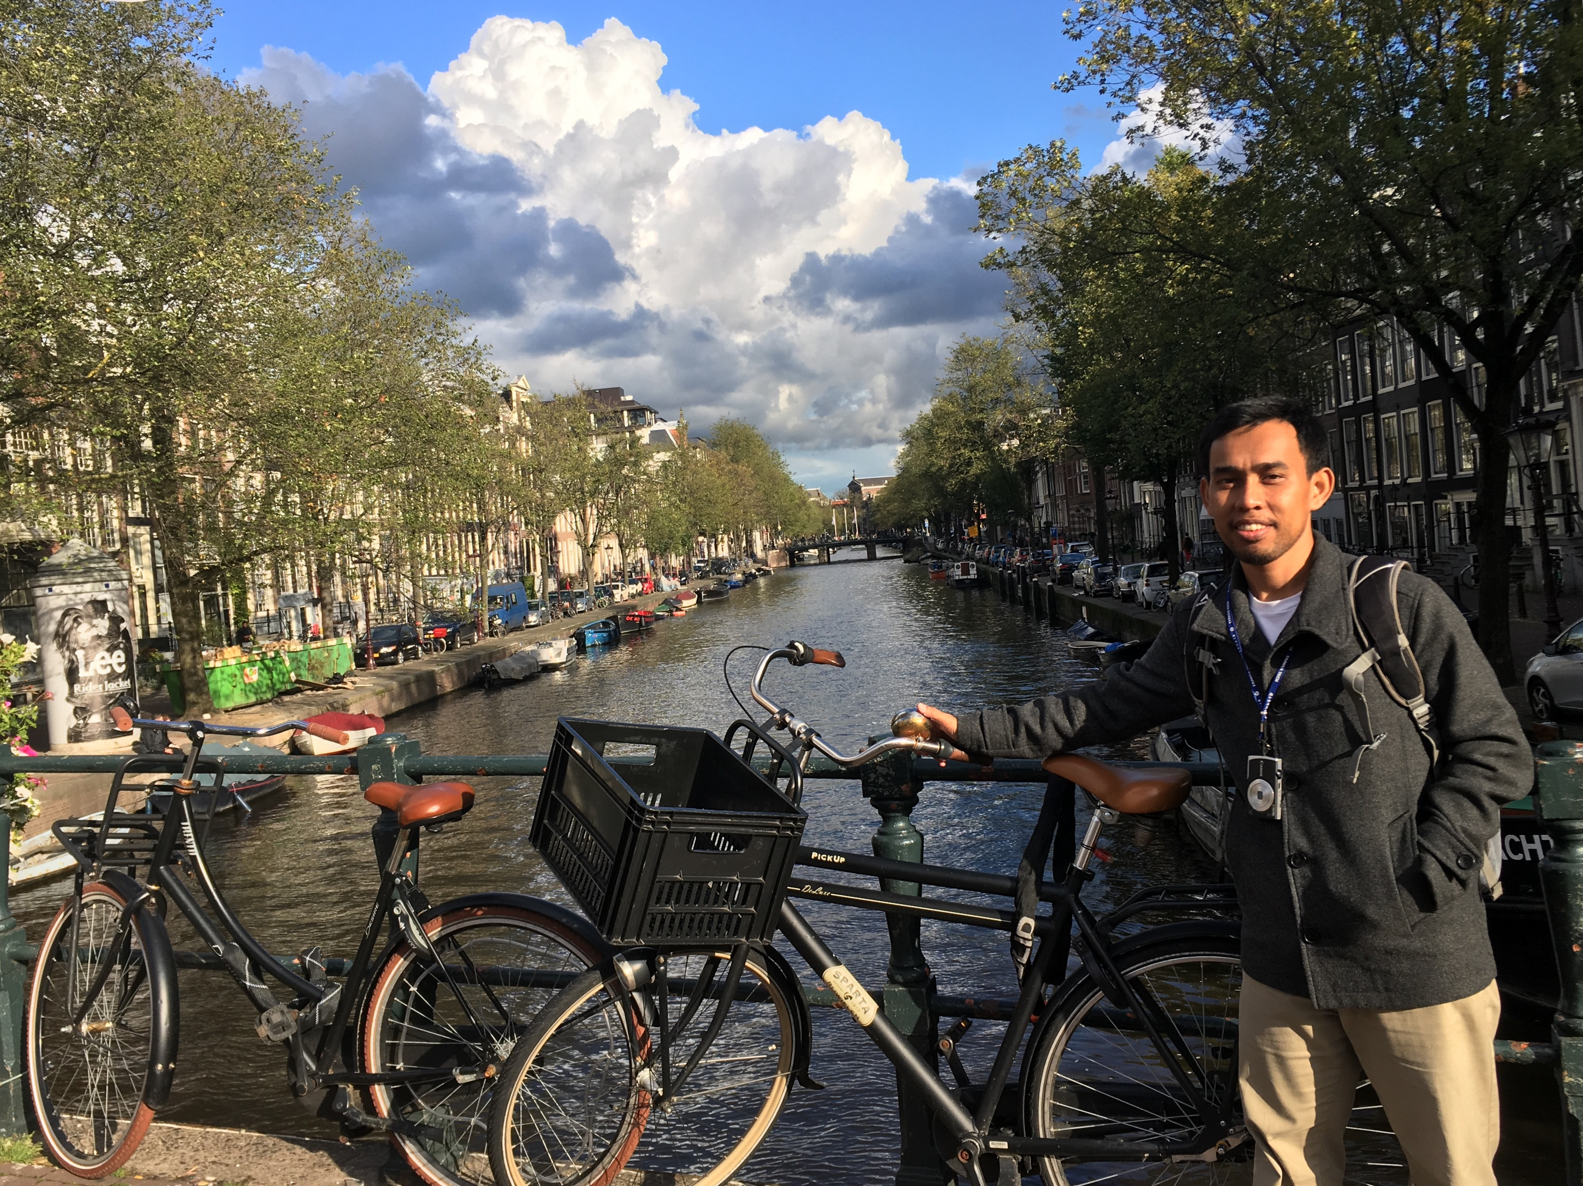

GARA-GARA ”MENULIS”

Slide 20
@ Copyright 2022
Disusun oleh:
Saide, S.Kom., M.Kom., M.I.M., Ph.D.
Ph.D. at Information Management, NTUST Taiwan
Lecturer at Dept. Information Systems, UIN SUSKA Riau.
Scholarship; LPDP, DIPA, Double Degree Master (ITS Surabaya & NTUST Taiwan), Taiwan`s scholarship, WTUN Grant Project (UK-Finland-Taiwan).
website: https://saide-sank.blogspot.com email: saide@uin-suska.ac.id youtube: saiderherza journal
Dokumen ini dan semua informasi yang terdapat didalamnya dilindungi hak cipta. Kecuali diijinkan oleh UU No. 28 Tahun 2014 tentang Hak Cipta, tidak ada bagian dari dokumen ini dapat direproduksi dengan cara apapun, tanpa izin tertulis dari penyusun. Isi dokumen ini sepenuhnya merupakan tanggungjawab penyusun.

