Slide 1
HOW TO RESPOND THE REVISIONS (BY ADVISOR, REVIEWER, EDITOR)
Saide
https://saide-sank.blogspot.com email: saide@uin-suska.ac.id youtube: saiderherza journal

Slide 2
Contents
CONCEPT:
WHAT IS RESEARCH.
WHAT IS INFORMATION SYSTEMS AND ITS FOUNDATION.
INFORMATION SYSTEMS (IS) RESEARCH.
ENGLISH FOR INFORMATION SYSTEMS.
WORLD’S INFORMATION SYSTEMS ORGANIZATIONS, &
IS JOURNALS, MAIN IS CONFERENCES, REFERENCES.
IS RESEARCH METHODS AND WRITING THE IDEA
IS FRAMEWORKS/THEORIES
CHOSING THE RIGHT IS JOURNAL FOR REFERENCES
RESEARCH GAPS
BACKGROUND/INTRODUCTION
HYPOTHESIS (DEVELOPMENT & HOW TO WRITE IT CORRECTLY)
METHODS
WRITING THE STATISTICS RESULTS
DISCUSSIONS (CONTRIBUTION TO KNOWLEDGE AND MANAGERIAL)
ABSTRACT
HOW TO RESPOND THE REVISIONS (BY ADVISOR, REVIEWER/EDITOR)
TECHNICAL & PROJECTS:
GROUP PROJECTS: - REVIEWING ARTICLES
- WRITING RESEARCH PROPOSAL/SHORT ARTICLE
- PRESENTING YOUR PROJECT (ALL MEMBERS MUST PRESENTS)
PERSONAL EXPERIENCE IN PUBLICATIONS

Slide 3
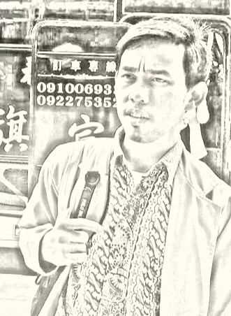
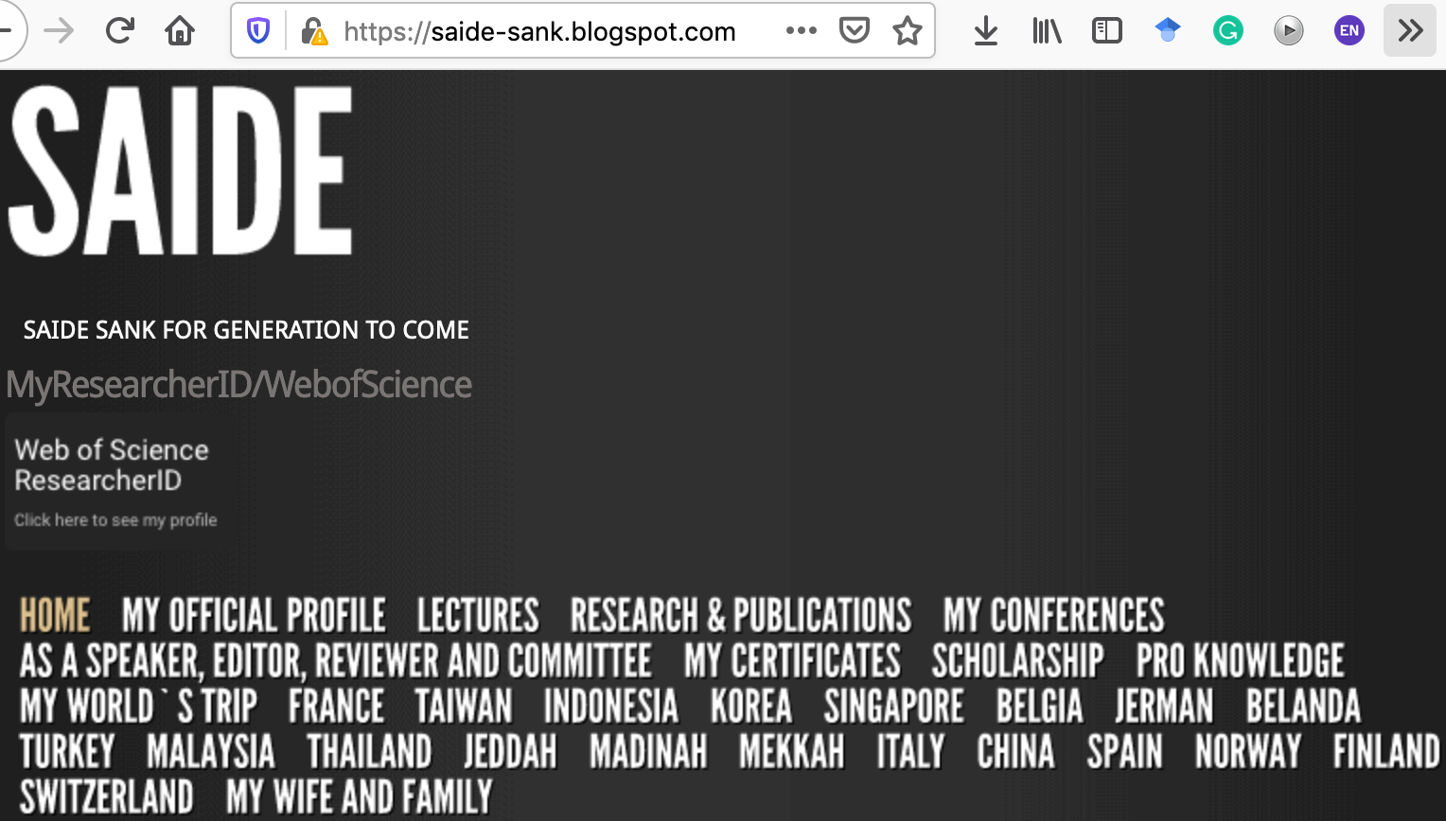
ABOUT ME
Researcher ID/Publons: H-2399-2018
Orcid ID: 0000-0002-1866-5305
Website: https://saide-sank.blogspot.com
S.Kom di UIN Suska Riau (2009-2013)
M.Kom di ITS Surabaya (2014-2016)
M.I.M di NTUST Taiwan (2014-2016)
Lecturer: Information System, UIN SUSKA Riau
Research: Knowledge Management, Information System, Business-IT alignment.
Chief Knowledge Officer: Pro-Knowledge Research Group
Project Management: Energy Research Centre (EnReach.or.id)
Ph.D. candidate: Information Management, NTUST Taiwan

Slide 4
HOW TO RESPOND THE REVISIONS (BY ADVISOR, REVIEWER, EDITOR)

Slide 5

Merespon Revisi dari Pembimbing/Reviewer/Editor
(Ref: MIS Quarterly Workshop: MIS Quarterly Vol. 43 No. 3 pp. iii-viii/September 2019)

Slide 6
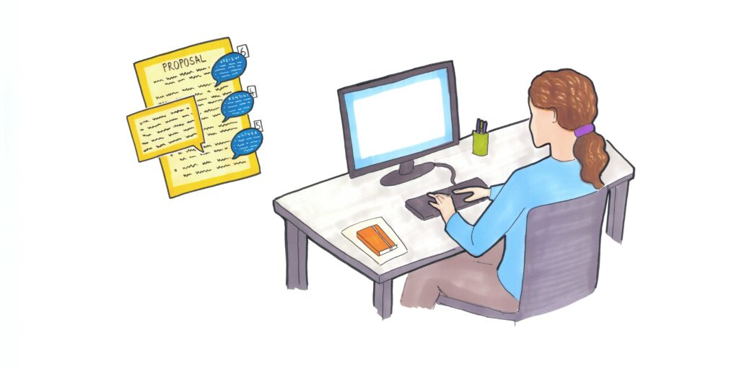


Slide 7
Revisions
Plan for a Cool-Down Period (menyantai)
Develop a Revision Strategy (memetakan)
Write as a Conversation (jelaskan per poin)
Start Early, Have a Timeline (lakukan sekarang)

Slide 8
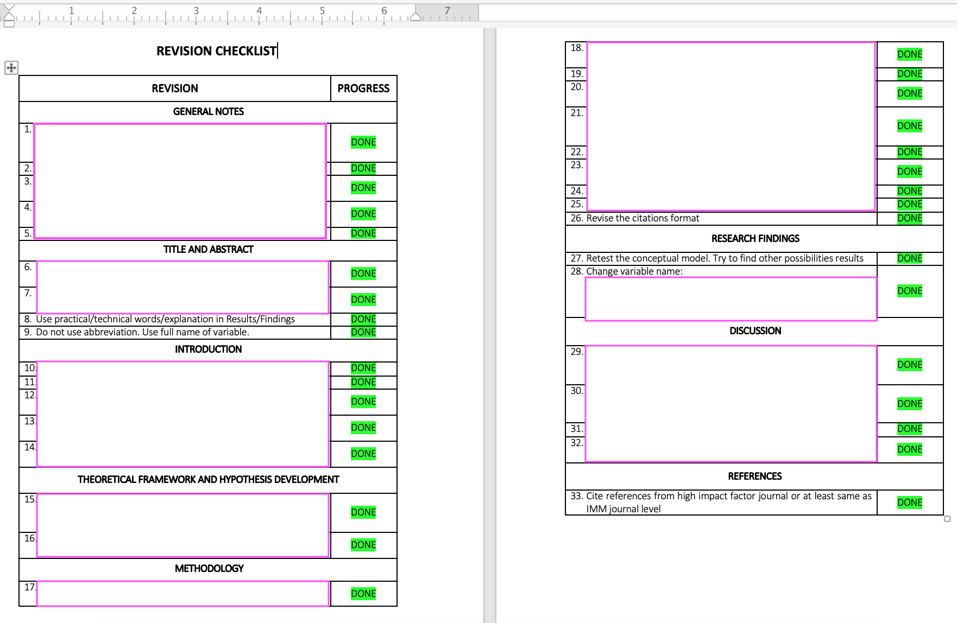
Plan for a Cool-Down Period
Step back after receiving the revision—(emotions, mentality, spirit).
Take a deep breath, and listen to what is being said.
A request for revision is good news!
Even if the comments are sharp or discouraging, they aren’t personal (“jangan baper”)
Every proposal is revised at least once
Don’t panic!

Slide 9
Develop a Revision Strategy
Map the issues into categories to interpret the connections of revisions/feedback.
Evaluate the implications of a choice/story plot.
Request feedback on the revision strategy (colleagues, senior scholars, editor).

Slide 10
Write the Response Document as Scholarly Conversation
Explain the choices to address the issues
Include evidence to address reviewer concerns
Disagree, without being disagreeable (topiknya, bukan orangnya)

Slide 11
Start Early, Have a Timeline
Schedule revision activities
Allocate time for refining

Slide 12
Menulis = Membaca

Slide 13
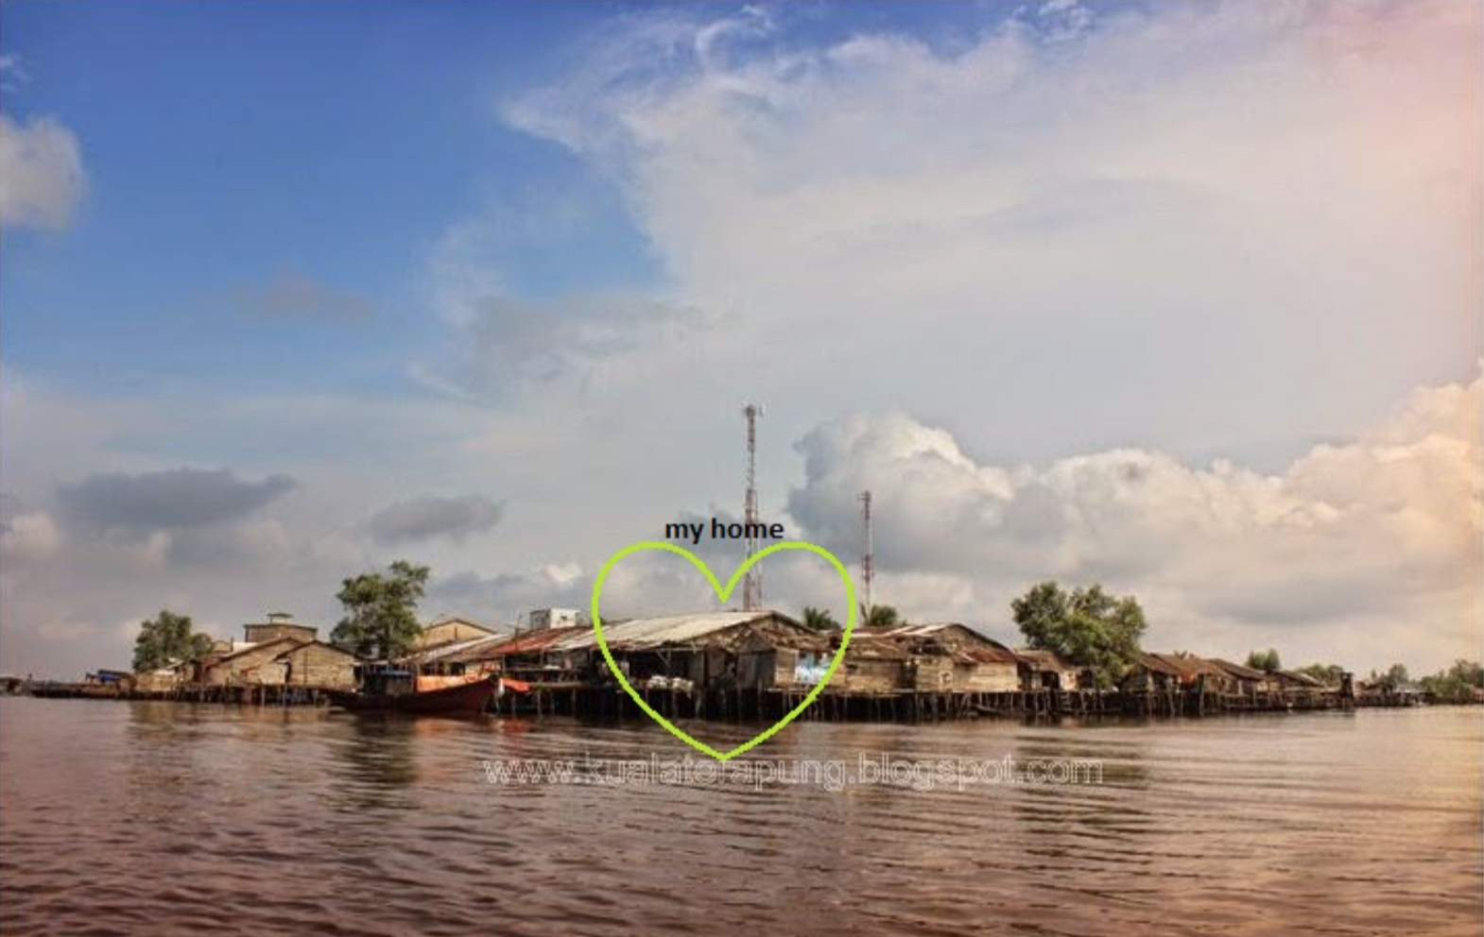
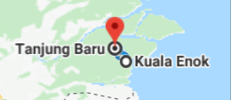

Slide 14
@ Copyright 2022
Disusun oleh:
Saide, S.Kom., M.Kom., M.I.M., Ph.D.
Ph.D. at Information Management, NTUST Taiwan
Lecturer at Dept. Information Systems, UIN SUSKA Riau.
Scholarship; LPDP, DIPA, Double Degree Master (ITS Surabaya & NTUST Taiwan), Taiwan`s scholarship, WTUN Grant Project (UK-Finland-Taiwan).
website: https://saide-sank.blogspot.com email: saide@uin-suska.ac.id youtube: saiderherza journal
Dokumen ini dan semua informasi yang terdapat didalamnya dilindungi hak cipta. Kecuali diijinkan oleh UU No. 28 Tahun 2014 tentang Hak Cipta, tidak ada bagian dari dokumen ini dapat direproduksi dengan cara apapun, tanpa izin tertulis dari penyusun. Isi dokumen ini sepenuhnya merupakan tanggungjawab penyusun.

