Slide 1
IS THEORIES & FRAMEWORKS
Saide
https://saide-sank.blogspot.com
email: saide@uin-suska.ac.id
youtube: saiderherza journal

Slide 2
Contents
CONCEPT:
WHAT IS RESEARCH.
WHAT IS INFORMATION SYSTEMS AND ITS FOUNDATION.
INFORMATION SYSTEMS (IS) RESEARCH.
ENGLISH FOR INFORMATION SYSTEMS.
WORLD’S INFORMATION SYSTEMS ORGANIZATIONS, &
IS JOURNALS, MAIN IS CONFERENCES, REFERENCES.
IS RESEARCH METHODS AND WRITING THE IDEA
IS FRAMEWORKS/THEORIES
CHOSING THE RIGHT IS JOURNAL FOR REFERENCES
RESEARCH GAPS
BACKGROUND/INTRODUCTION
HYPOTHESIS (DEVELOPMENT & HOW TO WRITE IT CORRECTLY)
METHODS
WRITING THE STATISTICS RESULTS
DISCUSSIONS (CONTRIBUTION TO KNOWLEDGE AND MANAGERIAL)
ABSTRACT
HOW TO RESPOND THE REVISIONS (BY ADVISOR, REVIEWER/EDITOR)
TECHNICAL & PROJECTS:
GROUP PROJECTS:
- REVIEWING ARTICLES
- WRITING RESEARCH PROPOSAL/SHORT ARTICLE
- PRESENTING YOUR PROJECT (ALL MEMBERS MUST PRESENTS)
PERSONAL EXPERIENCE IN PUBLICATIONS

Slide 3
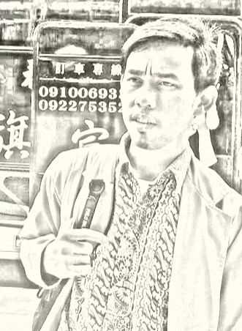
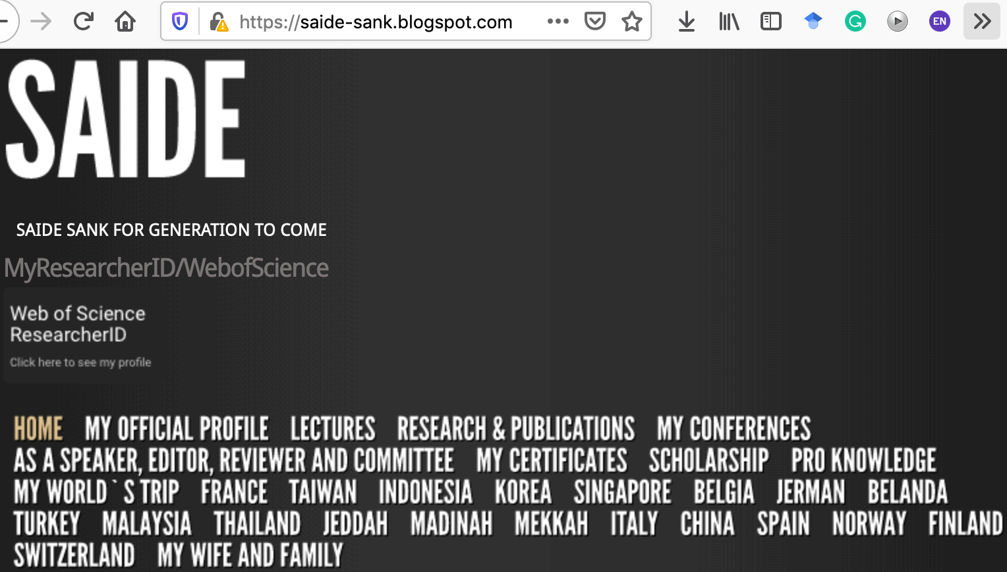
ABOUT ME
Researcher ID/Publons: H-2399-2018
Orcid ID: 0000-0002-1866-5305
Website: https://saide-sank.blogspot.com
S.Kom di UIN Suska Riau (2009-2013)
M.Kom di ITS Surabaya (2014-2016)
M.I.M di NTUST Taiwan (2014-2016)
Lecturer: Information System, UIN SUSKA Riau
Research: Knowledge Management, Information System, Business-IT alignment.
Chief Knowledge Officer: Pro-Knowledge Research Group
Project Management: Energy Research Centre (EnReach.or.id)
Ph.D. candidate: Information Management, NTUST Taiwan

Slide 4
GROUP PROJECTS:
- REVIEWING ARTICLES
- WRITING RESEARC PROPOSAL/ SHORT ARTICLE
- PRESENTING YOUR PROJECT (ALL MEMBERS MUST PRESENTS)
MULAI ANGSUR GROUP PROJECT

Slide 5
IS FRAMEWORKS/ THEORIES

Slide 6



IS Model Concept
Ref: Association for Information Systems-AIS (https://aisnet.org/)

Slide 7
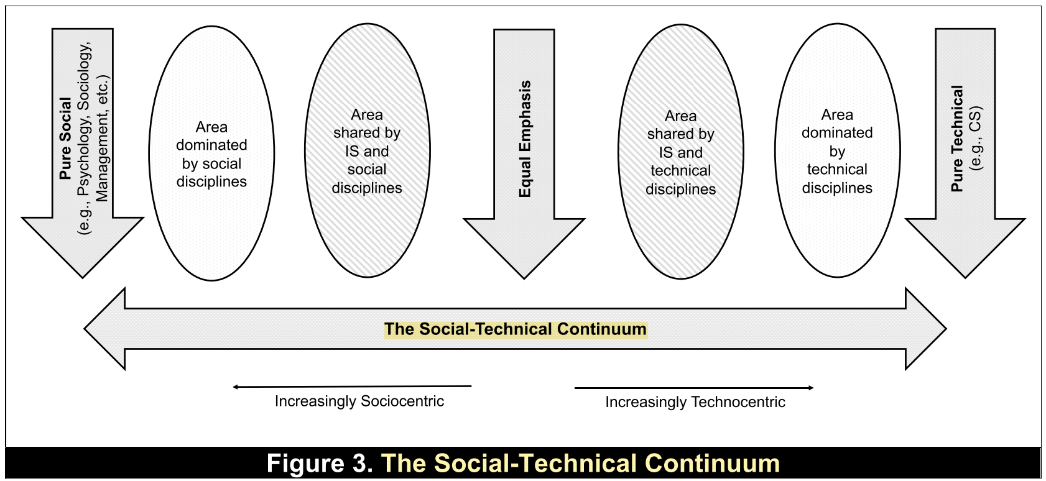
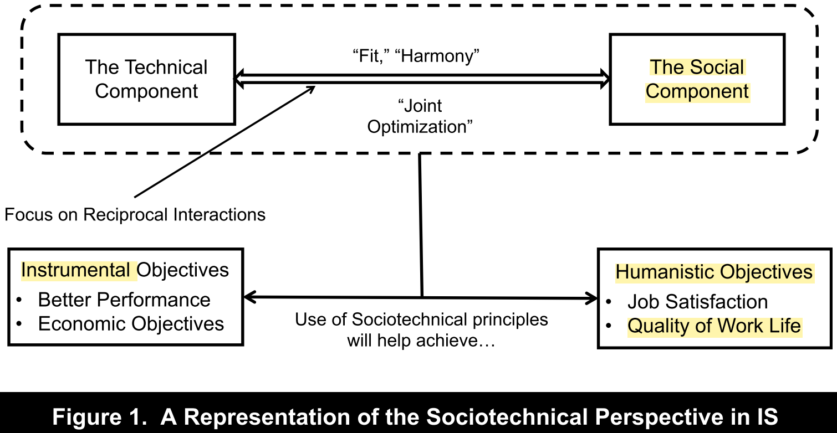
The Sociotechnical for the IS Discipline (Suprateek, 2019)

Slide 8
Theories/Frameworks in IS
Ref: Association for Information Systems-AIS (https://aisnet.org/)
https://is.theorizeit.org/wiki/Main_Page

Slide 9


Slide 10
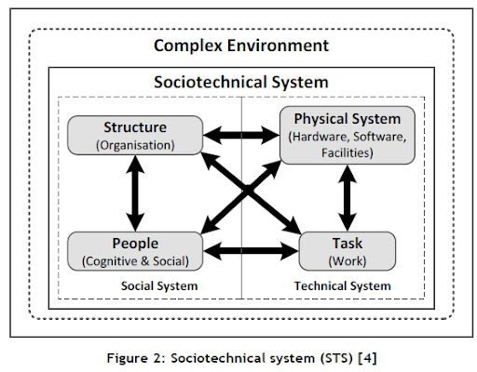
Socio-technical theory
Bostrom, R., Heinen, J. S., (1977), MIS Problems and Failures: A Socio-Technical Perspective, MISQ
Level of Analysis:
Organization
its employees
its environment

Slide 11
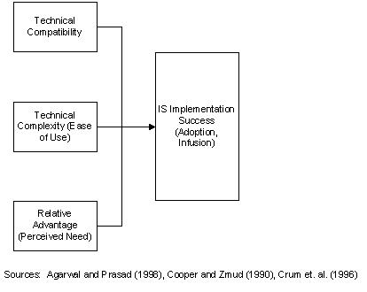
Diffusion of innovations theory
Level of Analysis:
Group
Firm
Industry
Society

Slide 12
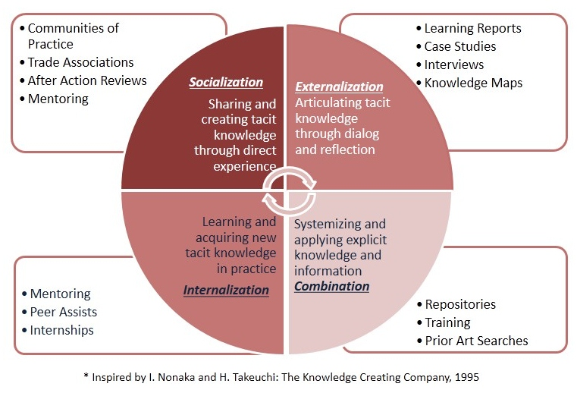
Organizational knowledge creation
Level of Analysis:
Individual
Group
Organization
Inter-organizational

Slide 13
Apa lagi!!!

Slide 14
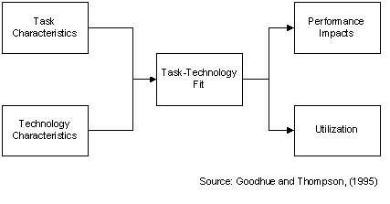
Task-technology fit
Level of Analysis:
Individual

Slide 15
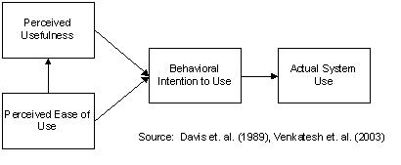
Technology acceptance model
Level of Analysis:
Group
Individual

Slide 16
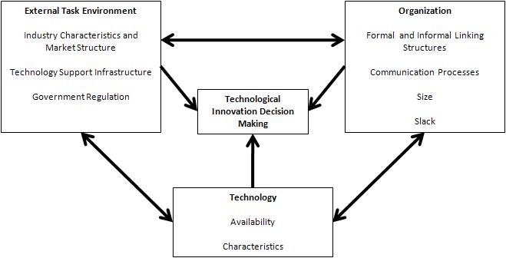
Technology-organization-environment framework
Level of Analysis:
Group
Firm
Rogers, E.M. Diffusion of Innovations, (4th ed.)
The Free Press, New York, 1995.

Slide 17
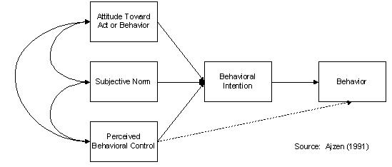
Theory of planned behavior
Level of Analysis:
Individual

Slide 18
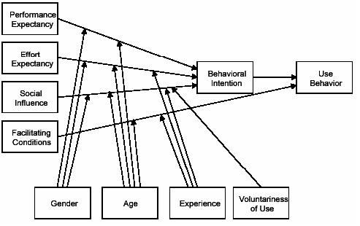
Unified theory of acceptance and use of technology
Venkatesh et al. (2003) MISQ
Level of Analysis:
Individual

Slide 19
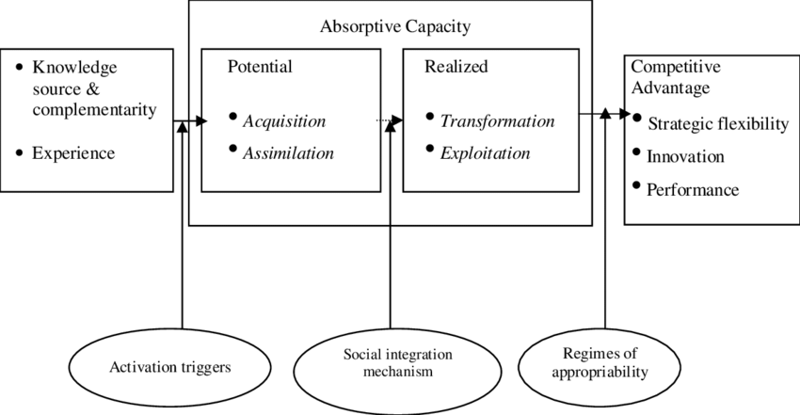
Absorptive capacity theory
Cohen W., and D. Levinthal. 1990. "Absorptive capacity: a new perspective on learning and innovation." Administrative Science Quarterly
Level of Analysis:
Group
Firm
Industry
inter-organizational

Slide 20
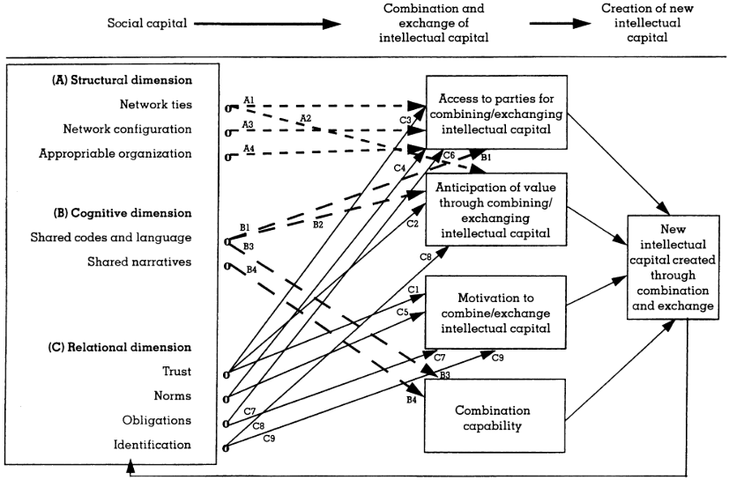
Social capital theory
Coleman, J.S. "Social Capital in the Creation of Human Capital," American Journal of Sociology
Level of Analysis:
Group
Firm
Industry
Society

Slide 21
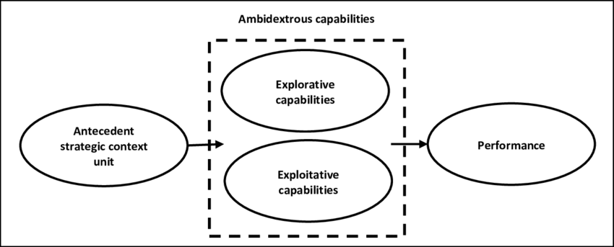
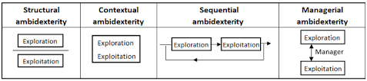
Ambidexterity theory
James G. March (1991). Exploration and Exploitation in Organizational Learning. Organization Science.
Level of Analysis:
Group
Firm
Industry
Society

Slide 22
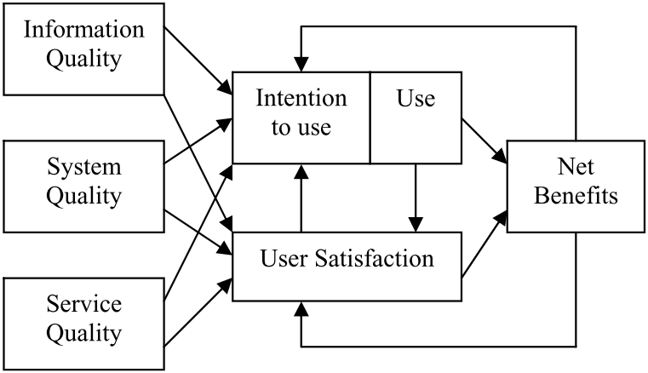
﻿Updated D&M IS Success Model
Level of Analysis:
Organization
Individual
DeLone, W.H., and McLean, E.R. 2003. "The DeLone and McLean Model of Information Systems Success: A Ten-Year Update," Journal of Management Information Systems (19:4)

Slide 23
GROUP PROJECTS:
- REVIEWING ARTICLES
- WRITING RESEARC PROPOSAL/ SHORT ARTICLE
- PRESENTING YOUR PROJECT (ALL MEMBERS MUST PRESENTS)
MULAI ANGSUR GROUP PROJECT

Slide 24
Menulis = Membaca

Slide 25
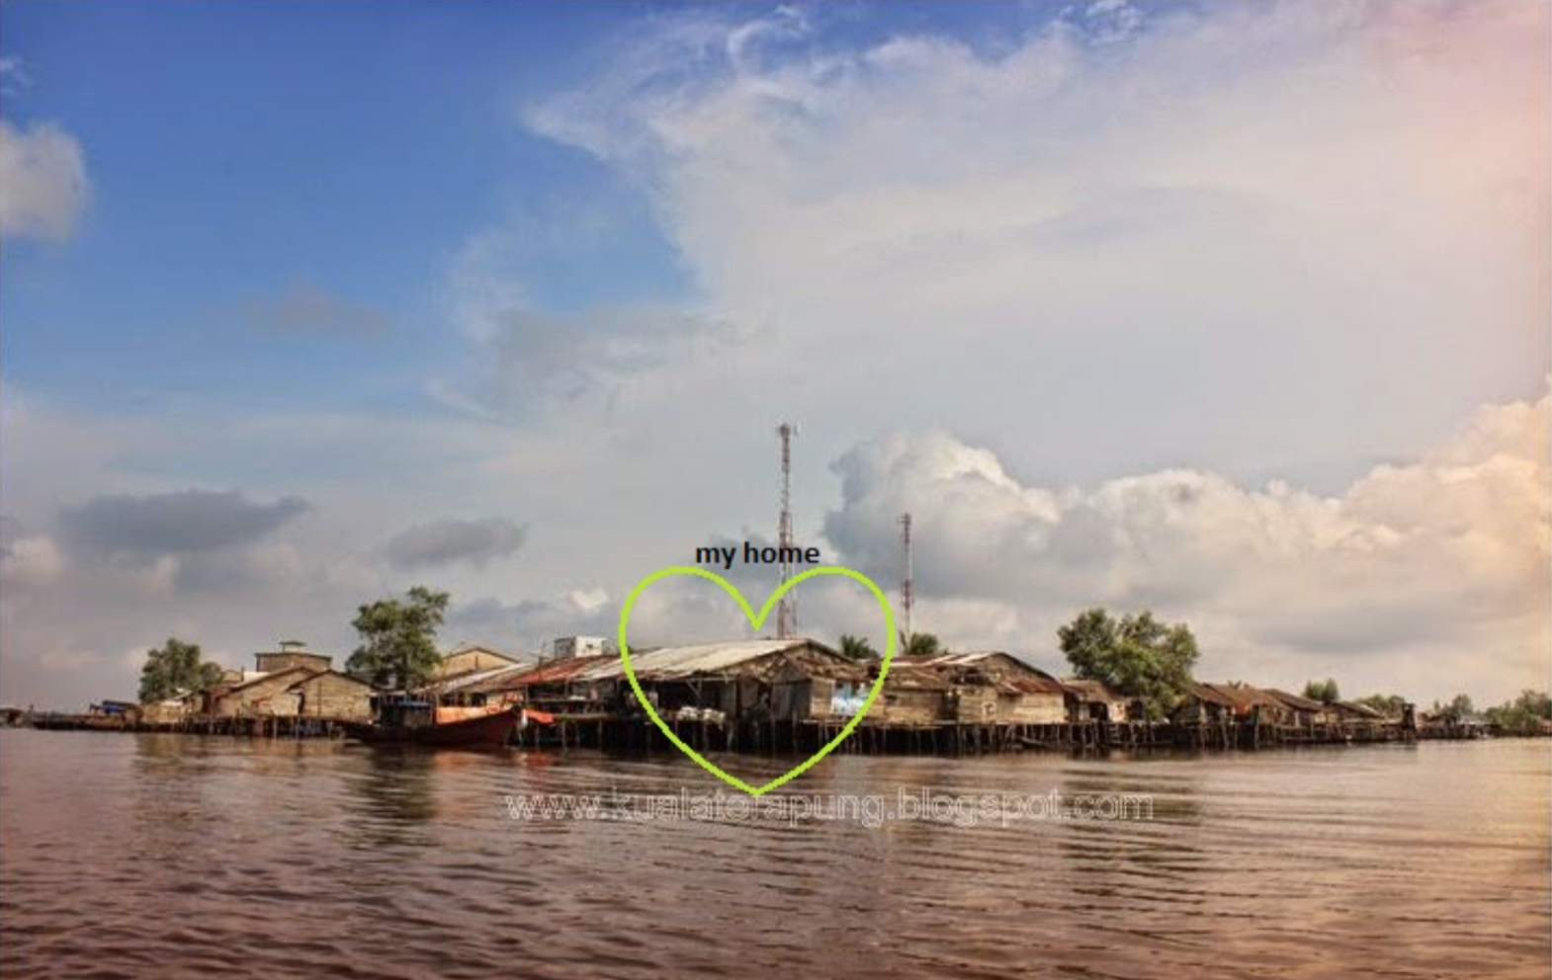
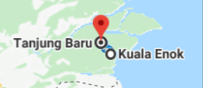

Slide 26
@ Copyright 2022
Disusun oleh:
Saide, S.Kom., M.Kom., M.I.M., Ph.D.
Ph.D. at Information Management, NTUST Taiwan
Lecturer at Dept. Information Systems, UIN SUSKA Riau.
Scholarship; LPDP, DIPA, Double Degree Master (ITS Surabaya & NTUST Taiwan), Taiwan`s scholarship, WTUN Grant Project (UK-Finland-Taiwan).
website: https://saide-sank.blogspot.com
email: saide@uin-suska.ac.id
youtube: saiderherza journal
Dokumen ini dan semua informasi yang terdapat didalamnya dilindungi hak cipta. Kecuali diijinkan oleh UU No. 28 Tahun 2014 tentang Hak Cipta, tidak ada bagian dari dokumen ini dapat direproduksi dengan cara apapun, tanpa izin tertulis dari penyusun. Isi dokumen ini sepenuhnya merupakan tanggungjawab penyusun.

