Slide 1

Why is an Organization ?

Slide 2
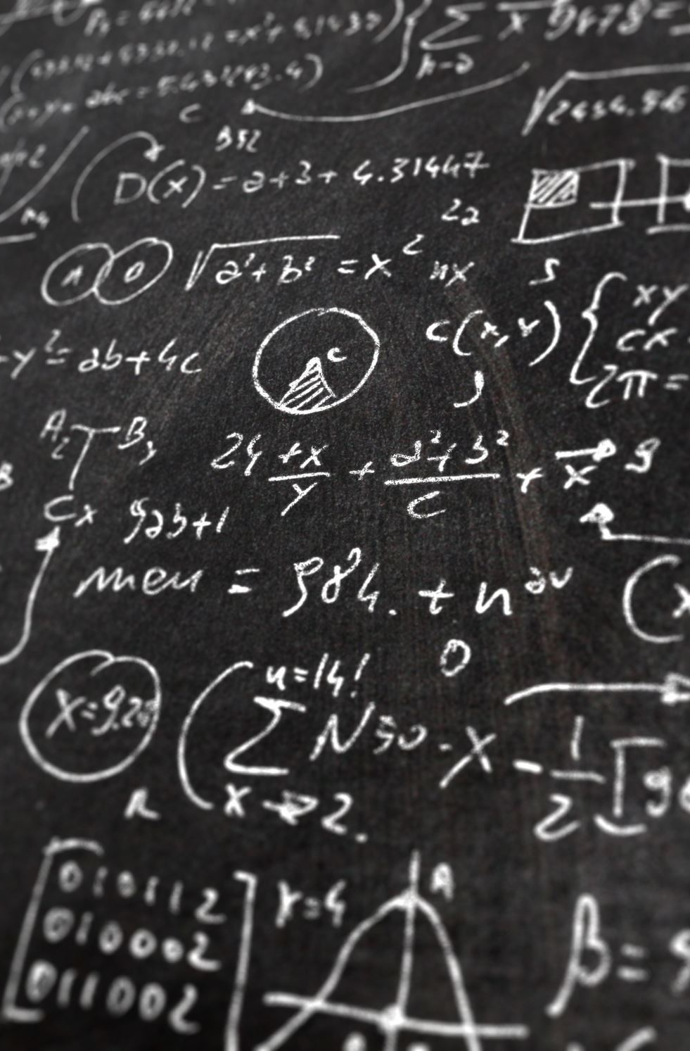
What is an Organization?
Definition of Organization
Elements of an Organization
Types of Organizations
Functional, Divisional, and Matrix Structures
Organizational Design
Case Study
Saide
Dept. Information Systems, UIN SUSKA Riau
https://saide-sank.blogspot.com

Slide 3

Definition of Organization
An organization is a structured and purposeful entity comprising individuals, resources, and processes working together to achieve specific goals or objectives
It is characterized by formalized roles and responsibilities, defined hierarchies, and guidance by rules, policies, and procedures

Slide 4
Elements of an Organization
People: Individuals with designated roles and responsibilities
Resources: Assets, such as finances, equipment, and technology
Processes: Procedures and workflows that enable tasks to be completed efficiently
Goals/Objectives: The desired outcomes an organization strives to achieve

Slide 5
Your personal experiences ?

Slide 6
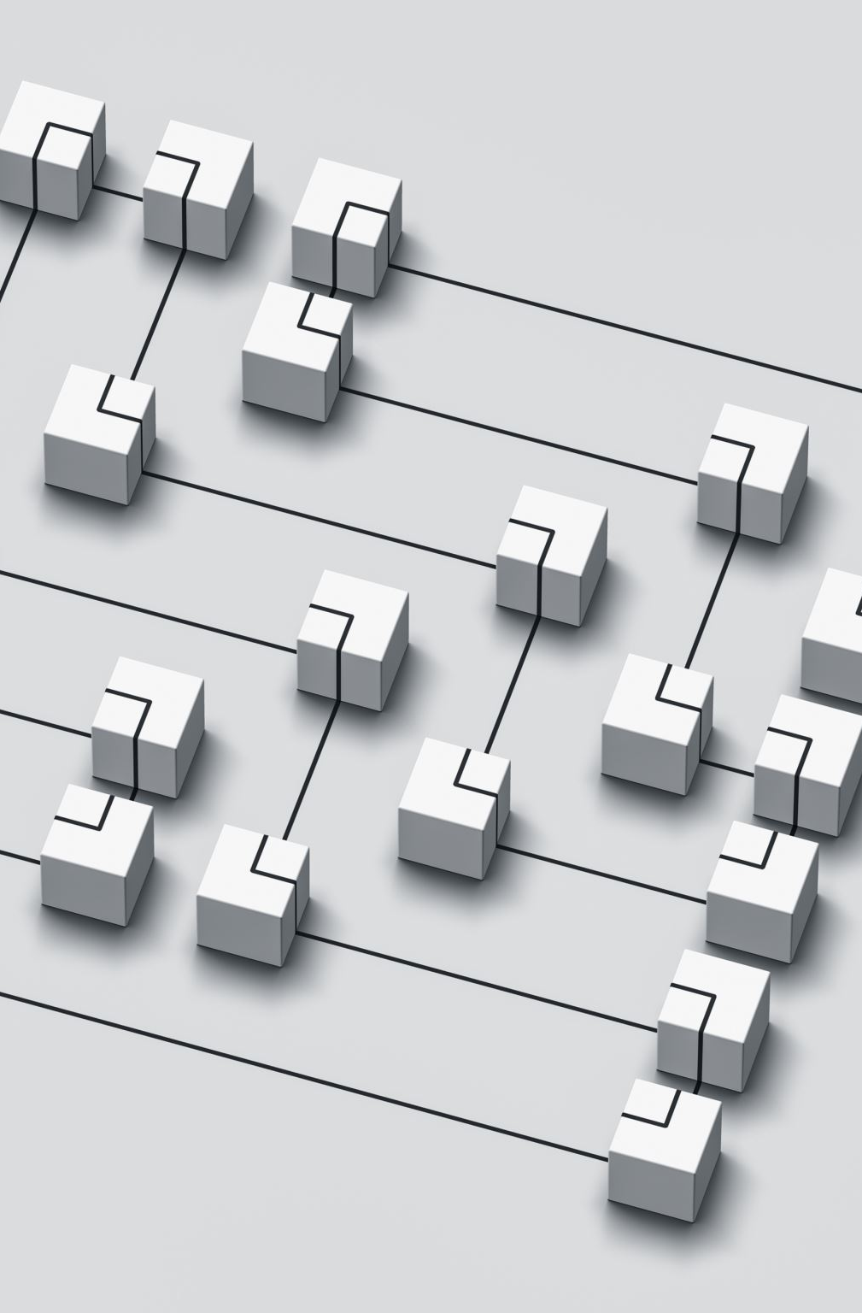
Types of Organizations
Use diagrams from MIS books to illustrate different organizational types
Hierarchical structure
Networked structure
Team-based structure
Divisional structure
Hybrid structures
Each diagram should represent a different organizational type

Slide 7
Benefits of ‘Networking’ ?
Or Senior for your future ?

Slide 8
Functional, Divisional, and Matrix Structures
Functional Structure
Description: Organized by functions or departments
Divisional Structure
Description: Organized by products, geographic locations, or customer groups
Matrix Structure
Description: A combination of functional and divisional structures

Slide 9
Can you provide examples of real-world organizations ?

Slide 10
Organizational Design
Organizational Design
Description: The process of creating the structure of an organization
Factors influencing design
Importance of aligning design with objectives

Slide 11
How do organizational culture and values impact the behavior and decision-making of employees and leaders within an organization?

