Slide 1

What did we learn in the last meeting?
Do you have a small task to do or something to read/study?

Slide 2
What does "IT" stand for in IT teams?

Slide 3
Why is teamwork important in IT projects?

Slide 4

Organizing and Managing IT Teams

Slide 5

Organizing and managing IT (Information Technology) teams involves the process of structuring, leading, and coordinating groups of professionals within an organization to achieve specific technology-related goals and objectives. It encompasses a range of activities and responsibilities aimed at ensuring that IT projects are completed successfully and that the IT team functions efficiently.

Slide 6

Team Dynamics
Definition: Team dynamics refer to the psychological forces that influence the behavior and performance of a group. It includes how team members interact, communicate, and work together to achieve common goals.
Examples:
Conflict Resolution: How team members handle conflicts within the group.
Leadership Roles: Who takes on leadership roles, and how they impact the team.
Communication Styles: The ways team members communicate, such as openly or passively.

Slide 7
What's the main job of a team leader in IT?

Slide 8

Collaboration Tools
Definition: Collaboration tools are software or platforms that enable team members to work together, share information, and collaborate on projects regardless of their physical location.
Examples:
Slack: A messaging platform for team communication.
Microsoft Teams: A collaboration and communication tool within the Microsoft 365 suite.
Trello: A project management tool that helps teams organize tasks.

Slide 9
What's the purpose of a project plan in IT?

Slide 10
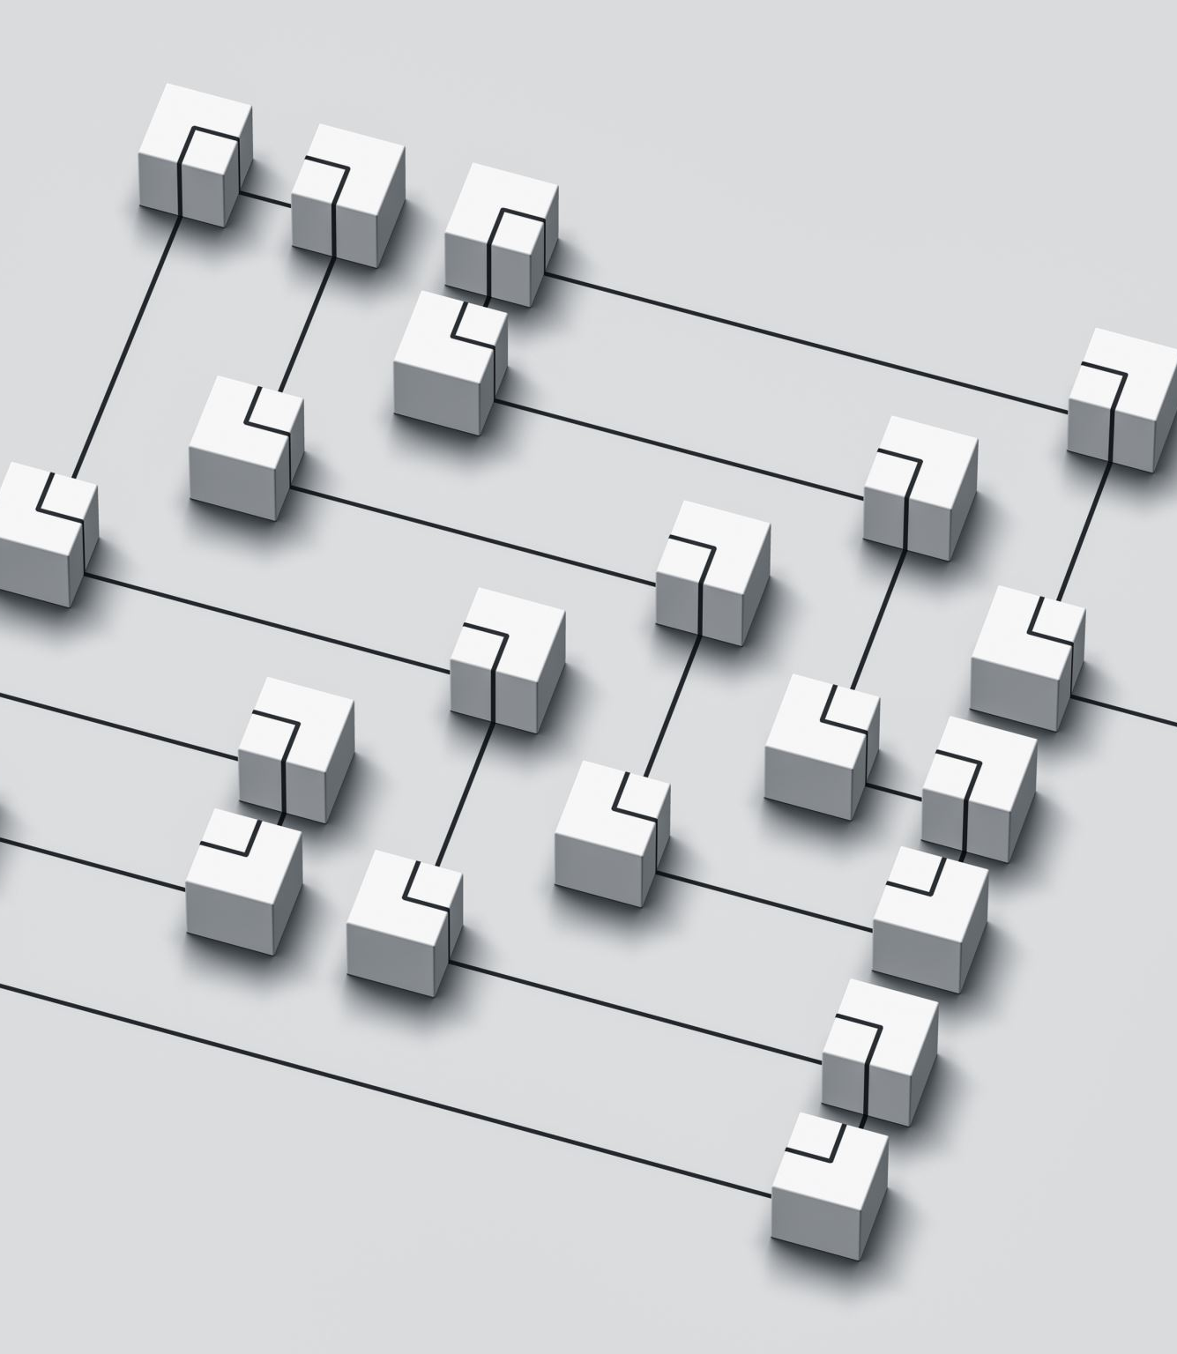
MIS for Team Management
Definition: Management Information Systems (MIS) for team management refer to the use of information technology to collect, process, and present data that helps managers make informed decisions regarding their teams.
Examples:
Dashboards: Customized software dashboards that provide real-time data on team performance.
Time Tracking Software: Tools to monitor and manage team members' work hours.
Project Management Software: Systems like Jira or Asana for tracking project progress.

Slide 11
Why is it essential to define team roles and responsibilities?

Slide 12

Introduction to ICT/IS Project Teams
Definition: ICT (Information and Communication Technology) or IS (Information Systems) project teams are groups of individuals assembled to plan, execute, and complete specific technology-related projects.
Examples:
Software Development Teams: For building applications or systems.
Network Implementation Teams: For setting up and maintaining network infrastructure.
Data Analytics Teams: Focused on analyzing data to extract insights.

Slide 13
Why is it important to identify and manage risks in IT projects?

