Slide 1

Course Title: Organization and Management
Saide
Dept. Information Systems, UIN SUSKA Riau
https://saide-sank.blogspot.com

Slide 2
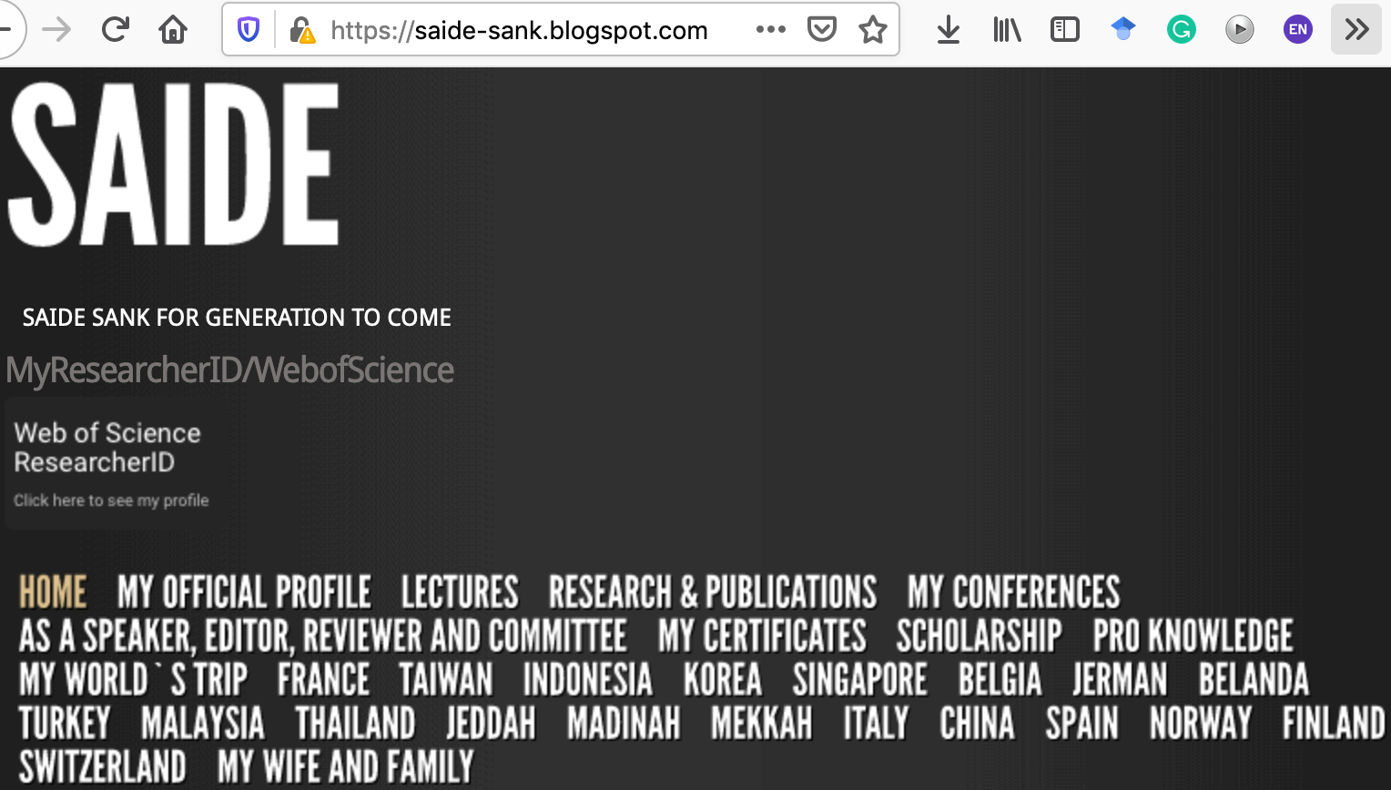
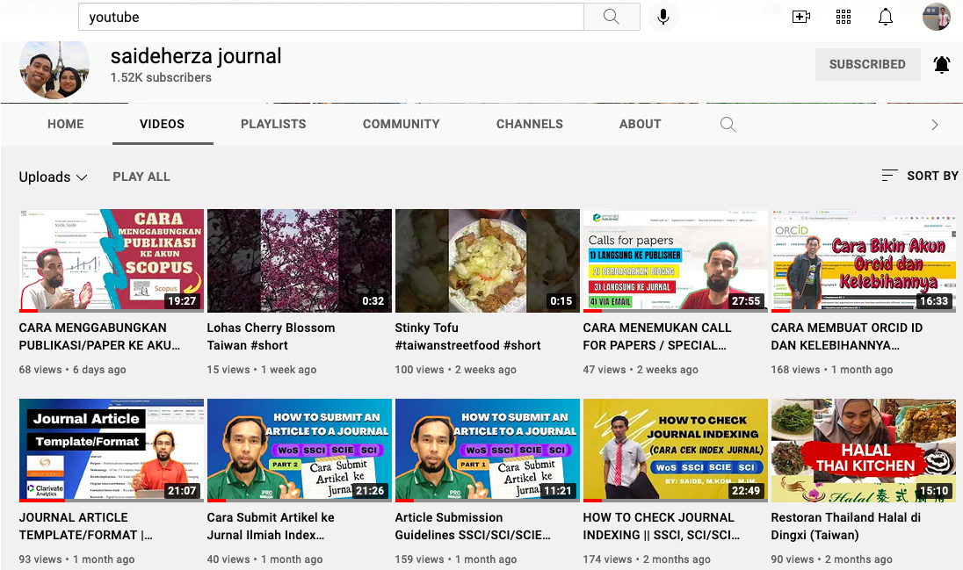
About me
Researcher ID/Publons: H-2399-2018
Website: https://saide-sank.blogspot.com
S.Kom di UIN Suska Riau (2009-2013)
M.Kom di ITS Surabaya (2014-2016)
M.I.M di NTUST Taiwan (2014-2016)
Ph.D. : Information Management, NTUST Taiwan (2018-2021)
Lecturer: Information System, UIN SUSKA Riau
Research: Knowledge Management, Information System, Business-IT alignment.
Chief Knowledge Officer:
Pro-Knowledge Research Group
Executive: Energy Research Centre (EnReach.or.id)

Slide 3
Agenda
Course Overview
Student Introductions (Students briefly introduce themselves)
Instructor Introduction (my background, qualifications, and contact information)
Grading and Attendance Policy, Participation Expectations, Assignment Submission Guidelines, Office Hours and Communication
Q&A

Slide 4
Role of The Game
Nilai Tambah:
Diskusi
Bertanya/Menjawab
On-time
Rapi
Respect
Penilaian (UAS, UTS, Mandiri, Terstruktur) mengacu ke Default sistem iRaise

Slide 5
Role of The Game
Jumlah SKS sebanyak 3 SKS (3 x 50 menit).
Setiap 1 sks, kita break 7-10 menit.
Jika saya terjadwal berhalangan hadir, saya akan kabarkan, jadi TIDAK PERLU BERTANYA MASUK / TIDAK.
Untuk tugas mandiri & kelompok (upload)
Tidak ada toleransi bagi mahasiswa yang ketahuan mencontek pada saat ujian, dan akan mendapatkan nilai E atau dianggap tidak lulus.

Slide 6

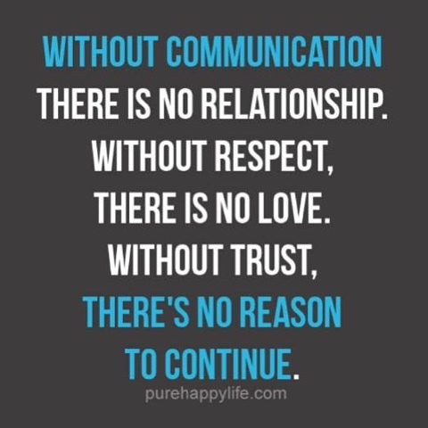


Role of The Game
Berpakaian standar UIN
Permission Letter if you have sick.
RESPECT

Slide 7





Slide 8
Course Description
This course provides an in-depth understanding of organization and management principles with a focus on the role of management information systems
Students will explore key concepts, organizational structures, leadership, and the strategic use of MIS in modern organizations
Case studies and real-world examples will be used to illustrate key principles

Slide 9
Course Objectives
Define and explain fundamental concepts related to organization and management
Describe different organizational structures and their implications
Analyze the role of leadership and communication in organizations
Understand the strategic use of MIS in decision-making and innovation
Apply project management principles to IT projects
Evaluate emerging IT trends and their relevance to modern organizations

Slide 10
Course Overview
Course overview and expectations
What is Organization and Management?
Key MIS Concepts
Case Study

Slide 11

What is an Organization?
Definition of Organization
Elements of an Organization
Types of Organizations
Functional, Divisional, and Matrix Structures
Organizational Design
Case Study

Slide 12
The Role of Management
Definition of Management
Functions of Management
Importance of MIS in Management

Slide 13
MIS in Organizational Context
Importance of MIS in Modern Organizations
How MIS Supports Management
Real-world examples from MIS books

Slide 14
Key Concepts in MIS
Key MIS Terminology
Visual representation
Reference to MIS books for in-depth content

Slide 15

Leadership and Communication
Definition
Leadership Styles
Communication Strategies
MIS in Leadership and Communication
Case Study

Slide 16

Organizing and Managing Teams
Team Dynamics
Collaboration Tools
MIS for Team Management
Case Study
Introduction to ICT/IS Project Teams
Composition and Roles

Slide 17
Planning and Decision Making
Definition
Planning Processes
Decision-Making Frameworks
MIS Support for Decision Making
Case Study
Class Participation/Discussion: 40%
Quizzes, Assignments, Midterm Exam: 30%
Final Project and Presentation: 30%
"Management Information Systems: Managing the Digital Firm" by Kenneth C. Laudon and Jane P. Laudon
“IS Success Model: The First Ten Years of Research" by DeLone and McLean

Slide 18

Assessment and Grading
Class Participation/ Discussion: 40%
Quizzes, Assignments, Midterm Exam: 30%
Final Project and Presentation: 30%

Slide 19
References
"Management Information Systems: Managing the Digital Firm" by Kenneth C. Laudon and Jane P. Laudon
“IS Success Model: The First Ten Years of Research" by DeLone and McLean

