Slide 1

What did we learn in the last meeting?
Do you have a small task to do or something to read/study?

Slide 2
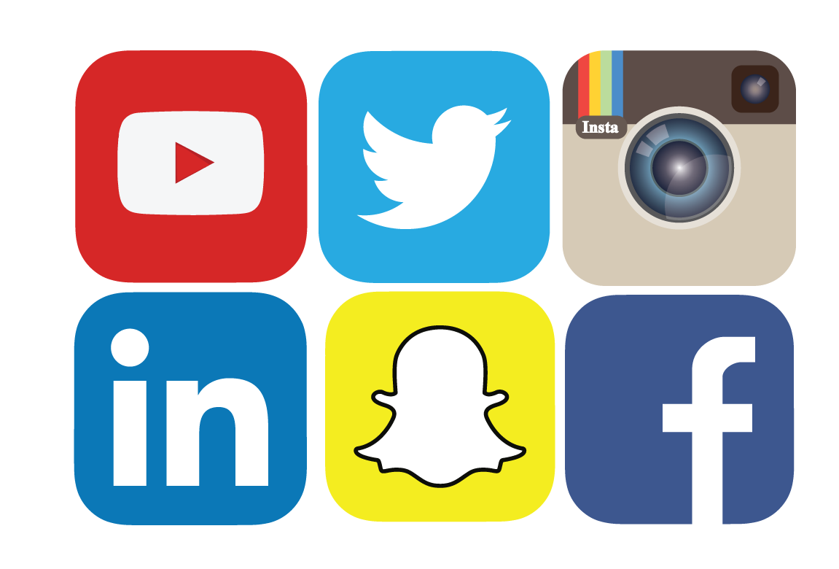
How do you use social media in your daily life?

Slide 3
What are the positive aspects of using social media for you?

Slide 4

Pros and Cons of Social Media in Student Life
Saide
Dept. Information Systems, UIN SUSKA Riau
https://saide-sank.blogspot.com
Notes:
Social media has become an integral part of students' lives, influencing their academic, social, and personal experiences

Slide 5
Pros of Social Media in Student Life
Information Access
Quick access to educational resources, news, and updates
Online forums and groups for academic discussions and knowledge sharing
Communication and Collaboration
Facilitates communication with classmates and professors
Collaboration on group projects and study groups
Networking Opportunities
Connecting with professionals and potential mentors in the field
Building a professional online presence for future career opportunities

Slide 6
Pros of Social Media in Student Life
Platforms for showcasing achievements and talents
Enhanced Learning
Educational content and tutorials on platforms like YouTube
Access to webinars and online courses for skill development
Personal Expression
Creative outlets for expressing thoughts and ideas

Slide 7
Have you ever experienced any negative effects of social media use?

Slide 8
What did we learn in the last meeting?
Do you have a small task to do or something to read/study?

Slide 9
Cons of Social Media in Student Life
Easily distracted from academic tasks by social media notifications
Procrastination can negatively impact study habits and grades
Privacy Concerns
Distraction and Procrastination
Risk of oversharing personal information.
Potential exposure to online threats and cyberbullying.

Slide 10
How do you handle disagreements or conflicts on social media?

Slide 11
Cons of Social Media in Student Life
Excessive time spent on social media can lead to poor time management.
Neglecting academic responsibilities and priorities.
Time Management Issues:
Comparison with peers may lead to feelings of inadequacy.
Cyberbullying and online negativity can affect mental well-being.
Negative Impact on Mental Health

Slide 12
Have you ever used social media for academic purposes, such as research or networking with professionals?

Slide 13
Reduced Face-to-Face Interaction
Over-reliance on online communication may reduce face-to-face social skills
Limited in-person networking opportunities

Slide 14
Do you think social media has influenced your overall well-being and mental health?

Slide 15
Balancing Social Media Use
Encourage students to strike a balance between the benefits and drawbacks of social media in their academic and personal lives
Promote responsible and mindful social media use to maximize its advantages while minimizing its disadvantages

Slide 16
Are you mindful of your online privacy and security?

Slide 17
How to communicate professionally using online tools: e-mail, sosmed, online forum.

Slide 18
What did we learn in the last meeting?
Do you have a small task to do or something to read/study?

Slide 19

What is TikTok, and how would you describe its main purpose?

Slide 20
How can you strike a balance between using TikTok and other activities in your daily routine?

Slide 21
Digital Literacy and Online Safety: The importance of being critical consumers of online content
Social Media Addiction: Explore the addictive nature of TikTok and social media in general
Influencer Culture: Analyze the concept of influencers on TikTok
Creativity and Expression: TikTok is a platform for creative expression

Slide 22
Trends and Virality: Explore the mechanics of viral TikTok trends and challenges
Cultural and Social Trends: TikTok often reflects current cultural and social trends
Copyright and Intellectual Property: Teach students about copyright laws and intellectual property rights on TikTok
Cyberbullying and Online Harassment: Address the issue of cyberbullying and online harassment on TikTok

Slide 23
What's the difference between a TikTok trend and a viral challenge?

Slide 24
What are some potential risks of spending too much time on TikTok?

Slide 25
Positive Impact and Community Building: Highlight positive examples of how TikTok has been used to build communities, support causes, and spread positivity
Screen Time Management: Discuss the importance of balancing screen time on TikTok with other activities, such as homework, physical exercise, and face-to-face interactions
Privacy Settings and Permissions: Show students how to adjust their privacy settings on TikTok to protect their personal information and control who can see their content
Online Etiquette: Teach students about online etiquette and how to engage respectfully with others on TikTok

