Slide 1

What is MIS ? based on book/paper last week

Slide 2
Why is English proficiency crucial for global IS/IT professionals?

Slide 3
IMPORTANT ENGLISH IN IS RESEARCH
Saide
https://saide-sank.blogspot.com
email: saide@uin-suska.ac.id
youtube: saiderherza journal

Slide 4
“RESEARCH”

Slide 5
ARTIKEL/PAPER TIDAK SAMA
JURNAL/JOURNAL
basic knowledge

Slide 6
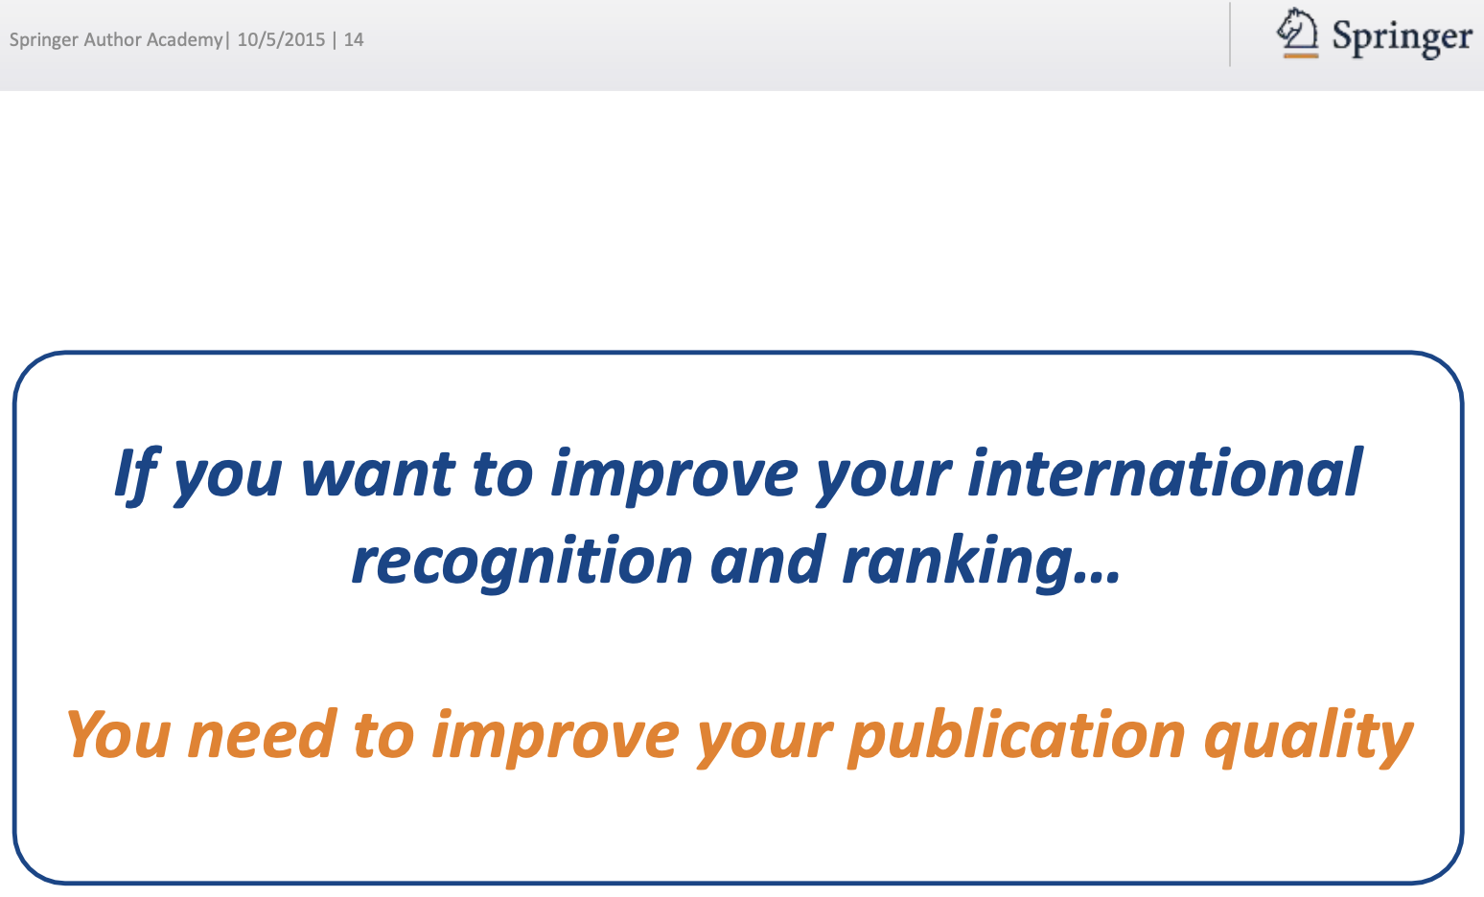

Slide 7
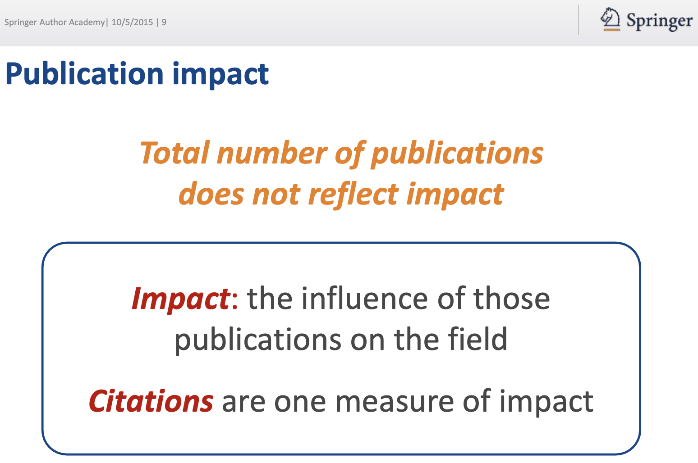

Slide 8
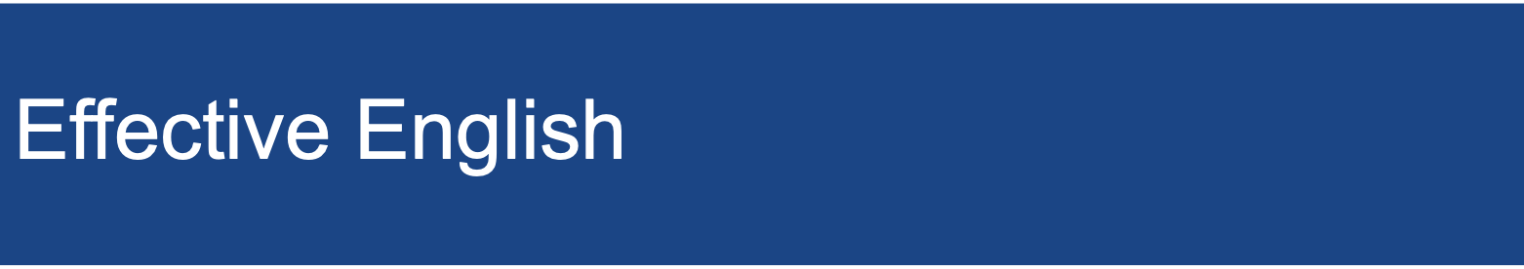

Slide 9
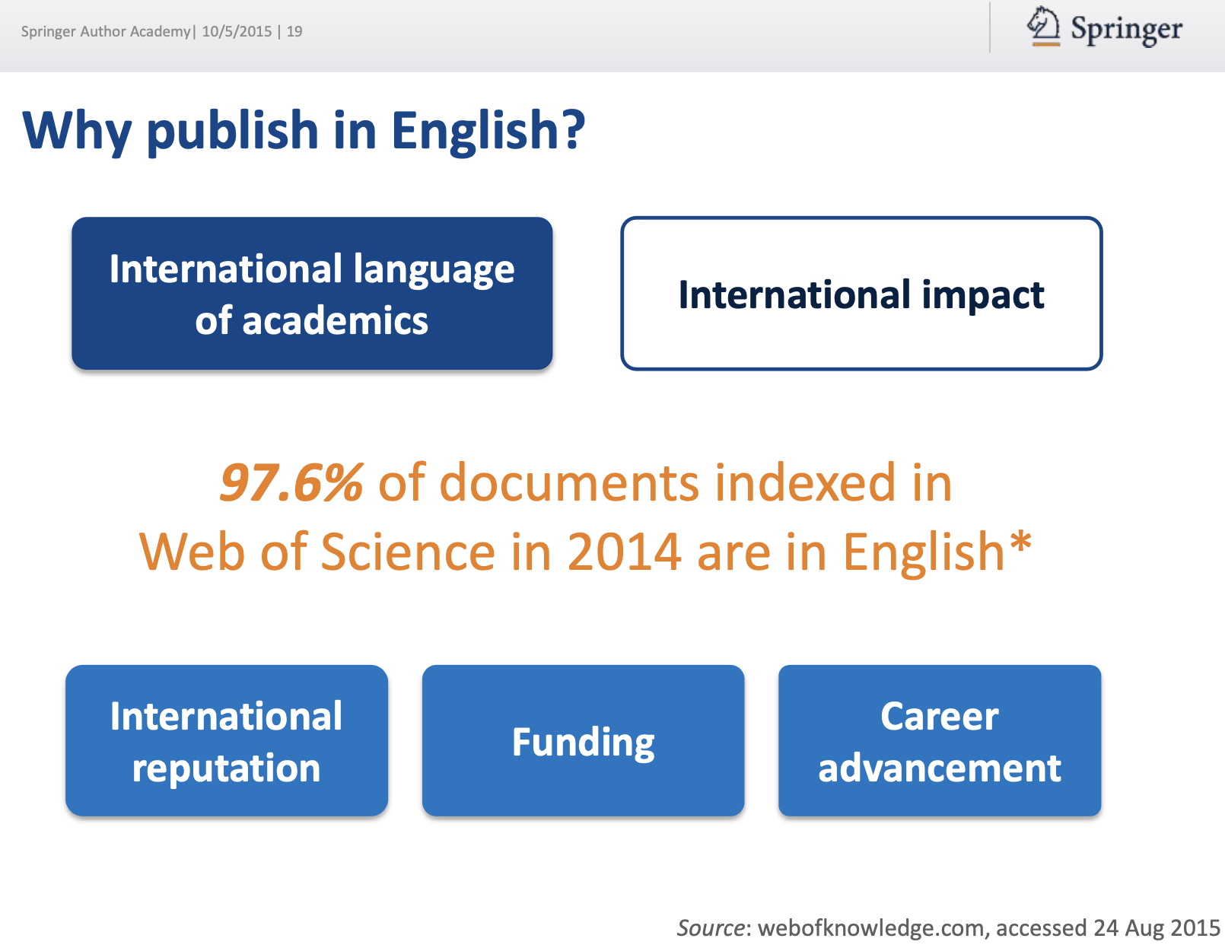

Slide 10
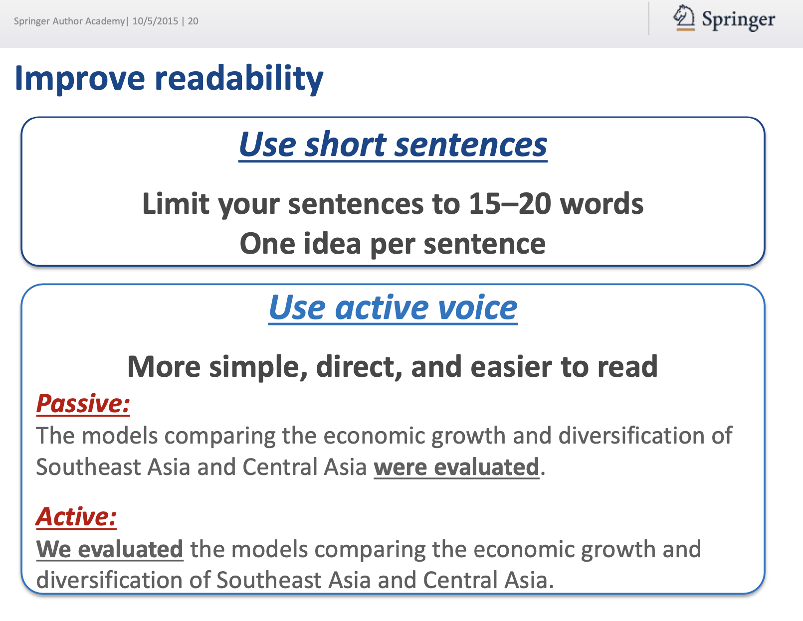

Slide 11
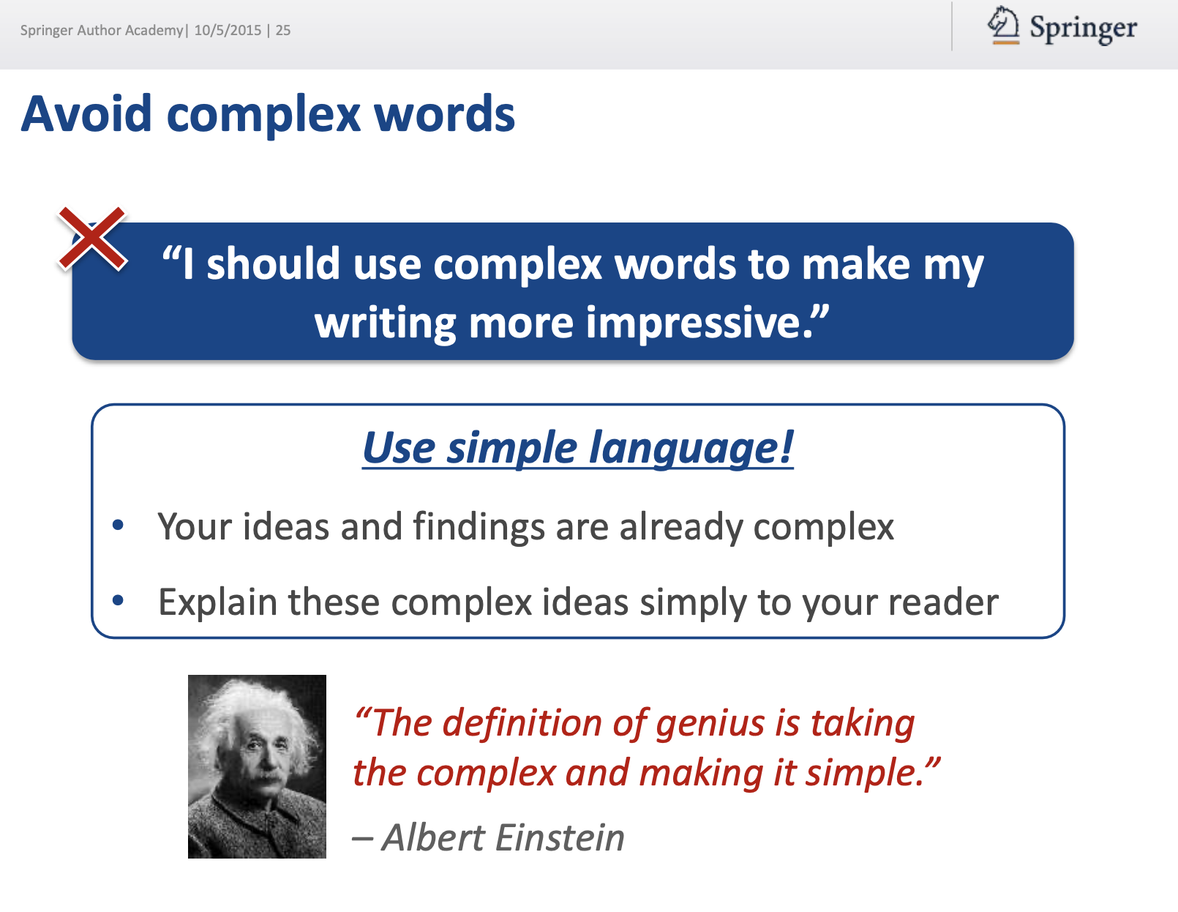

Slide 12
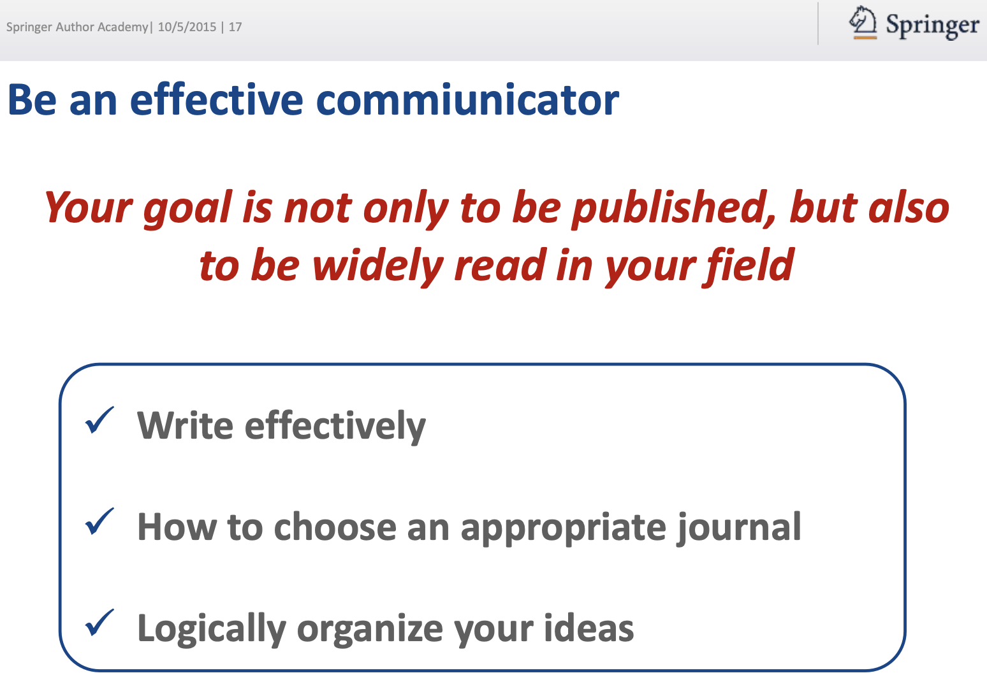

Slide 13
How can strong English skills enhance your ability to collaborate on international IT projects?

Slide 14

“INFORMATION SYSTEMS”
Information Systems, Information Management, Management Information Systems

Slide 15
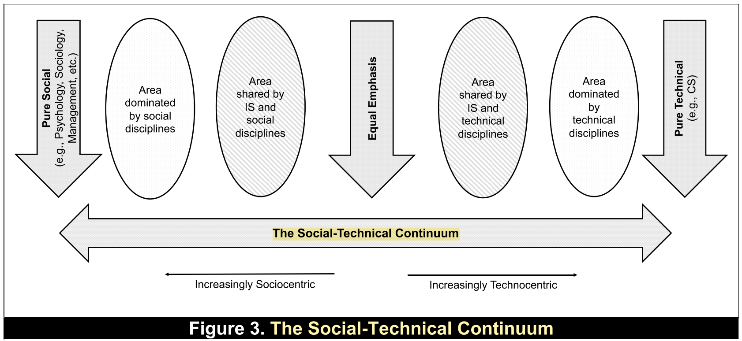
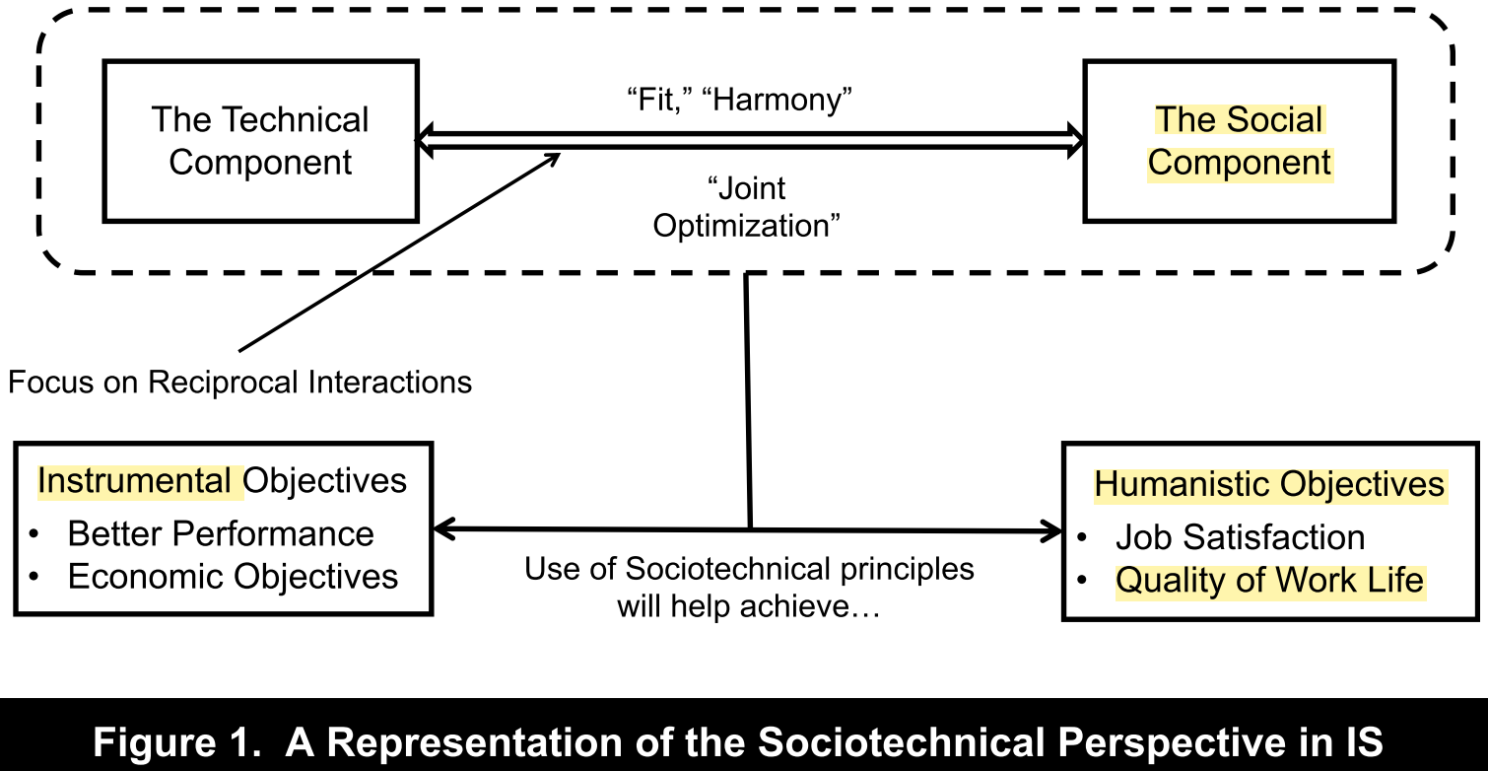
The Sociotechnical for the IS Discipline (Suprateek, 2019)

Slide 16
What strategies do you use to improve your technical English ?

Slide 17
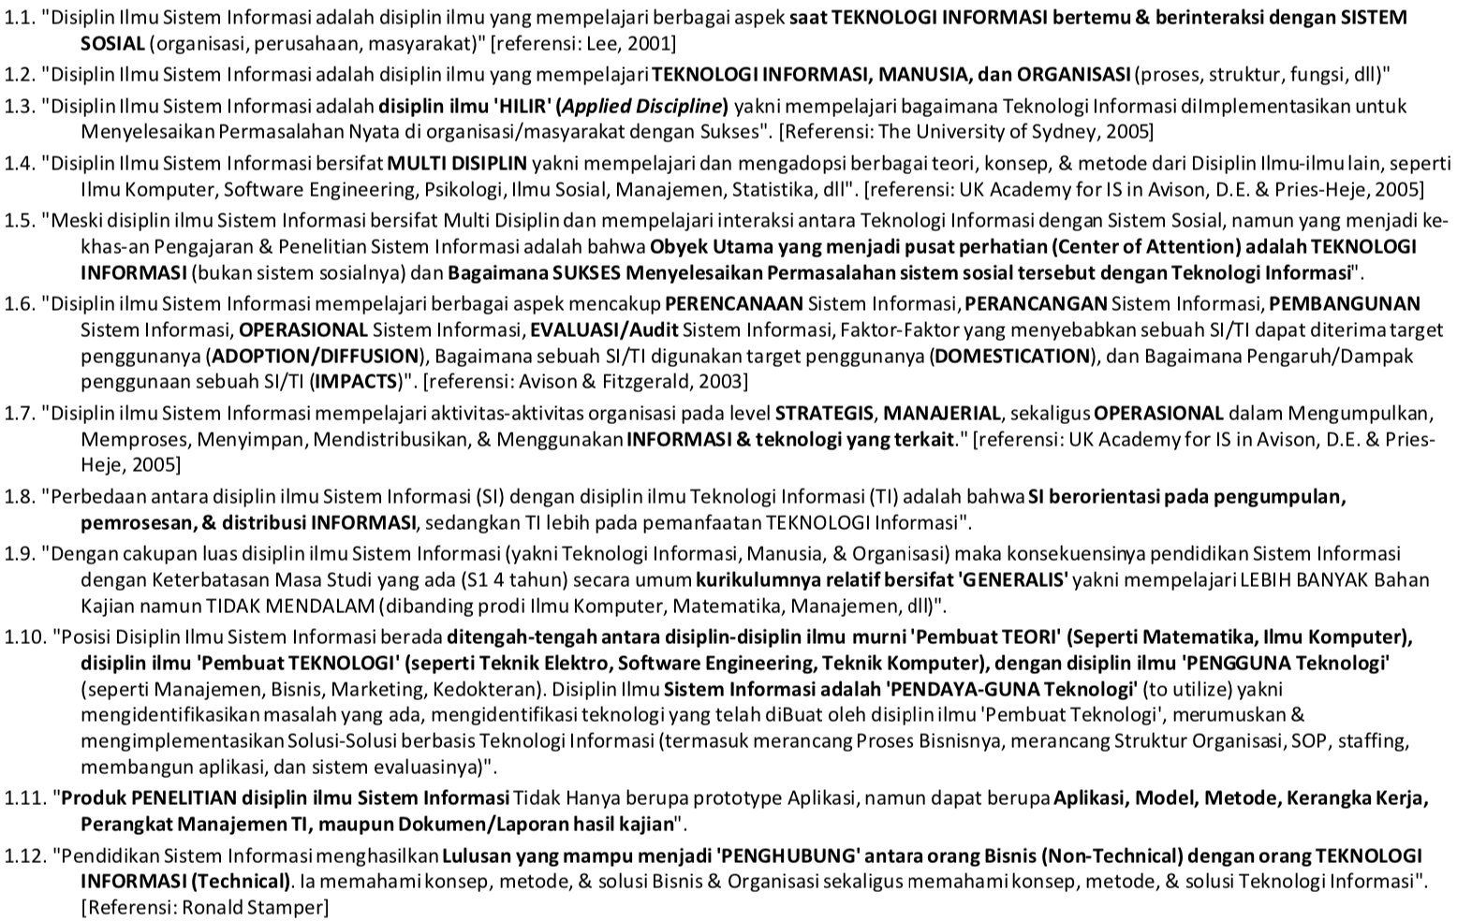
Forum SI Indonesia 2018 (AISINDO-APTIKOM)

Slide 18
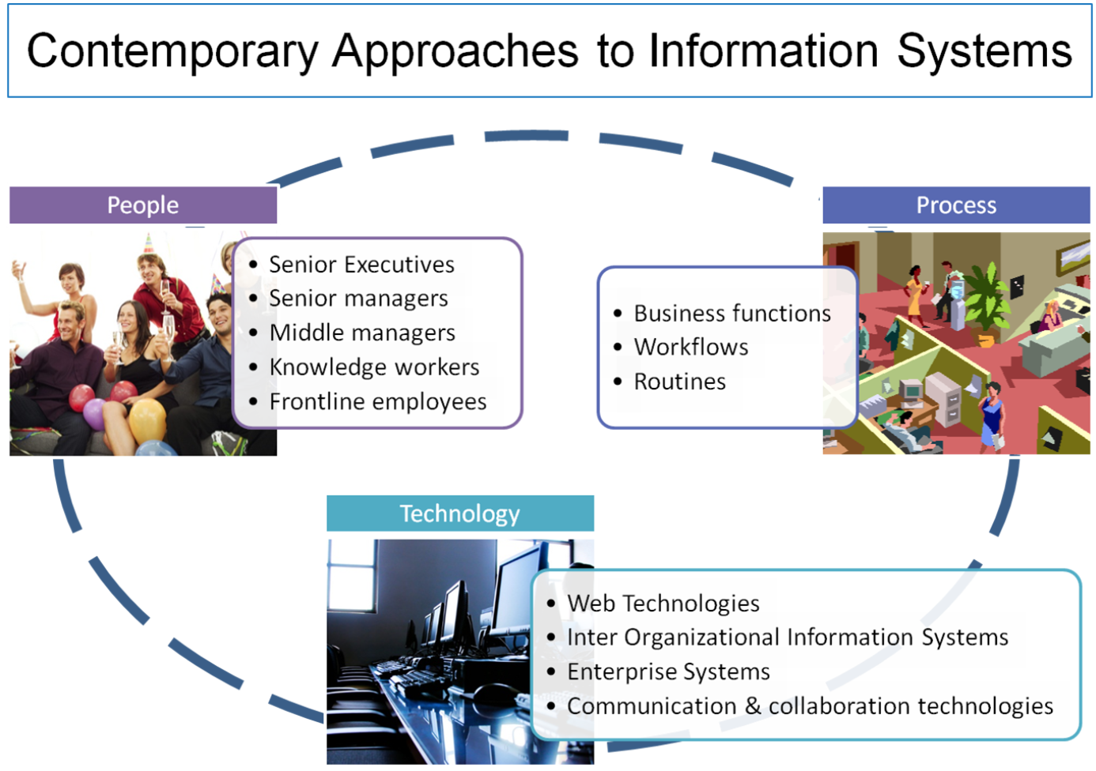

Slide 19
In what ways can English language proficiency open doors to career opportunities in the Information Systems field?

Slide 20
Menulis = Membaca

