Slide 1

What did we learn in the last meeting?
Do you have a small task to do or something to read/study?

Slide 2
What is your understanding of the term "Digital Government"?
Saide
Dept. Information Systems, UIN SUSKA Riau
https://saide-sank.blogspot.com

Slide 3
Why is digital transformation important for government agencies and public services?

Slide 4

E-Government and Digital Transformation

Slide 5
Knowledge
Definition and evolution of e-government
Digital government maturity models
Case studies in digital transformation

Slide 6

E-Government
Concept: E-government refers to the concept of using digital technologies to enhance government operations and service delivery
Characteristics:
Focuses on the digitization of existing government services and processes
Aims to improve efficiency, accessibility, and transparency in government operations
Often involves creating government websites, online forms, and digital interfaces for citizens
Examples: E-government initiatives include online tax filing systems, government websites for information and services, and digital portals for accessing public records

Slide 7

Digital Transformation in Government
Evolution: Digital transformation in government is an ongoing evolution beyond e-government
Characteristics:
Involves a holistic transformation of government operations, culture, and citizen engagement
Embraces emerging technologies like AI, blockchain, and IoT to reimagine how government functions
Focuses on data-driven decision-making, innovation, and agility
Examples: Digital transformation initiatives include the implementation of AI-powered chatbots for citizen inquiries, the use of data analytics to optimize public services, and the integration of blockchain for secure and transparent transactions

Slide 8

Key Differences
Scope: E-government primarily focuses on improving online service delivery, while digital transformation encompasses a wider spectrum of modernization efforts, including cultural and organizational changes
Technology Adoption: E-government typically involves adopting existing digital technologies, while digital transformation explores and adopts emerging and disruptive technologies to drive innovation
Objectives: E-government aims to make existing government processes more efficient and accessible
Mindset: E-government often involves a project-based approach

Slide 9
What are some common challenges and obstacles that governments face during the digital transformation journey?

Slide 10

Digital government maturity models
Digital government maturity models are frameworks used to assess and measure the level of digital transformation and maturity within government agencies and organizations. These models help governments evaluate their current state, set goals for digital advancement, and track progress over time. Here are some well-known digital government maturity models:

Slide 11

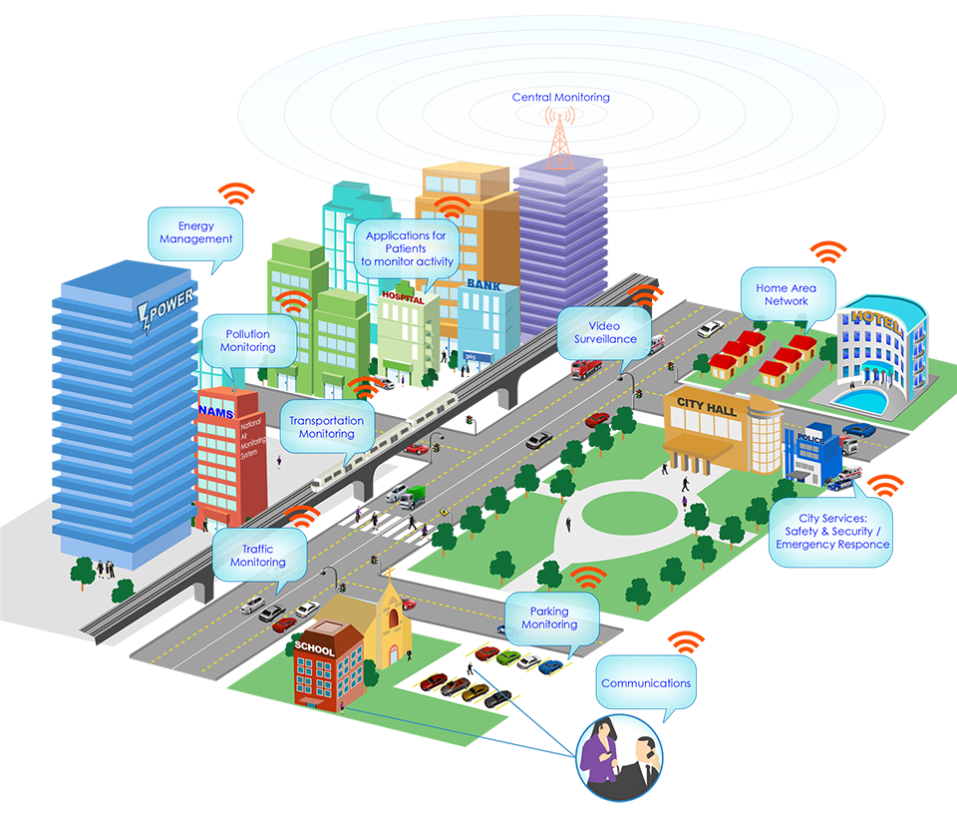
e-Government Development Index : Developed by the United Nations, EGDI assesses the readiness and maturity of countries in adopting e-government practices
Capability Maturity Model Integration : Originally designed for software development, CMMI has been adapted for assessing the maturity of various government processes, including those related to digital transformation
Digital Government Adoption Framework : Created by the European Commission, DGA assesses the progress of European Union member states in implementing digital government strategies
e-Government Maturity Model : Developed by the Government of Malaysia, eGovMM assesses the readiness of government agencies to deliver online services

Slide 12
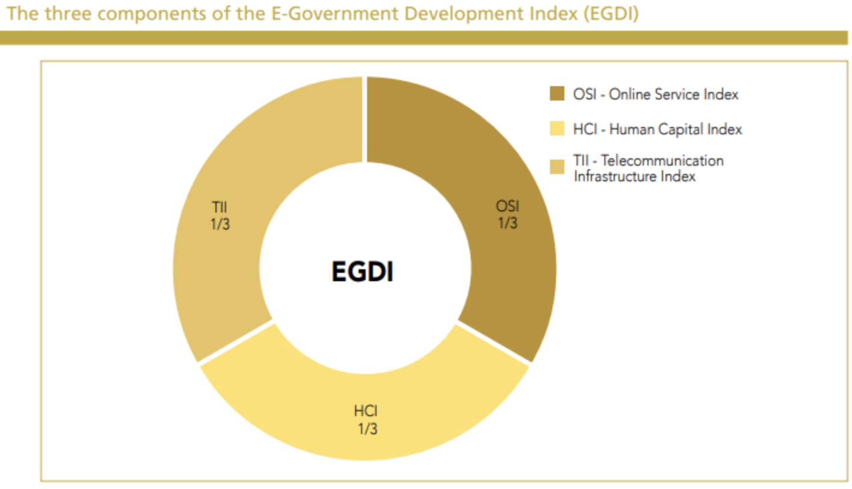
e-Government Development Index

Slide 13
Case studies & Success Stories

Slide 14
Can you identify any global examples of countries that have made significant strides in digital transformation within government agencies?

Slide 15
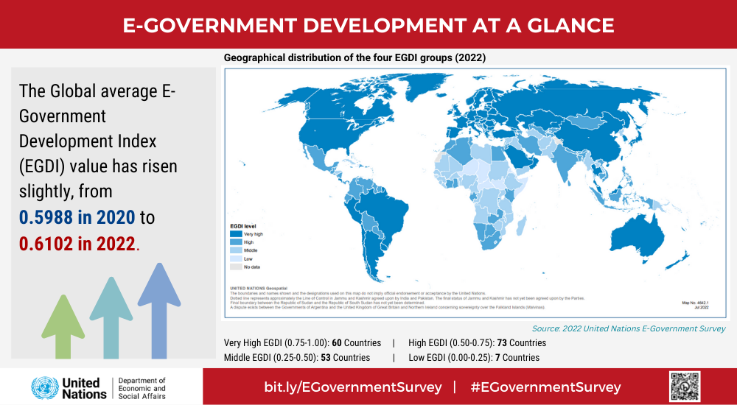

Slide 16
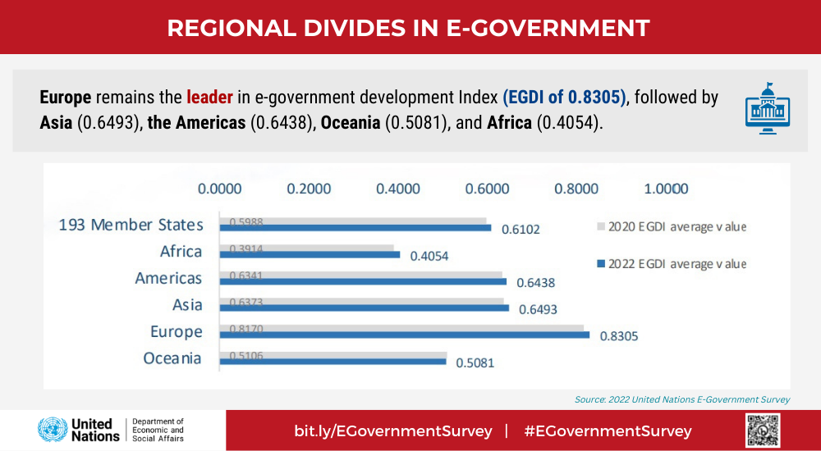

Slide 17
How does digital transformation enhance citizen engagement and the quality of services delivered to the public?

Slide 18
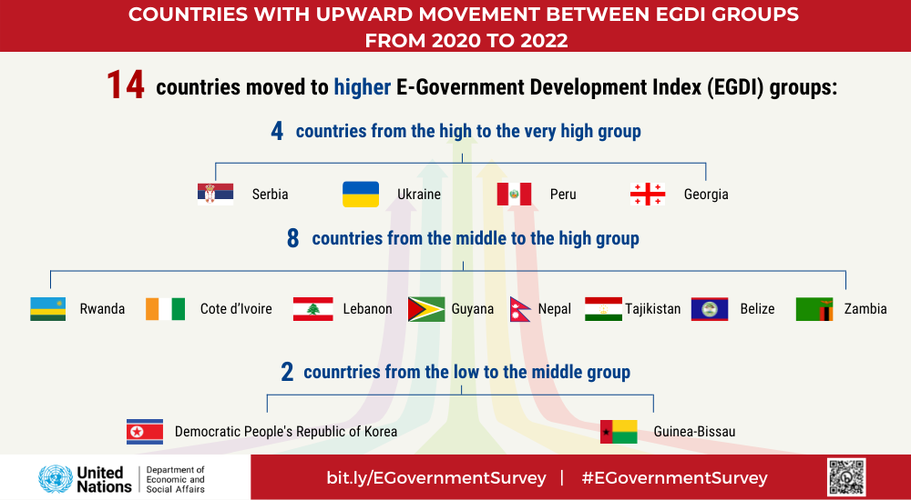

Slide 19
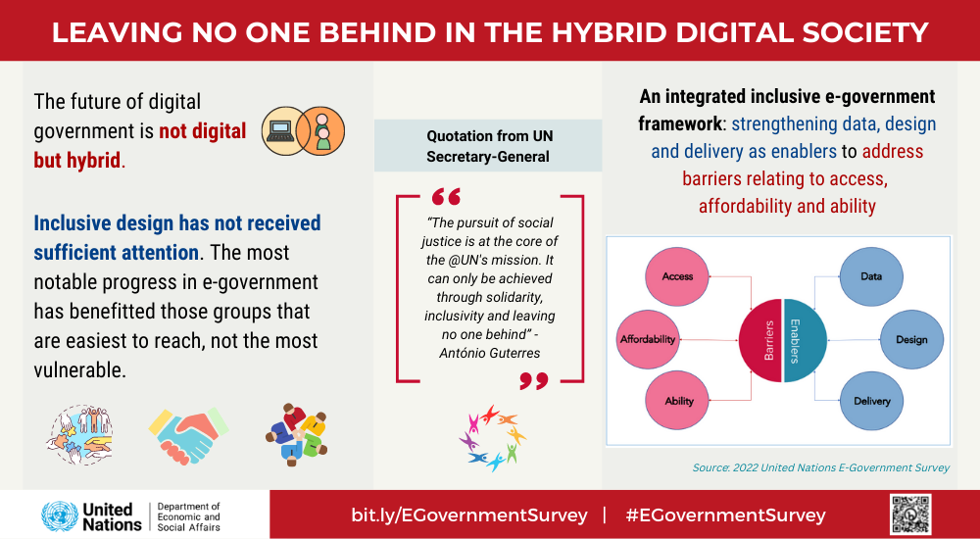

Slide 20
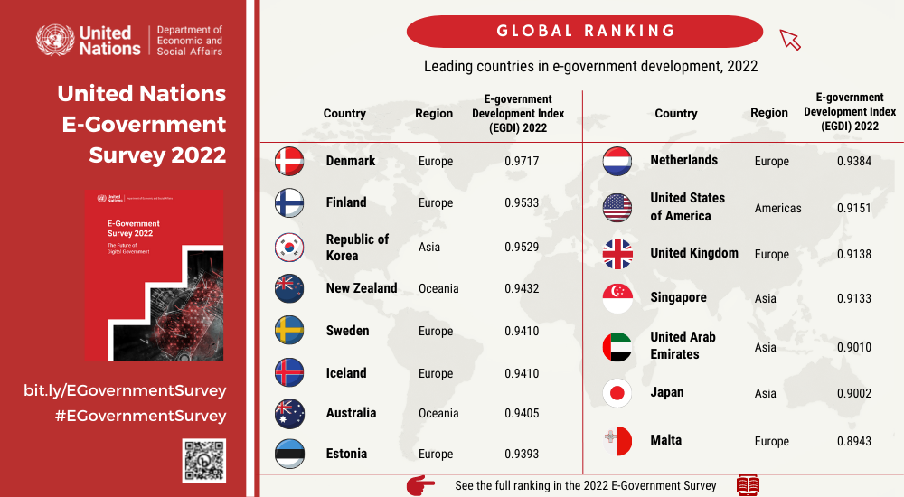

Slide 21
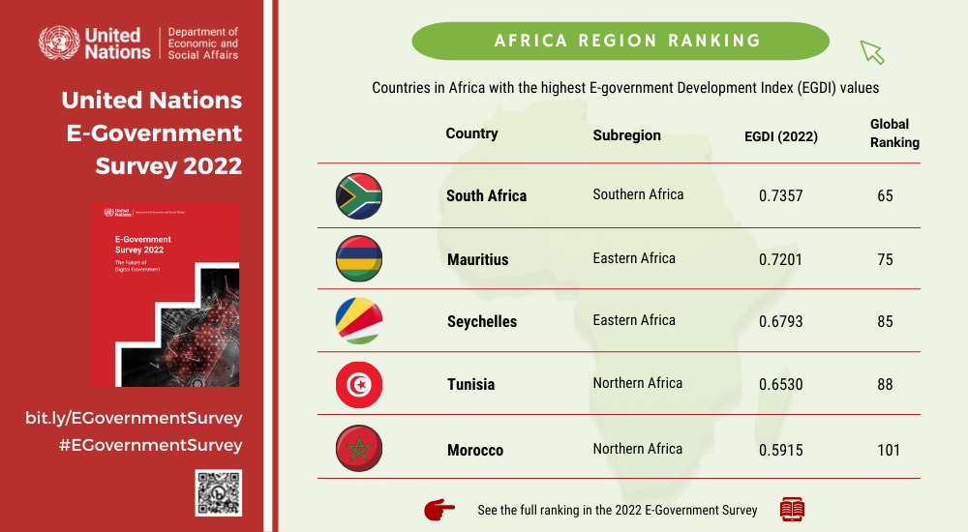

Slide 22
In what ways do you think emerging technologies like artificial intelligence (AI), blockchain, or Internet of Things (IoT) are shaping the future of digital transformation in government?

Slide 23
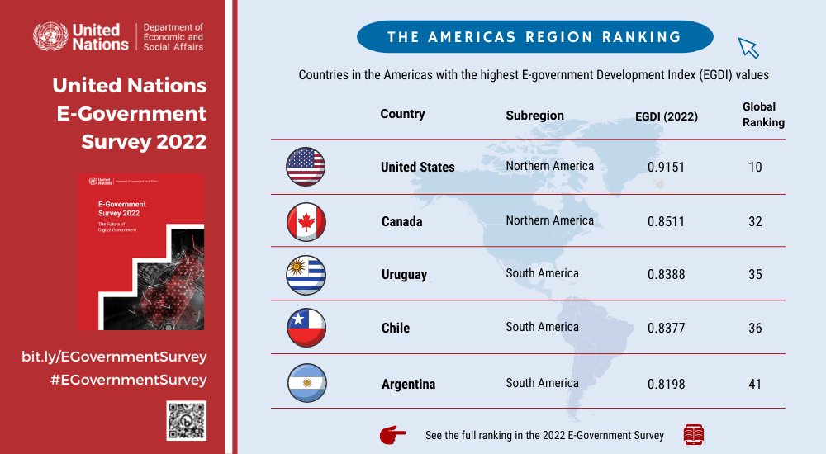

Slide 24
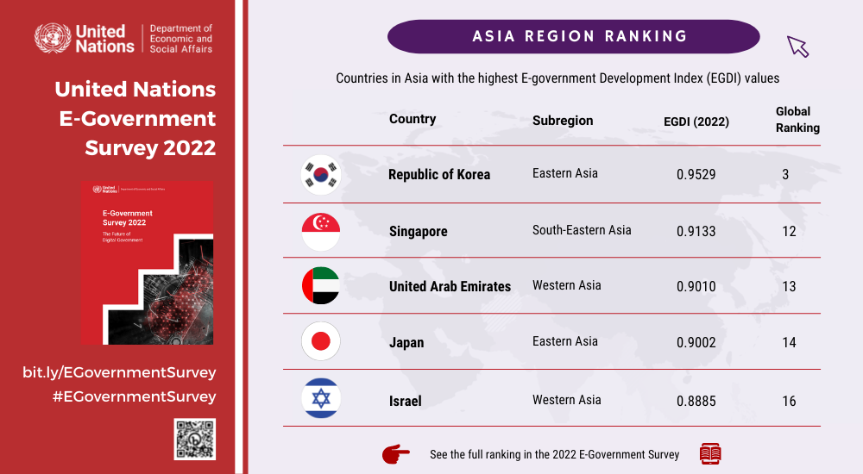

Slide 25
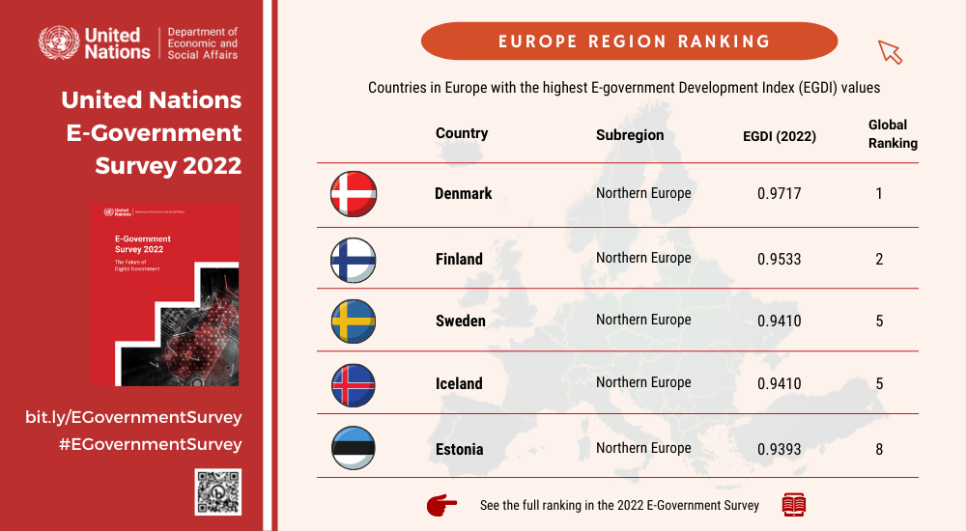

Slide 26
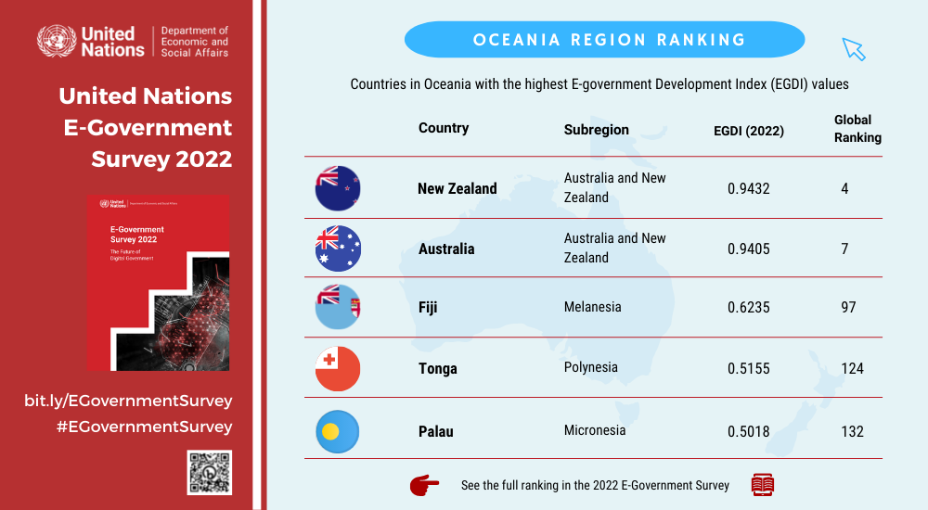

Slide 27
What potential career opportunities or roles do you see emerging in the field of digital transformation in government?

