Slide 1

Course Title: E/digital-government
Saide
Dept. Information Systems, UIN SUSKA Riau
https://saide-sank.blogspot.com

Slide 2
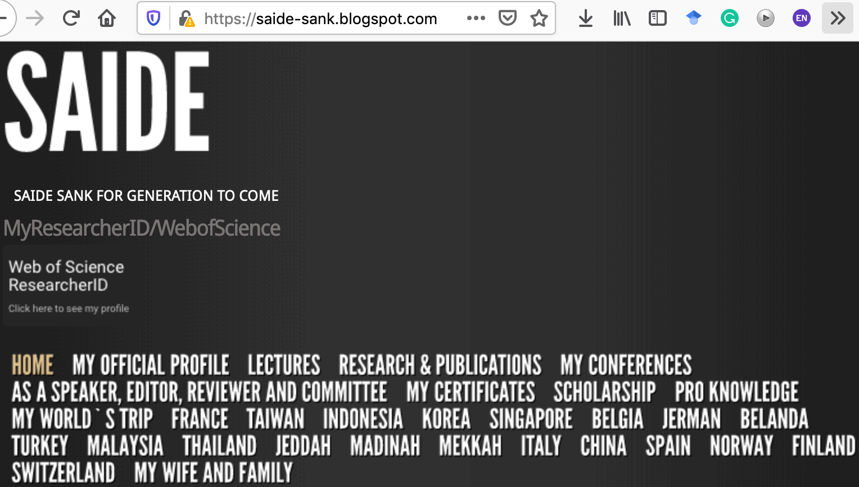
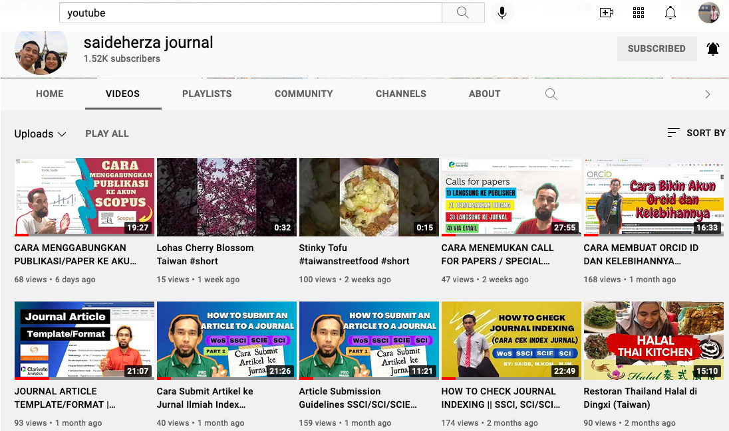
About me
Researcher ID/Publons: H-2399-2018
Website: https://saide-sank.blogspot.com
S.Kom di UIN Suska Riau (2009-2013)
M.Kom di ITS Surabaya (2014-2016)
M.I.M di NTUST Taiwan (2014-2016)
Ph.D. : Information Management, NTUST Taiwan (2018-2021)
Lecturer: Information System, UIN SUSKA Riau
Research: Knowledge Management, Information System, Business-IT alignment.
Chief Knowledge Officer:
Pro-Knowledge Research Group
Executive: Energy Research Centre (EnReach.or.id)

Slide 3
Agenda
Course Overview
Student Introductions (Students briefly introduce themselves)
Instructor Introduction (my background, qualifications, and contact information)
Grading and Attendance Policy, Participation Expectations, Assignment Submission Guidelines, Office Hours and Communication
Q&A

Slide 4
Role of The Game
Nilai Tambah:
Diskusi
Bertanya/Menjawab
On-time
Rapi
Respect
Penilaian (UAS, UTS, Mandiri, Terstruktur) mengacu ke Default sistem iRaise

Slide 5
Role of The Game
Jumlah SKS sebanyak 3 SKS (3 x 50 menit).
Setiap 1 sks, kita break 7-10 menit.
Jika saya terjadwal berhalangan hadir, saya akan kabarkan, jadi TIDAK PERLU BERTANYA MASUK / TIDAK.
Untuk tugas mandiri & kelompok (upload)
Tidak ada toleransi bagi mahasiswa yang ketahuan mencontek pada saat ujian, dan akan mendapatkan nilai E atau dianggap tidak lulus.

Slide 6




Role of The Game
Berpakaian standar UIN
Permission Letter if you have sick.
RESPECT

Slide 7





Slide 8
Course Outline

Slide 9
Week 1 - Introduction to Digital Government
Overview of the course and syllabus
Understanding the digital government landscape
Historical perspectives and trends

Slide 10
Week 2 - E-Government and Digital Transformation
Definition and evolution of e-government
Digital government maturity models
Case studies in digital transformation

Slide 11
Week 3 - Government Data and Open Government
Open data principles and policies
Benefits and challenges of open government data
Data-driven decision-making in government

Slide 12
Week 4 - Digital Service Delivery
Online service delivery models
User-centric design and usability
Government portals and online platforms

Slide 13

Week 5 - Digital Citizenship and Engagement
Citizen participation in the digital age
Social media and government communication
Digital inclusion and accessibility

Slide 14
Week 6 - Cybersecurity in Digital Government
Cyber threats and vulnerabilities
Government cybersecurity strategies
Case studies in cybersecurity incidents

Slide 15
Week 7 - Emerging Technologies in Government
Blockchain, AI, IoT, and their applications
Ethics and governance of emerging tech
Future trends in digital government

Slide 16
Week 8 - Midterm Exam

Slide 17
Week 9 - Digital Government Policies and Regulations
Legal and regulatory frameworks
Privacy and data protection
Digital government in international contexts

Slide 18
Week 10 - Case Studies in Digital Government
Analysis of digital government initiatives
Successes and failures
Best practices and lessons learned

Slide 19
Week 11 - Digital Government and Public Policy
Digital government's impact on policy development
Evidence-based policymaking
Policy challenges in the digital age

Slide 20
Week 12 - Government Analytics and Big Data
Big data analytics in government
Predictive modeling and decision support
Case studies in government analytics

Slide 21
Week 13 - Smart Cities and Urban Governance
The concept of smart cities
IoT and urban infrastructure
Case studies of smart city initiatives

Slide 22
Week 14 - Ethics, Accountability, and Transparency
Ethical considerations in digital government
Accountability mechanisms
Ensuring transparency in digital government

Slide 23
Week 15 - Future Directions and Capstone Projects
Students present capstone project proposals
Discussion of future developments in digital government

Slide 24

Week 15 - Future Directions and Capstone Projects
Week 16 - Final Exam

