Slide 1
Business Intelligence
Bab 9 Machine Learning
M. Afdal, ST., M.Kom
m.afdal@uin-suska.ac.id

Slide 2
01
02
03
Content
Machine Learning
Supervised Machine Learning
Unsupervised Machine Learning
Learning Outcome
Students are able to understand the role of machine learning in data processing

Slide 3
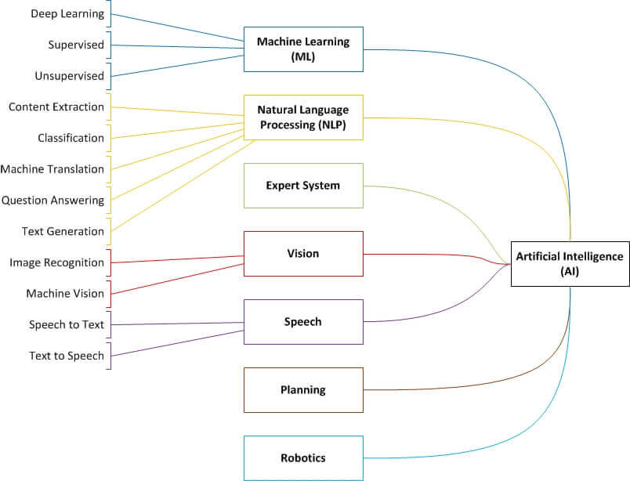

Slide 4
01
Machine Learning

Slide 5
Machine Learning
cabang kecerdasan buatan (AI) dan ilmu komputer yang berfokus pada penggunaan data dan algoritme untuk meniru cara manusia belajar, dan secara bertahap meningkatkan akurasinya.

Slide 6
Cara kerja Machine Learning:
Proses Keputusan -> prediksi atau klasifikasi
Fungsi Kesalahan -> mengevaluasi prediksi model
Proses Pengoptimalan Model -> mengevaluasi dan mengoptimalkan

Slide 7
Algoritme Machine Learning:
Neural networks
Linear regression
Logistic regression
Clustering
Decision trees
Random forests

Slide 8
Kasus penggunaan Machine Learning di dunia nyata :
Speech recognition
Customer service
Computer vision
Recommendation engines
Automated stock trading
Fraud detection

Slide 9
Metode Machine learning:
Supervised machine learning
Unsupervised machine learning
Semi-supervised learning

Slide 10
02
Supervised Machine Learning

Slide 11
Supervised Learning
Pendekatan machine learning ditentukan oleh penggunaan kumpulan data berlabel untuk melatih algoritme guna mengklasifikasikan data dan memprediksi hasil.

Slide 12
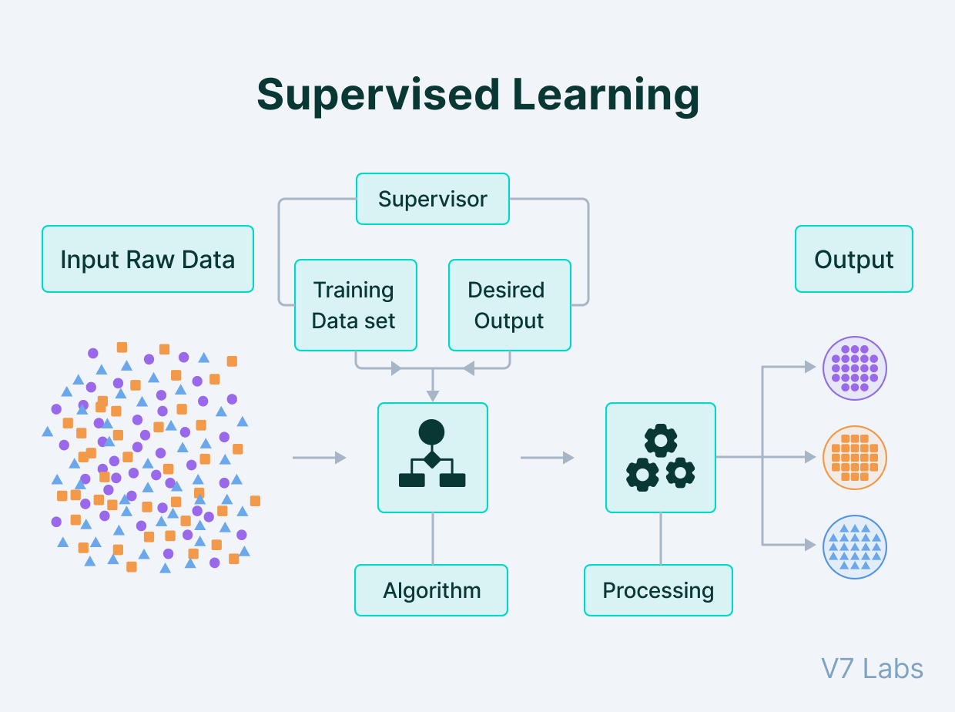
Machine learning methods :
Supervised machine learning
Unsupervised machine learning
Semi-supervised learning

Slide 13
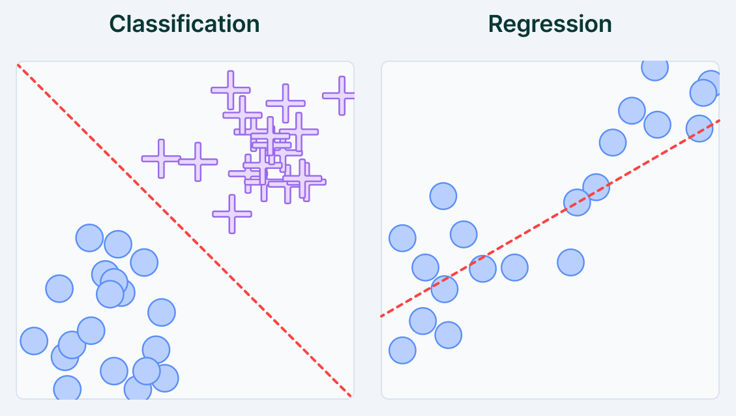
Metode
Supervised Machine learning :
Classification
Regression

Slide 14
Penerapan
Supervised Machine learning :
Predictive analytics (house prices, stock exchange prices, etc.)
Text recognition
Spam detection
Customer sentiment analysis
Object detection (e.g. face detection)

Slide 15
03
Unsupervised Machine Learning

Slide 16
Unsupervised Learning
jenis machine learning yang algoritmanya dilengkapi dengan data yang tidak mengandung label atau instruksi eksplisit apa pun tentang apa yang harus dilakukan dengannya. Tujuannya adalah agar algoritma pembelajaran menemukan struktur dalam data masukannya sendiri.

Slide 17
Metode
Unsupervised Machine learning :
Clustering
Association
Dimensionality reduction

Slide 18
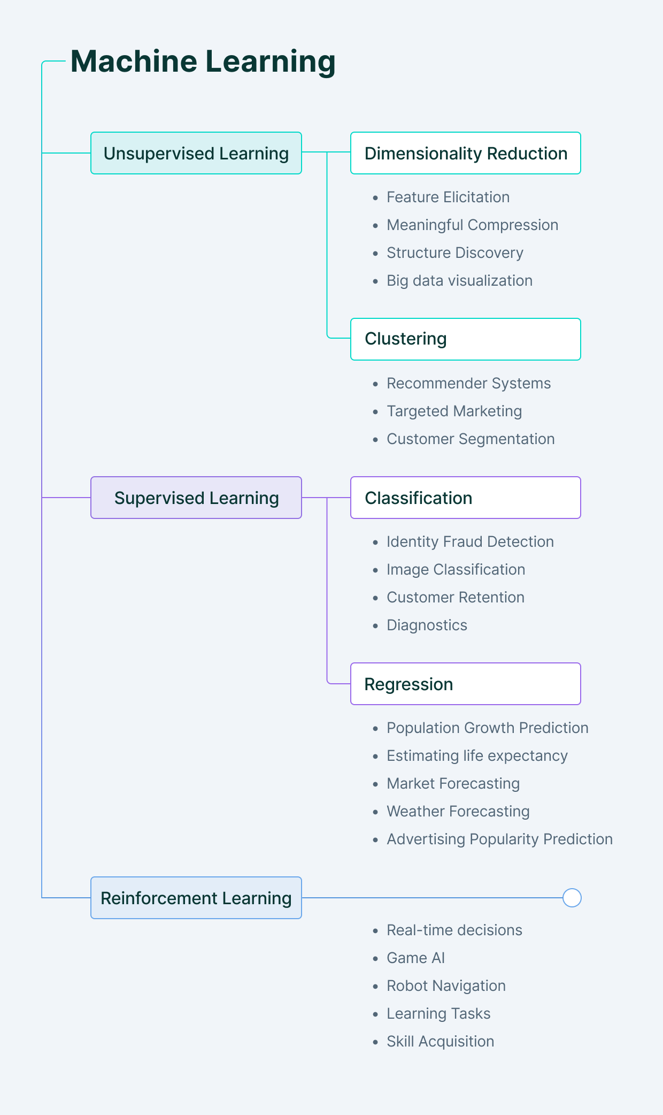
Machine learning methods :
Supervised machine learning
Unsupervised machine learning
Semi-supervised learning

Slide 19
Supervised Learning vs. Unsupervised Learning:
Kunci Perbedaan
Supervised Learning memerlukan data pelatihan yang diberi label, sedangkan Unsupervised Learning bergantung pada data mentah yang tidak diberi label.

Slide 20
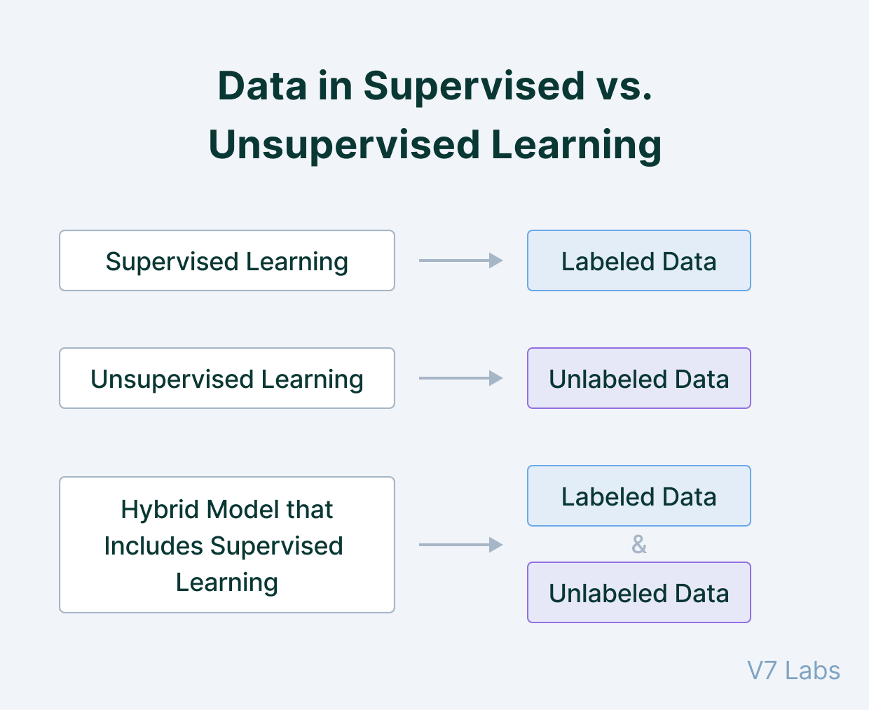
Machine learning methods :
Supervised machine learning
Unsupervised machine learning
Semi-supervised learning

Slide 21
References
https://www.ibm.com/topics/machine-learning
https://www.v7labs.com/blog/supervised-vs-unsupervised-learning

