Slide 1
Pola-pola Perancangan

Slide 2
Pola-pola Perancangan
Pola perancangan adalah cara untuk menggunakan kembali pengetahuan tentang suatu masalah dan solusinya.
Pola adalah deskripsi masalah dan intisari solusinya.
Pola harus cukup abstrak untuk dapat digunakan kembali pada keadaan yang berbeda.
Deskripsi pola biasanya menggunakan karakteristik berorientasi obyek seperti pewarisan (inheritance) dan polimorfisme.

Slide 3
Elemen Pola
Nama
Pengenal pola yang berarti
Deskripsi masalah
Deskripsi solusi
Bukan rancangan konkrit tapi berupa template solusi yang dapat digunakan secara berbeda.
Konsekuensi
Hasil dan tambahan setelah mengaplikasikan pola tersebut

Slide 4
Pola Observer
Nama
Observer.
Deskripsi
Memisahkan tampilan obyek dari obyek itu sendiri.
Deskripsi masalah
Digunakan ketika banyak tampilan dibutuhkan.
Deskripsi solusi
Ada dalam slide deskripsi UML.
Konsekuensi
Optimasi hasil tampilan mungkin tidak praktis.

Slide 5
Pola Observer (1)
Pattern name | Observer
Description | Separates the display of the state of an object from the object itself and allows alternative displays to be provided. When the object state changes, all displays are automatically notified and updated to reflect the change.
Problem description | In many situations, you have to provide multiple displays of state information, such as a graphical display and a tabular display. Not all of these may be known when the information is specified. All alternative presentations should support interaction and, when the state is changed, all displays must be updated. This pattern may be used in all situations where more than one display format for state information is required and where it is not necessary for the object that maintains the state information to know about the specific display formats used.

Slide 6
Pola Observer (2)
Pattern name | Observer
Solution description | This involves two abstract objects, Subject and Observer, and two concrete objects, ConcreteSubject and ConcreteObject, which inherit the attributes of the related abstract objects. The abstract objects include general operations that are applicable in all situations. The state to be displayed is maintained in ConcreteSubject, which inherits operations from Subject allowing it to add and remove Observers (each observer corresponds to a display) and to issue a notification when the state has changed. The ConcreteObserver maintains a copy of the state of ConcreteSubject and implements the Update() interface of Observer that allows these copies to be kept in step. The ConcreteObserver automatically displays the state and reflects changes whenever the state is updated.
Consequences | The subject only knows the abstract Observer and does not know details of the concrete class. Therefore there is minimal coupling between these objects. Because of this lack of knowledge, optimizations that enhance display performance are impractical. Changes to the subject may cause a set of linked updates to observers to be generated, some of which may not be necessary.

Slide 7
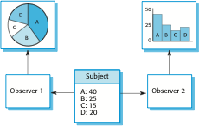
Banyak tampilan dengan pola Observer

Slide 8
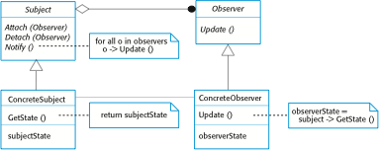
Model UML untuk pola Observer

Slide 9
Referensi
Sommerville, I., Software Engineering 8th edition, Addison-Wesley, 2007

